Slide 1
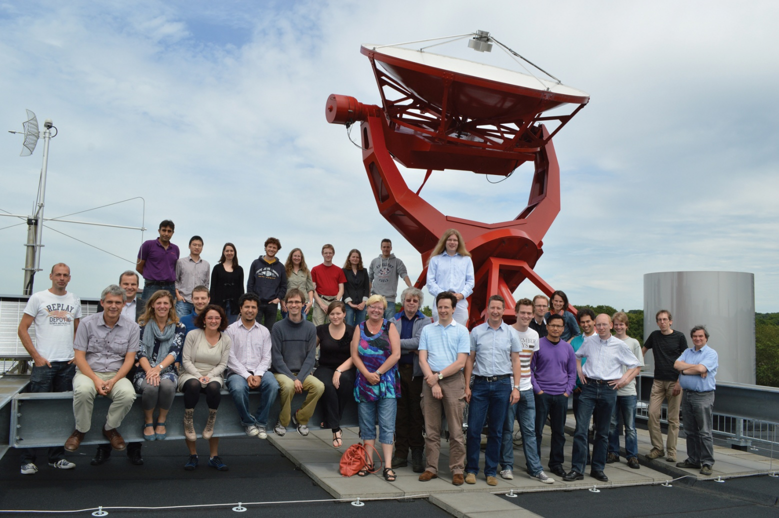
Department of Astrophysics

Slide 2
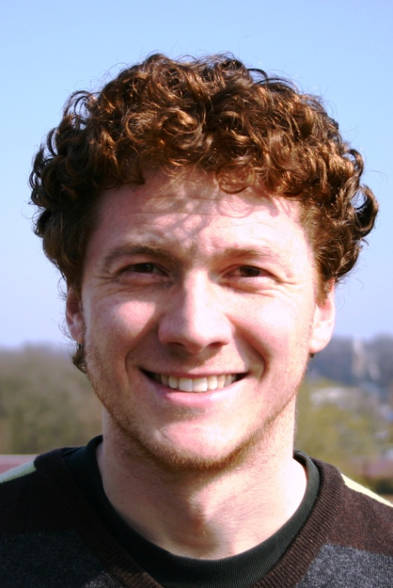
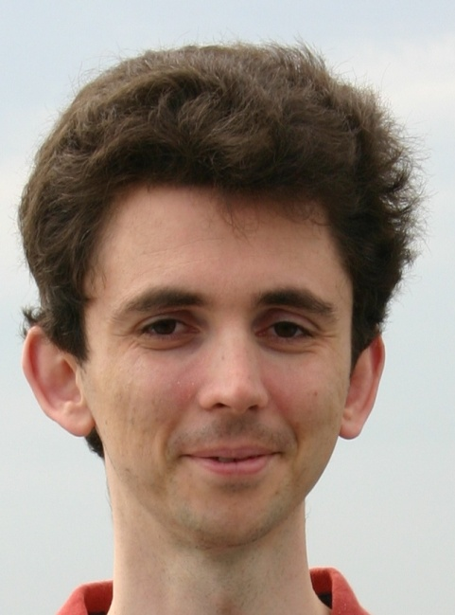
Department of Astrophysics
Employees
Carlo Abate MSc.
PhD Student

Slide 3
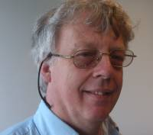
Department of Astrophysics
Employees
Prof. dr. Bram Achterberg
Professor

Slide 4
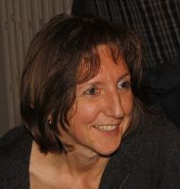
Department of Astrophysics
Employees
Prof.dr. Conny Aerts
Professor

Slide 5
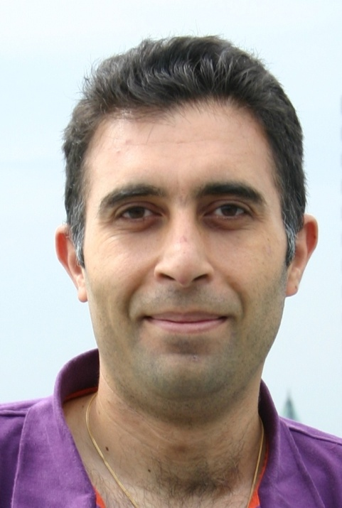
Department of Astrophysics
Employees
Dr. Amin Aminaei
Postdoc / Technical Engineer

Slide 6
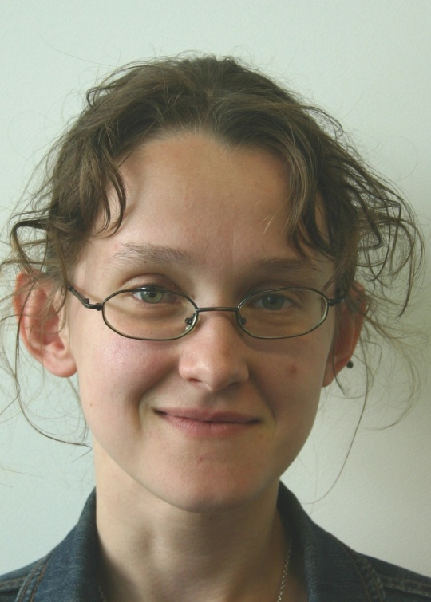
Department of Astrophysics
Employees
Dr. Anya Bilous
Postdoc

Slide 7
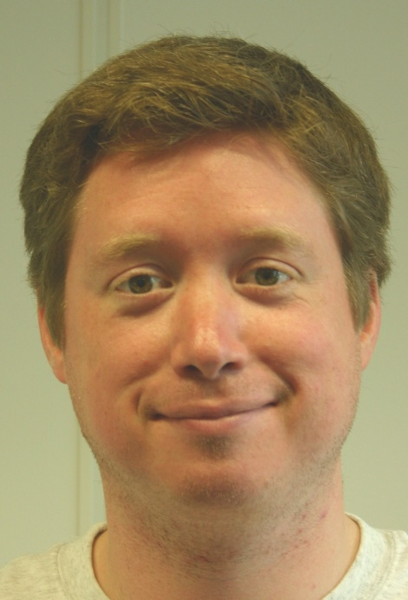
Department of Astrophysics
Employees
Christiaan Brinkerink MSc.
PhD Student

Slide 8
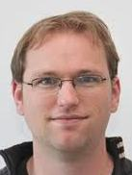
Department of Astrophysics
Employees
Dr. Stijn Buitink
Postdoc

Slide 9
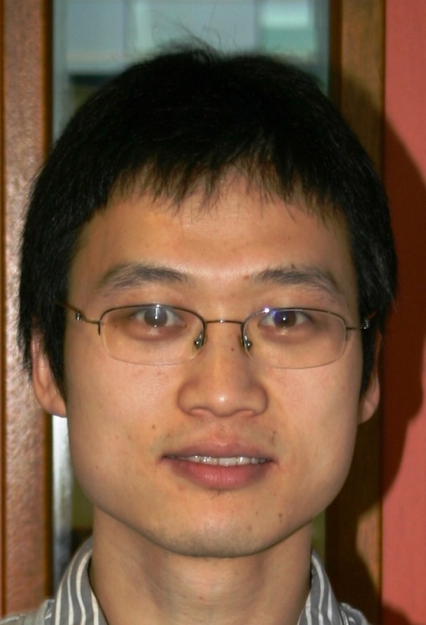
Department of Astrophysics
Employees
Linjie Chen MSc.
PhD Student

Slide 10
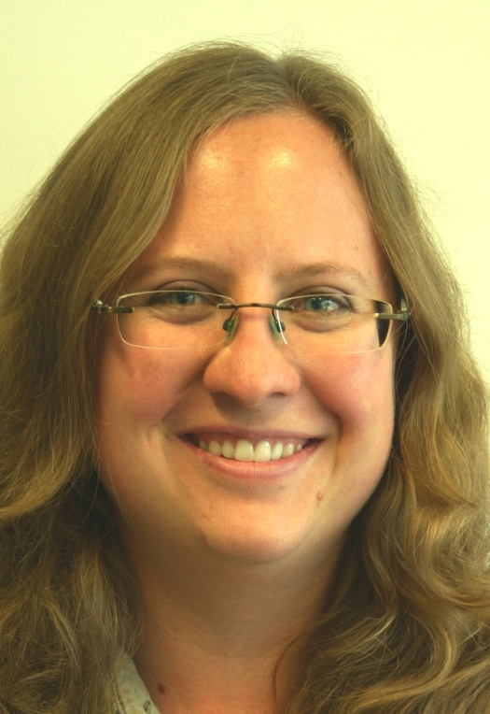
Department of Astrophysics
Employees
Deanne Coppejans MSc.
PhD Student

Slide 11
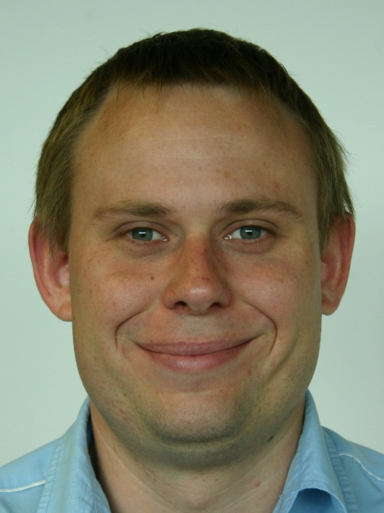
Department of Astrophysics
Employees
Rocco Coppejans MSc.
PhD Student

Slide 12
Department of Astrophysics
Employees
Arthur Corstanje MSc.
PhD Student

Slide 13
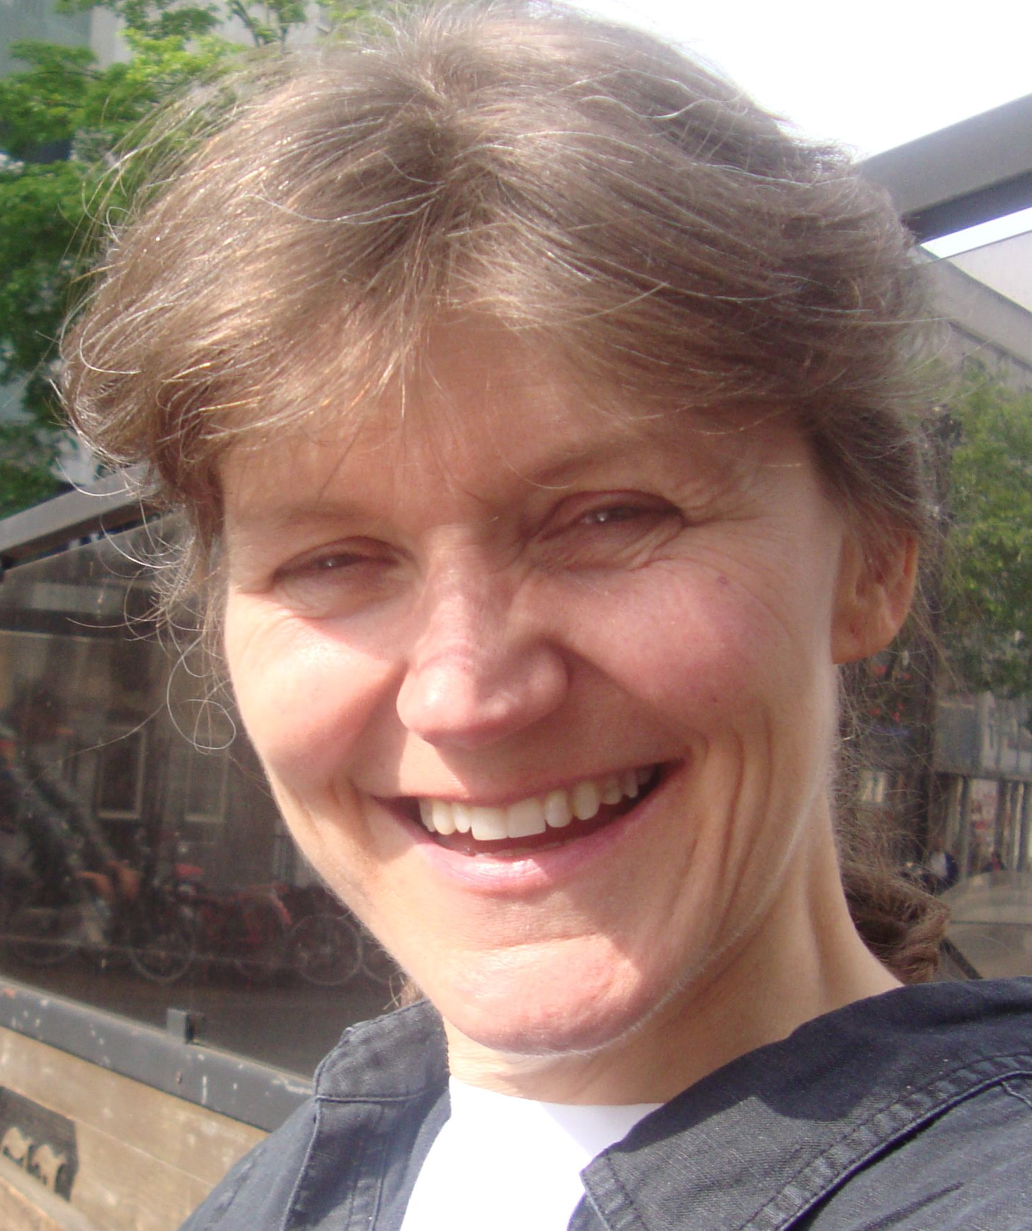
Department of Astrophysics
Employees
Cisca Custers
Secretary

Slide 14
Department of Astrophysics
Employees
Dr. David Cseh
Postdoc

Slide 15
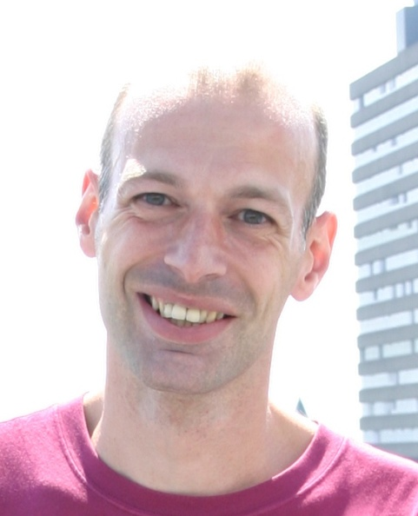
Department of Astrophysics
Employees
Ing. Peter Dolron
Technician

Slide 16
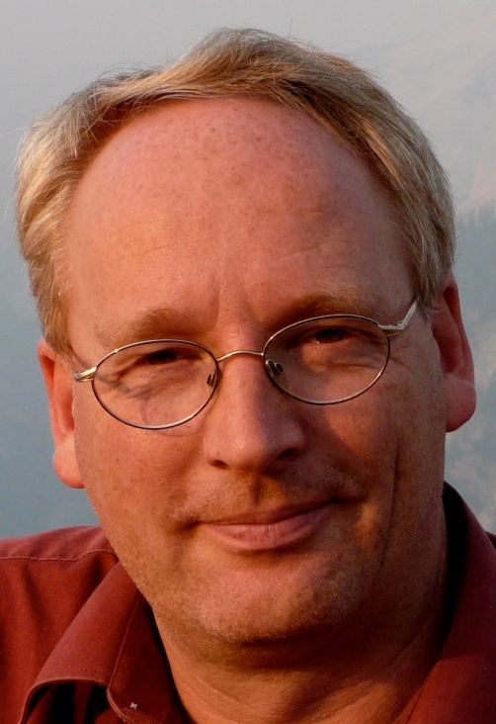
Department of Astrophysics
Employees
Prof. dr. Carsten Dominik
Adjunct Professor

Slide 17
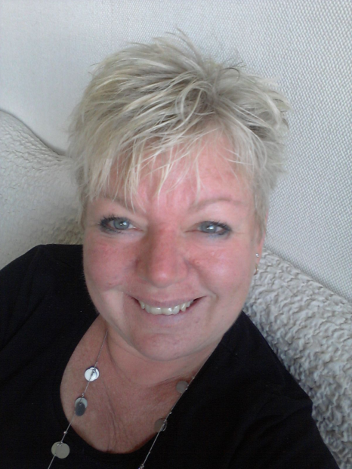
Department of Astrophysics
Employees
Marja van Duijvenvoorde
secretary

Slide 18
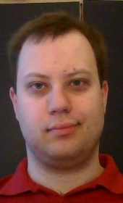
Department of Astrophysics
Employees
Cameron van Eck MSc.
PhD Student

Slide 19
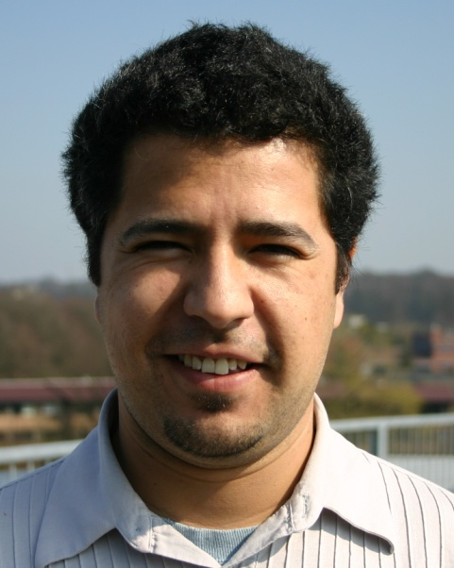
Department of Astrophysics
Employees
Emilio Enriquez MSc.
PhD Student

Slide 20
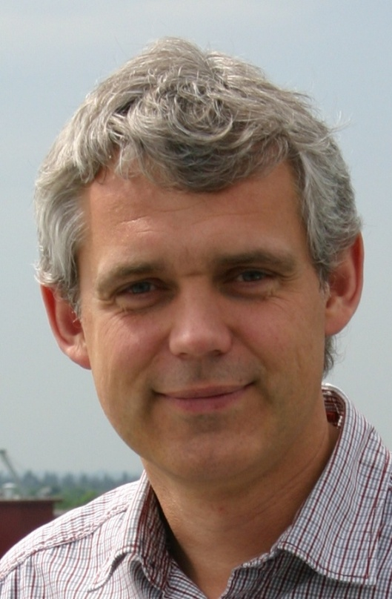
Department of Astrophysics
Employees
Prof. dr. Heino Falcke
Professor of radio astronomy and
astroparticle physics
Notes:
Falcke

Slide 21
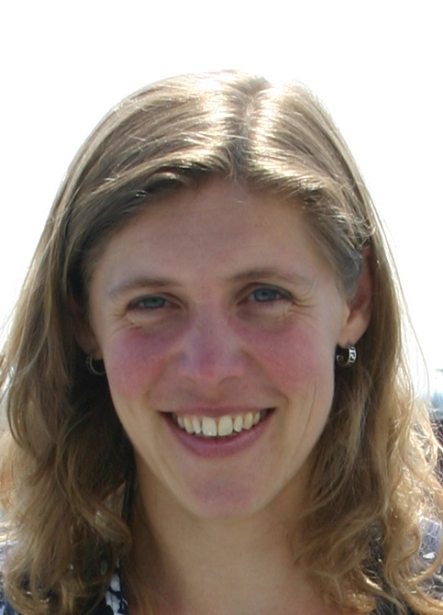
Department of Astrophysics
Employees
Esther Gebhardt
secretary

Slide 22
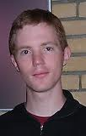
Department of Astrophysics
Employees
Dr. Evert Glebbeek
Postdoc

Slide 23
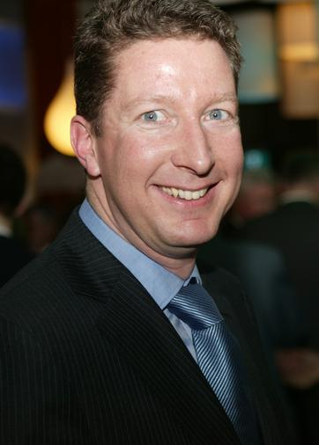
Department of Astrophysics
Employees
Prof. dr. Paul Groot
Head of Department
Notes:
Groot

Slide 24
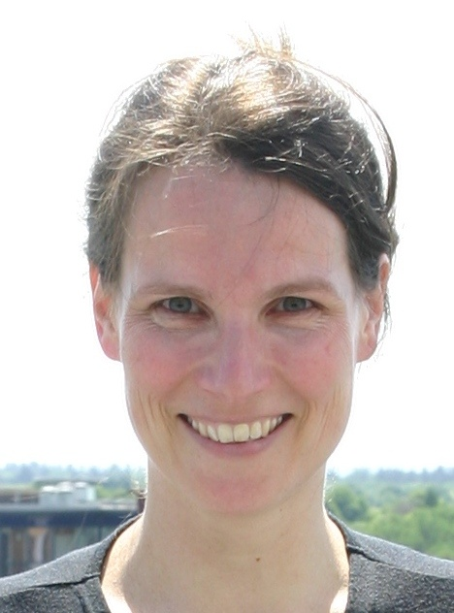
Department of Astrophysics
Employees
Dr. Marijke Haverkorn
Assistant Professor
Notes:
Haverkorn

Slide 25
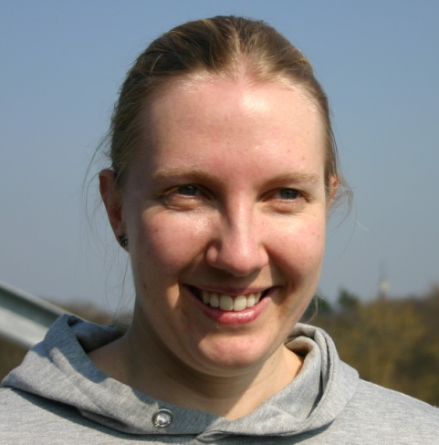
Department of Astrophysics
Employees
Marianne Heida MSc.
PhD Student

Slide 26
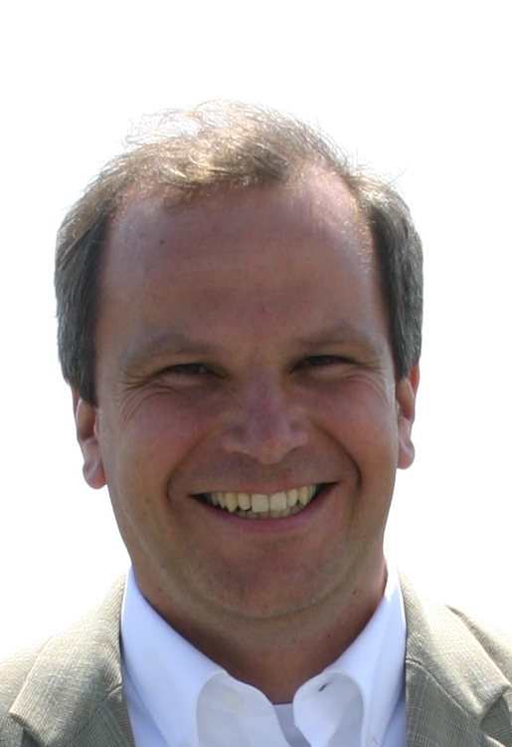
Department of Astrophysics
Employees
Dr. Jörg R. Hörandel
Assistant Professor
Notes:
Hörandel

Slide 27
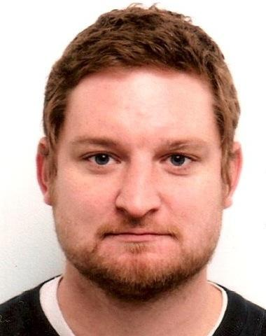
Department of Astrophysics
Employees
Dr. David Jones
Postdoc

Slide 28
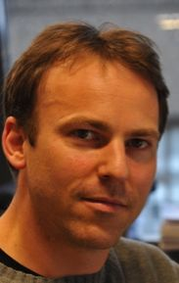
Department of Astrophysics
Employees
Dr. Peter Jonker
Assistant Professor

Slide 29
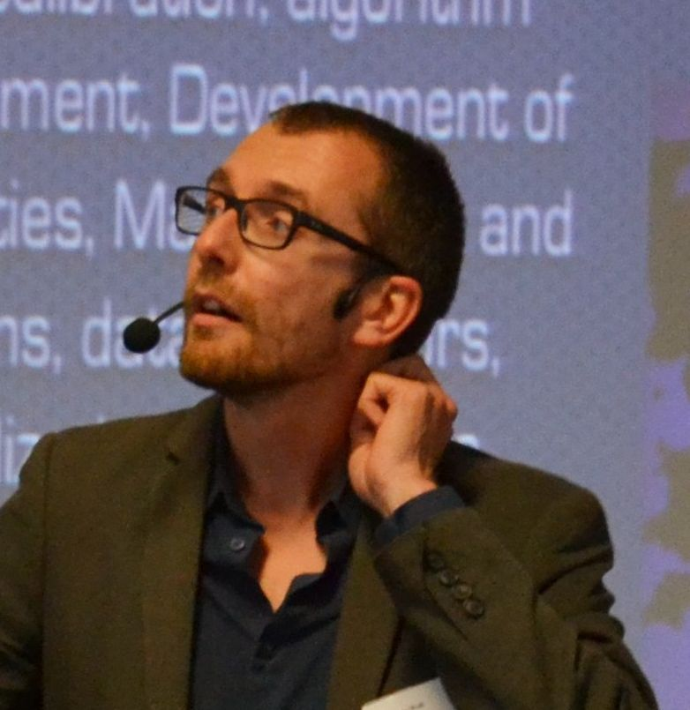
Department of Astrophysics
Employees
Dr. Marc Klein Wolt
Assistant Professor
Scientific Program Manager

Slide 30
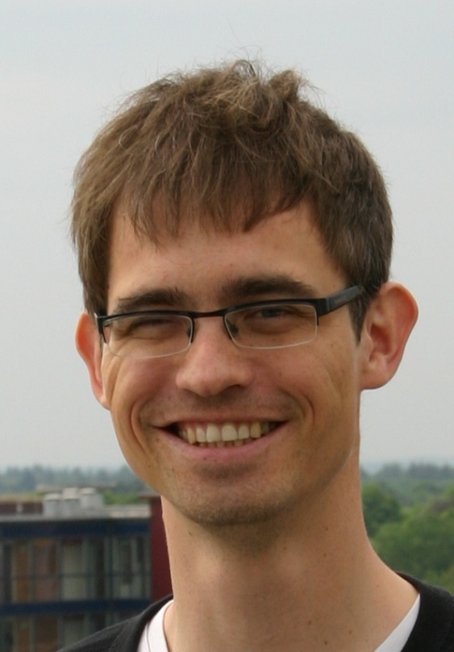
Department of Astrophysics
Employees
Dr. Elmar Körding
Assistant Professor
Notes:
Körding

Slide 31
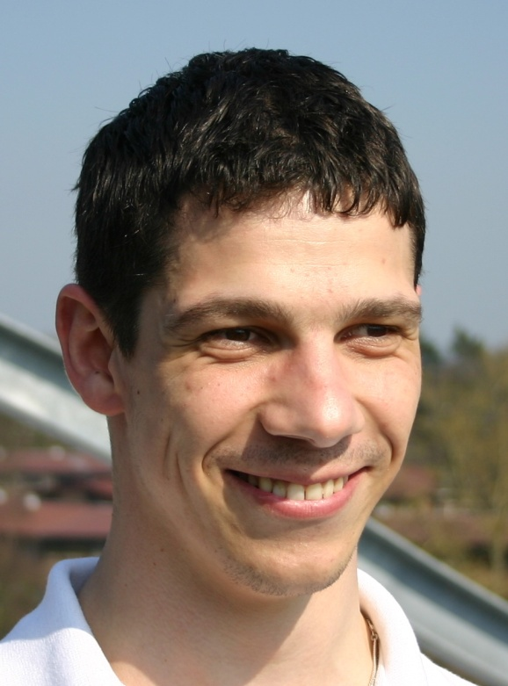
Department of Astrophysics
Employees
Thomas Kupfer MSc.
PhD Student

Slide 32
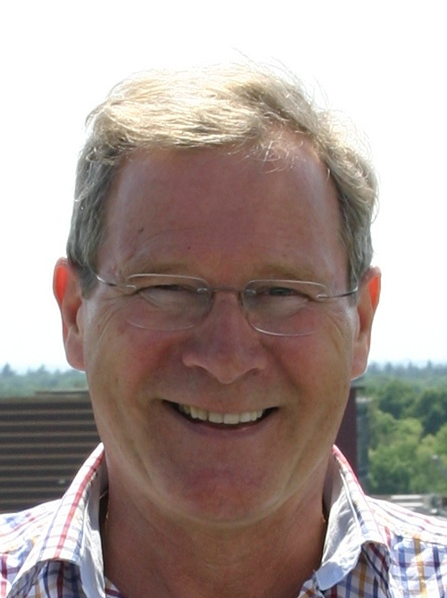
Department of Astrophysics
Employees
Prof. dr. Jan Kuijpers
Emeritus Professor

Slide 33
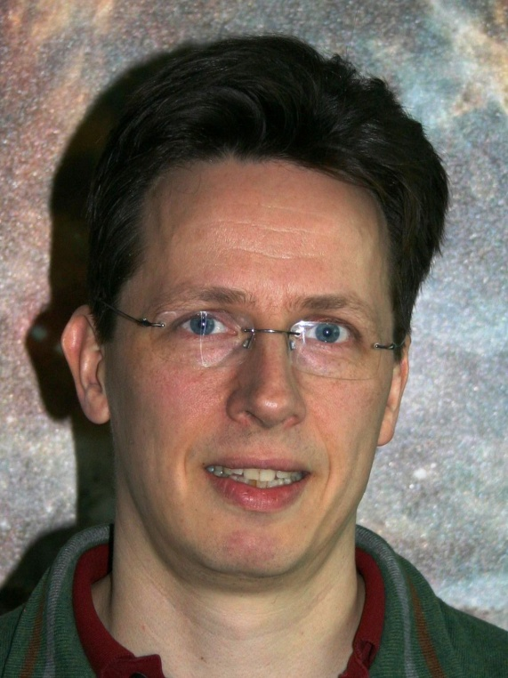
Department of Astrophysics
Employees
Dr. Søren Larsen
Assistant Professor

Slide 34
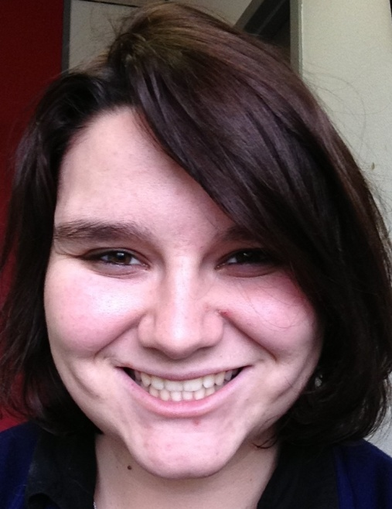
Department of Astrophysics
Employees
Sally MacFarlane MSc.
PhD Student

Slide 35
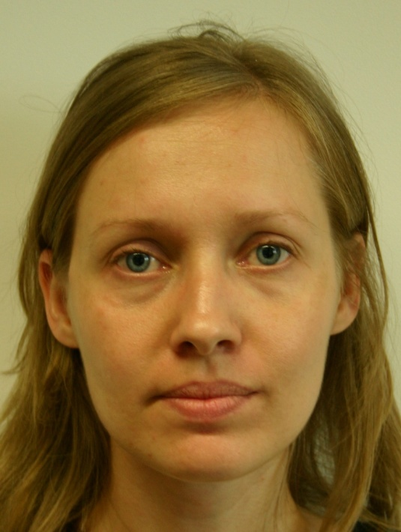
Department of Astrophysics
Employees
Dr. Monika Moscibrodzka
Postdoc

Slide 36
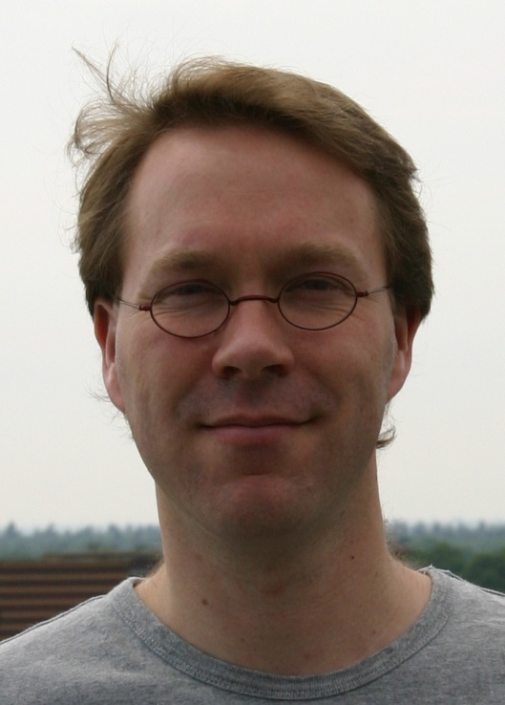
Department of Astrophysics
Employees
Prof. dr. Gijs Nelemans
Associate Professor
Notes:
Nelemans

Slide 37
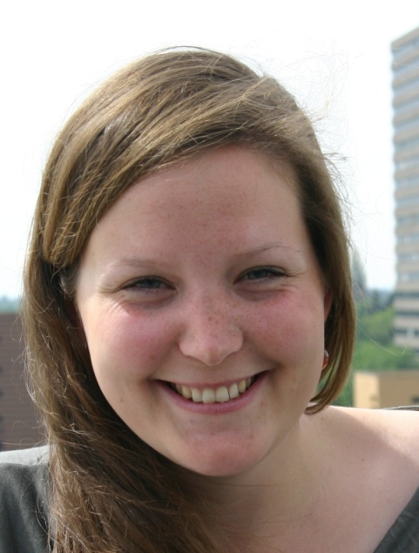
Department of Astrophysics
Employees
Anna Nelles MSc.
PhD Student

Slide 38
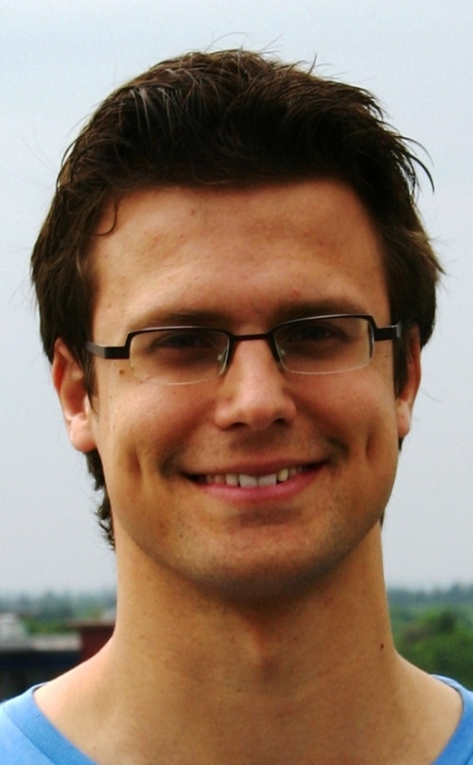
Department of Astrophysics
Employees
Pim van Oirschot MSc.
PhD Student

Slide 39
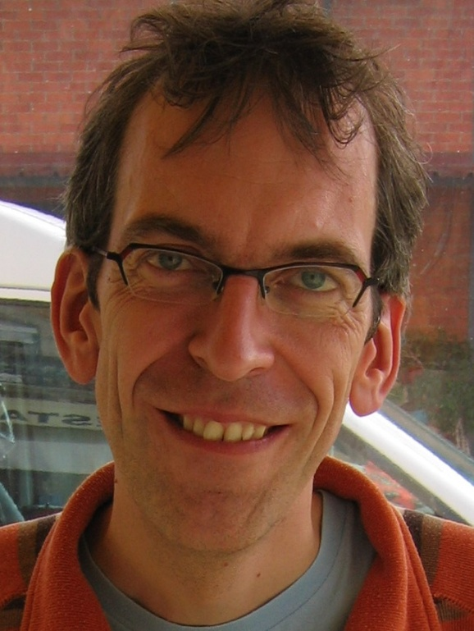
Department of Astrophysics
Employees
Dr. Onno Pols
Assistant Professor

Slide 40
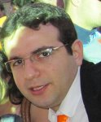
Department of Astrophysics
Employees
Dr. Hamid Pourshaghaghi
Postdoc

Slide 41
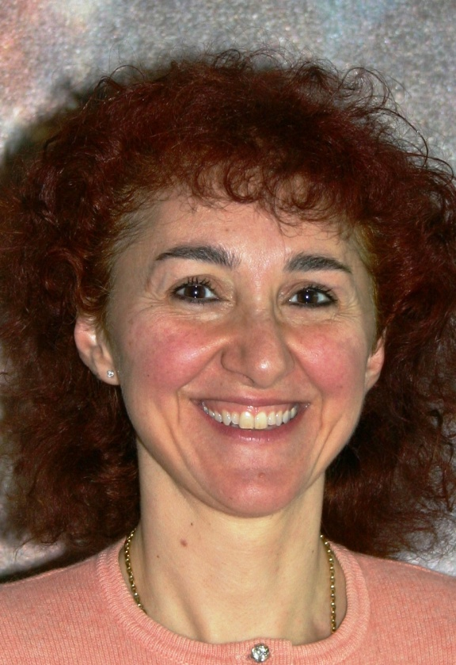
Department of Astrophysics
Employees
Dr. Vanna Pugliese
Postdoc

Slide 42
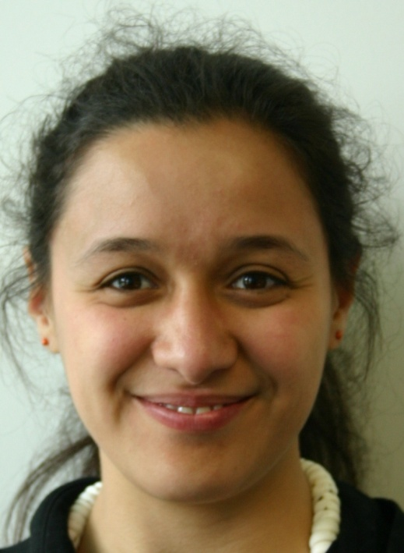
Department of Astrophysics
Employees
Tjibaria Pijloo MSc.
PhD Student

Slide 43
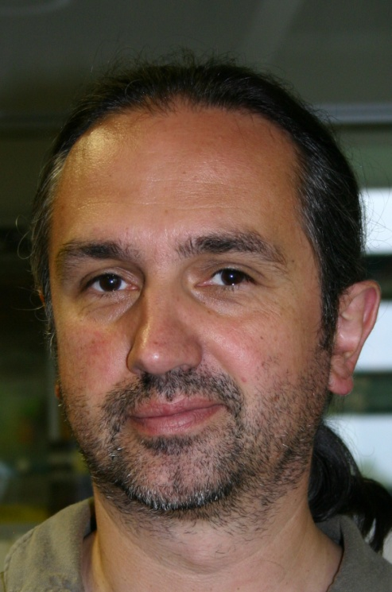
Department of Astrophysics
Employees
Dr. Jörg Rachen
Scientist

Slide 44
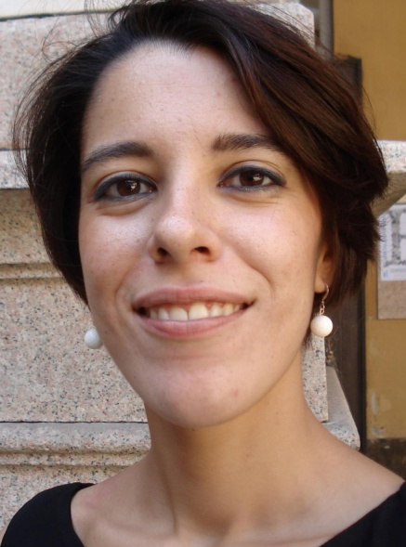
Department of Astrophysics
Employees
Serena Repetto MSc.
PhD Student

Slide 45
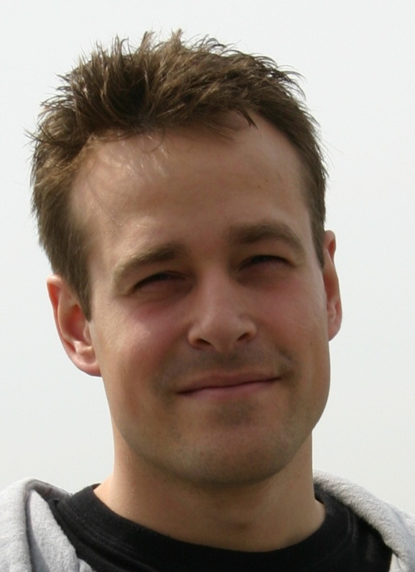
Department of Astrophysics
Employees
Pim Schellart MSc.
PhD Student

Slide 46
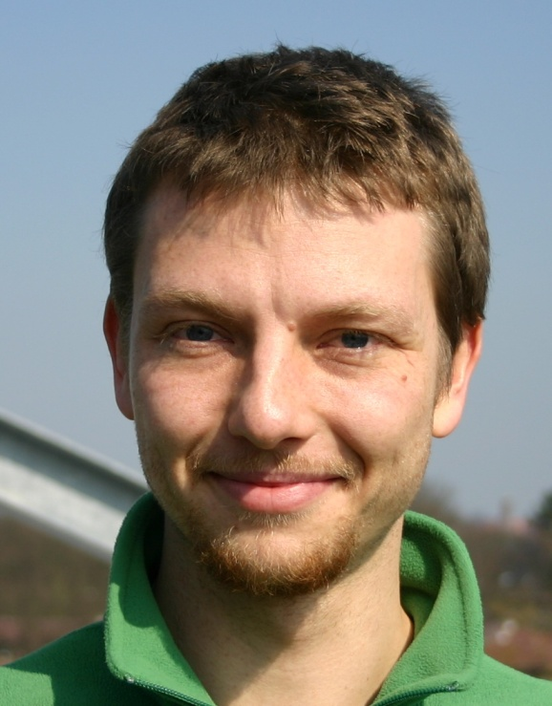
Department of Astrophysics
Employees
Johannes Schulz MSc.
PhD Student

Slide 47
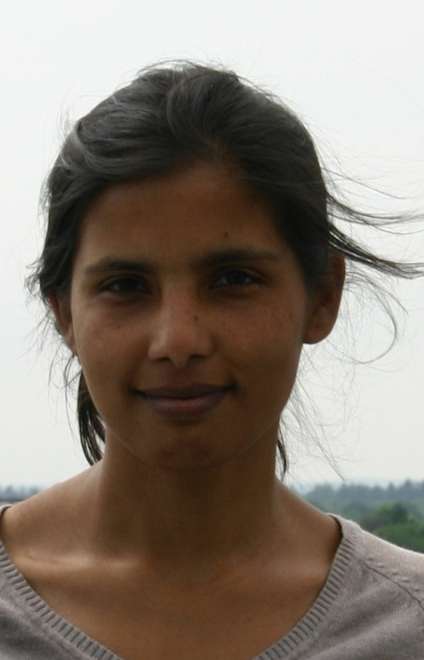
Department of Astrophysics
Employees
Sweta Shah MSc.
PhD Student

Slide 48
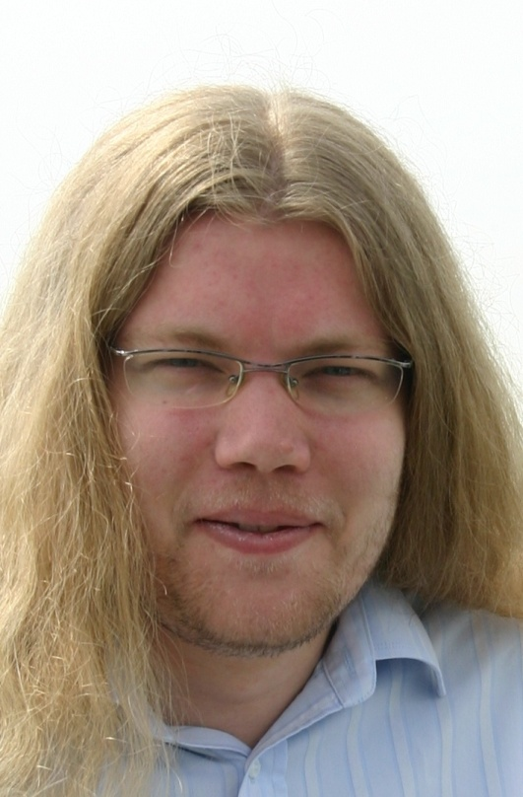
Department of Astrophysics
Employees
Sander Ter Veen MSc.
PhD Student

Slide 49
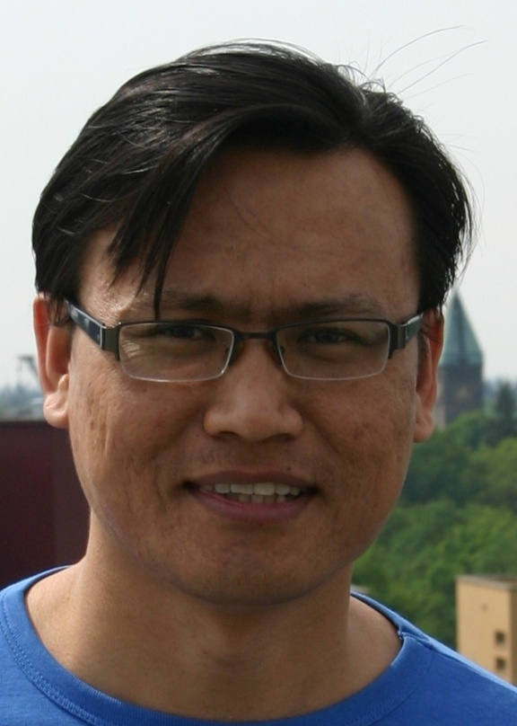
Department of Astrophysics
Employees
Dr. Satyendra Thoudam
Postdoc

Slide 50
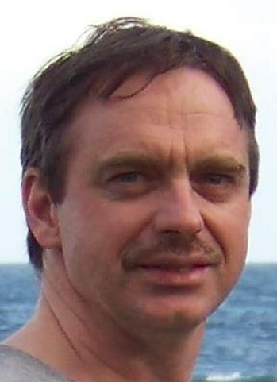
Department of Astrophysics
Employees
Dr. Remo Tilanus
Program Manager mmVLBI and Event Horizon Telescope

Slide 51
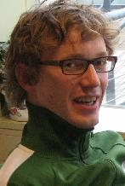
Department of Astrophysics
Employees
Sjoert van Velzen MSc.
PhD Student

Slide 52
Department of Astrophysics
Employees
Prof. dr. Frank Verbunt
Professor

Slide 53
Department of Astrophysics
Employees
Sander Walg MSc.
PhD Student

Slide 54
Department of Astrophysics
Employees
Thomas Wijnen MSc.
PhD Student

Slide 55
Department of Astrophysics
Employees
Payaswini Saikia MSc.
PhD Student

Slide 56
Department of Astrophysics
Employees
Sarka Wykes MSc.
PhD Student

Slide 57
Department of Astrophysics
Employees
Dr. Steven Bloemen
PostDoc

Slide 58
Department of Astrophysics
Employees
Dr. Shaon Ghosh
PostDoc

Slide 59
Department of Astrophysics
Employees
Raquel Fraga-Encinas MSc.
PhD Student

Slide 60
Department of Astrophysics
Employees
Jan van Roestel MSc.
PhD Student

Slide 61
Department of Astrophysics
Employees
Roque Ruiz Carmona MSc.
PhD Student

Slide 62
Department of Astrophysics
Employees
Andrei Igoshev MSc.
PhD Student

Slide 63
Department of Astrophysics
Employees
Thomas Wevers MSc.
PhD Student

Slide 64
Department of Astrophysics
Employees
Ester Aranzana MSc.
PhD Student

Slide 65
Department of Astrophysics
Employees
Dr. Antonio Bonardi
Postdoc

Slide 66
Department of Astrophysics
Calender
Opening hours secretariat August 4 – August 15 Monday – Wednesday + Friday: 08.30 hrs – 17.00 hrs Thursday 08.30 – 12.30 hrs Cisca is on holiday from July 14 until August 8 Esther is on holiday from July 28 until August 15 Marja is on holiday from August 21 until September 19

