Slide 1


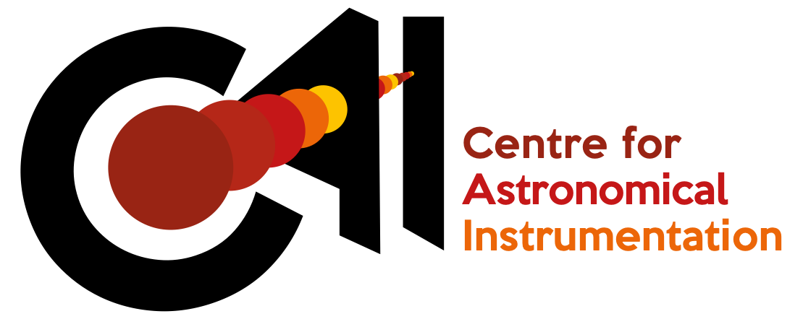
Toward a Lunar far-side radio observatory
Science goals, ESA CDF study results, and the ALO TT
ngSVLBI workshop, ASTRON/JIVE, 17-19 Oct 2022
With: Marc Klein Wolt (RRL), James Carpenter (ESA), Leonid Gurvits (JIVE), Leon Koopmans (RUG), Jan Tauber (ESA), Jessica Grenouilleau (ESA), Borja García Gutiérrez (ESA), Albert-Jan Boonstra (ASTRON) and the ALO Topical Team
Christiaan Brinkerink (Radboud Radio Lab)

Slide 2
The European Large Logistics Lander
EL3 aim is to develop an independent way to deliver payloads to the Lunar surface. Decision to pursue development will be made at the ministerial meeting, Nov 2022
Currently, various use case for the platform are being developed: e.g., in-situ resource utilisation, infrastructure development, radio astronomy
The topical team on radio astronomy is studying how we can make use of the Lunar far side for this discipline

Slide 3
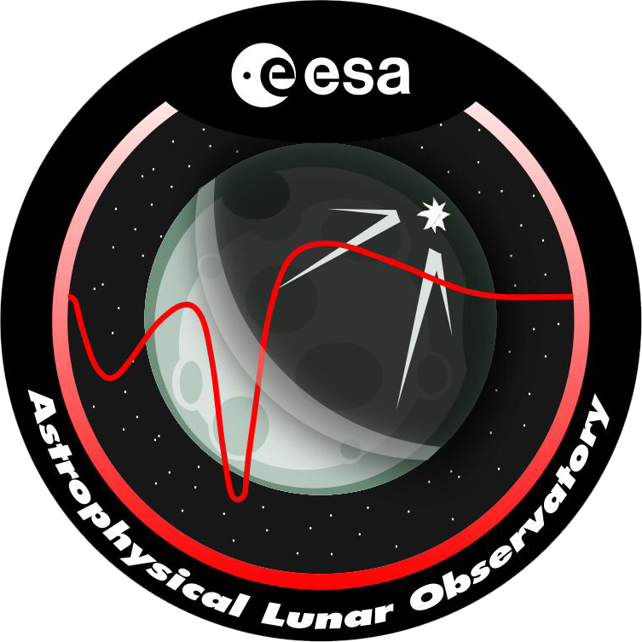
What is ALO?
Astrophysical Lunar Observatory: a many-element low-frequency radio interferometer on the Lunar far side, to be delivered by EL3
Currently being defined in more detail by the ALO Topical Team, consisting of ~65 scientists and engineers from various research institutes and commercial partners, with ESA as client
Precursor instrument (PRE-DEX) has finished concept design study

Slide 4
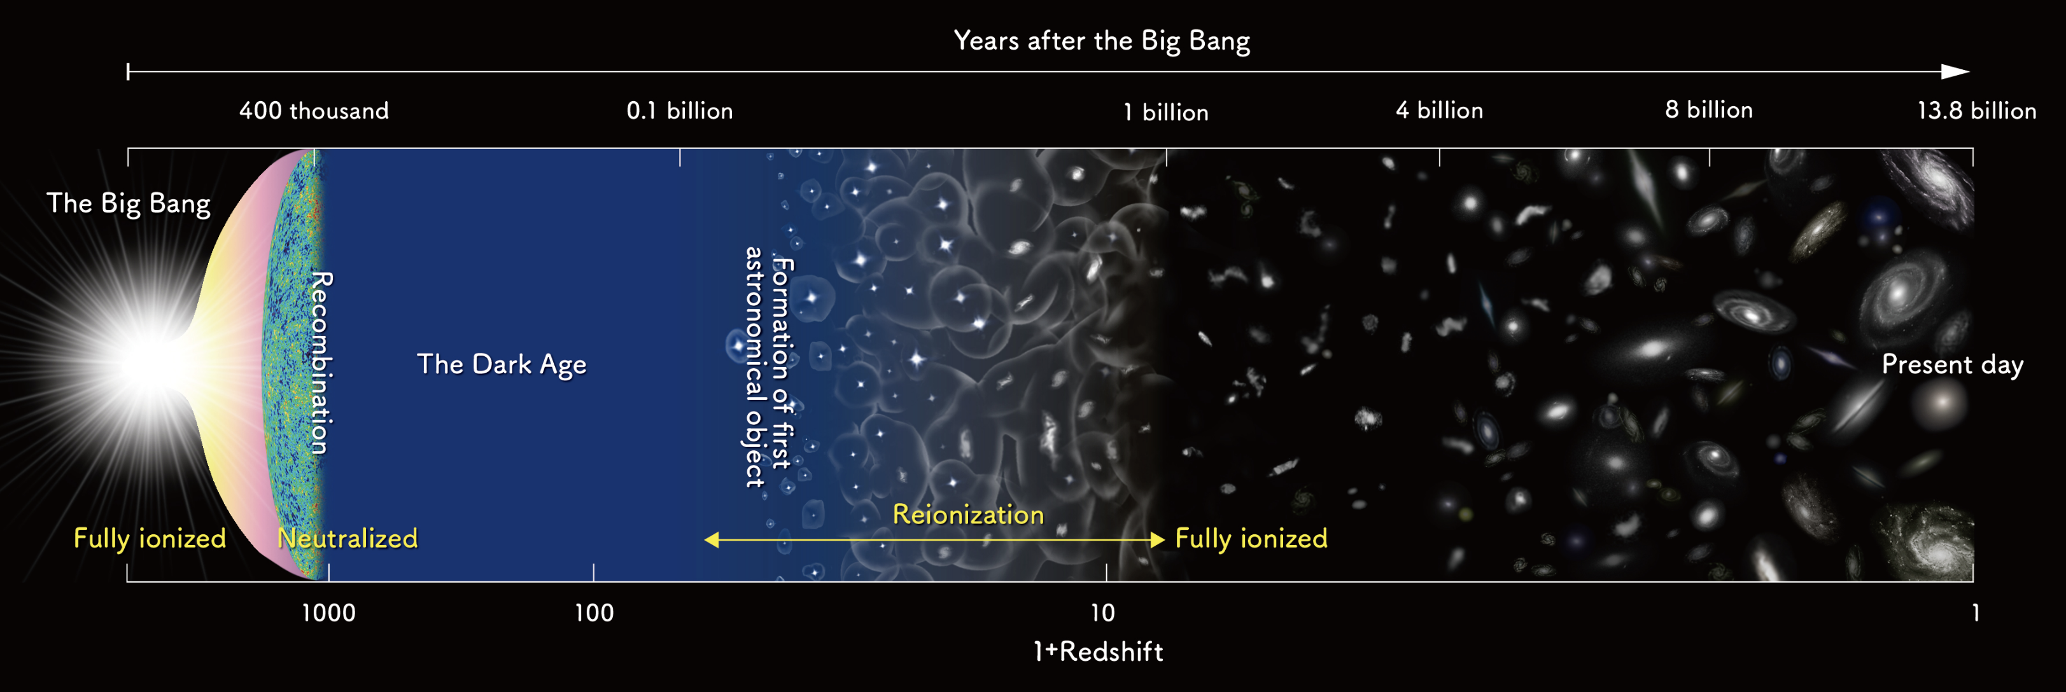
ALO Science Goals I
z=200 to z=30:
Dark Ages
z=30 to z=6:
Cosmic Dawn

Slide 5
ALO Science Goals II
Top science goal for ALO: neutral hydrogen cosmology in the redshift range from ~200 to ~16 (Dark Ages and initial phase of Cosmic Dawn)
Capture global signal as well as power spectrum at different redshift slices
Loeb 2006

Slide 6
Existing experiments in neutral hydrogen cosmology
PAPER, HERA, EDGES, SARAS2, MWA, GMRT, LOFAR, LWA, …
Earth’s ionosphere significantly affects observed structure below ~50 MHz, and completely blocks frequencies below ~20 MHz
Anthropogenic RFI is an issue for all Earth-based experiments
Radio-quiet, stable location without ionospheric influence needed: the far side of the Moon
MWA
LOFAR

Slide 7
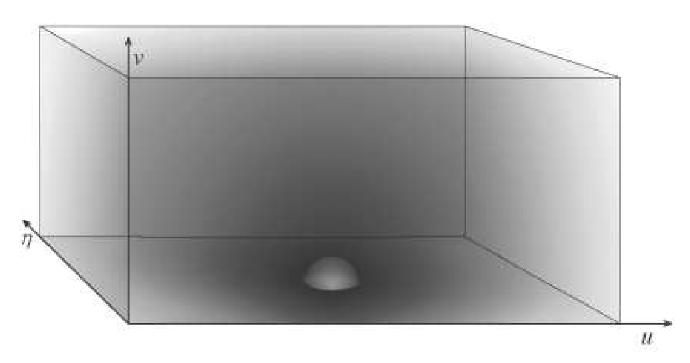
Power Spectrum Measurement
Measurement of spatial power spectrum involves measurement of Fourier modes of hydrogen emission in 3 dimensions: 1 spectral (‘depth’), 2 spatial (directions on the sky).
Spectral
Detectability of neutral hydrogen density fluctuations drops RAPIDLY with increasing redshift: important to maximise sensitivity at particular angular scales on the sky.
𝛈
Spatial
v
u
Spatial
Morales & Hewitt 2004

Slide 8
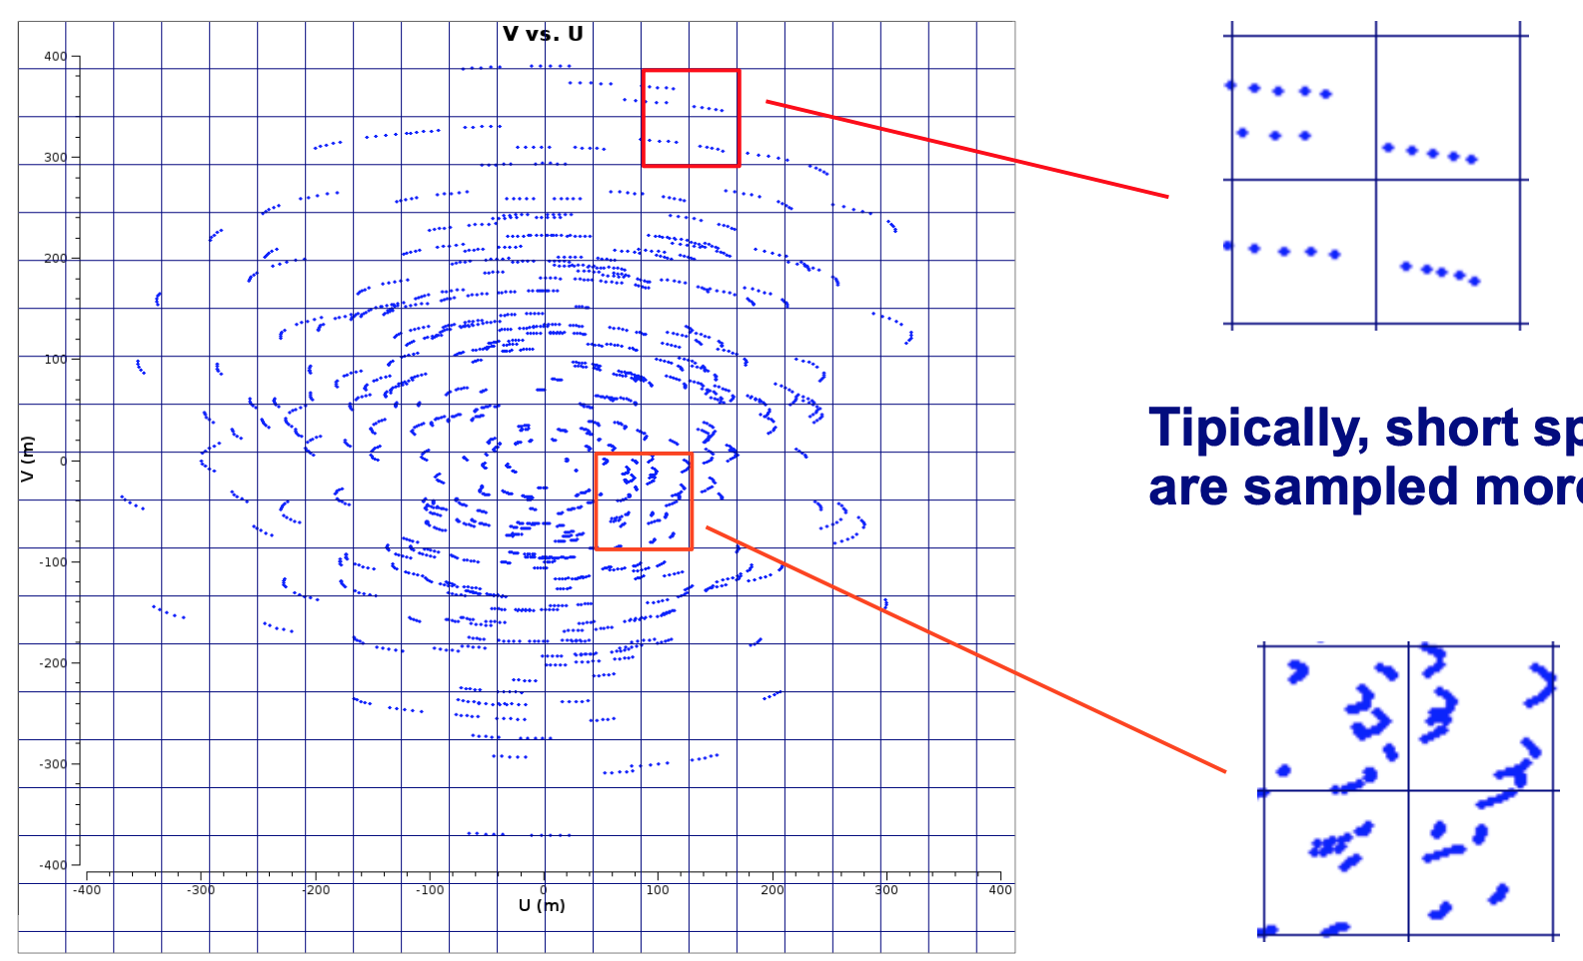
Science-derived properties I
uv-cell size is determined by FoV (~1 radian)
View on sky rotates -> changing visibility for each uv-point and frequency bin. But we can only use coherent measurements, so limit on integration time.
Short baselines: long dwell times in uv-cells, gridded array: ‘redundant’ measurements.
R. Paladino

Slide 9
Science-derived properties II
Total number of antennas: 32 x 32, to meet sensitivity requirements for discerning different physics models for the Dark Ages
Antenna size: several meters (to be chosen in the current concept design activity), dual polarisation
Antennas to be placed close together in a regular grid: an ‘FFT telescope'
lander

Slide 10
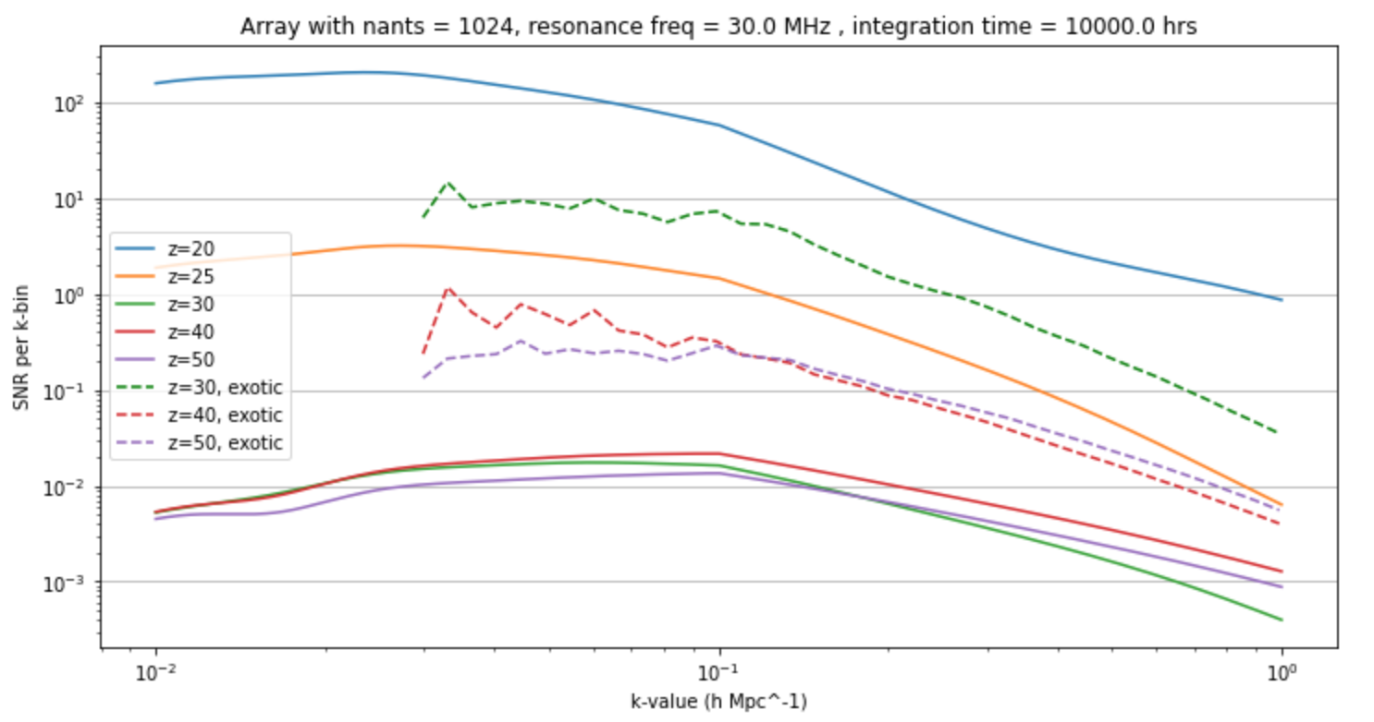
Motivation for array size and sensitivity
32x32 is the smallest array that enables us to distinguish ‘standard’ physics models from DM-enhanced interaction models

Slide 11
ALO top-level system requirements
Mass
1500 kg total, 1024 antennas: ~1 kg/ant
Sensitivity
7 x 10⁻²⁰ W/m²/Hz (1 - 100 MHz range)
Power budget
~few Watts per antenna
Data rate
250 Ms/s @ ~6 bits per sample for each antenna, ~20 Mbit/s aggregate (after integration)
Temperature range
~100 to 390 K (-173 to 117 C) at surface
Data processing
2.6 Gflops/s per antenna (FFT), 20 Tflops/s for grid processing

Slide 12
Measurement data of ALO
No direct correlation per baseline, but array-wide FFT imaging: large impact on processing requirements!
Limited sky resolution and sidelobe structure make proper sky modelling and array calibration extra important

Slide 13
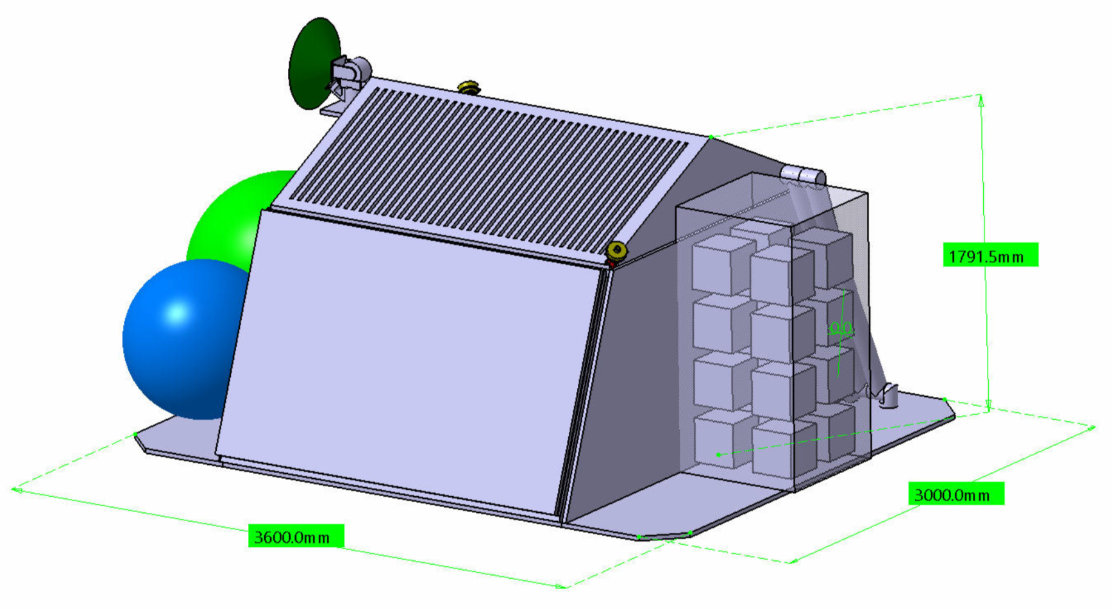
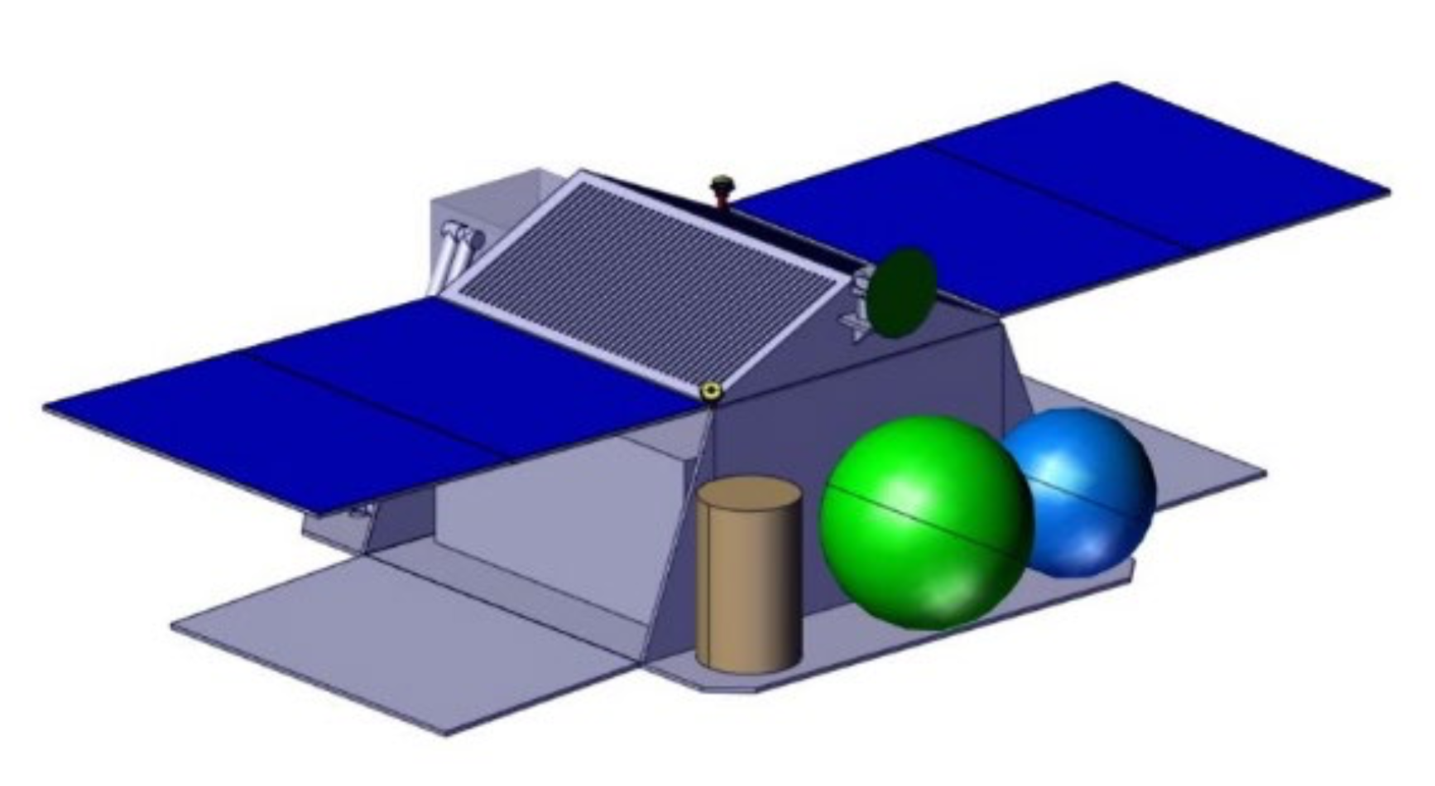
Outcome of CDF study
With current tech, max scale of system for 1 lander: 4x4 antennas. Significant mass reduction needed in antenna hardware, deployment system, power/data harnessing for 32x32 array.
Reduction in power consumption needed: ~2W per antenna is the goal
Modular approach fits array design: multiple ‘hubs’ with their own locally organised antenna subarrays (+power, data…)

Slide 14
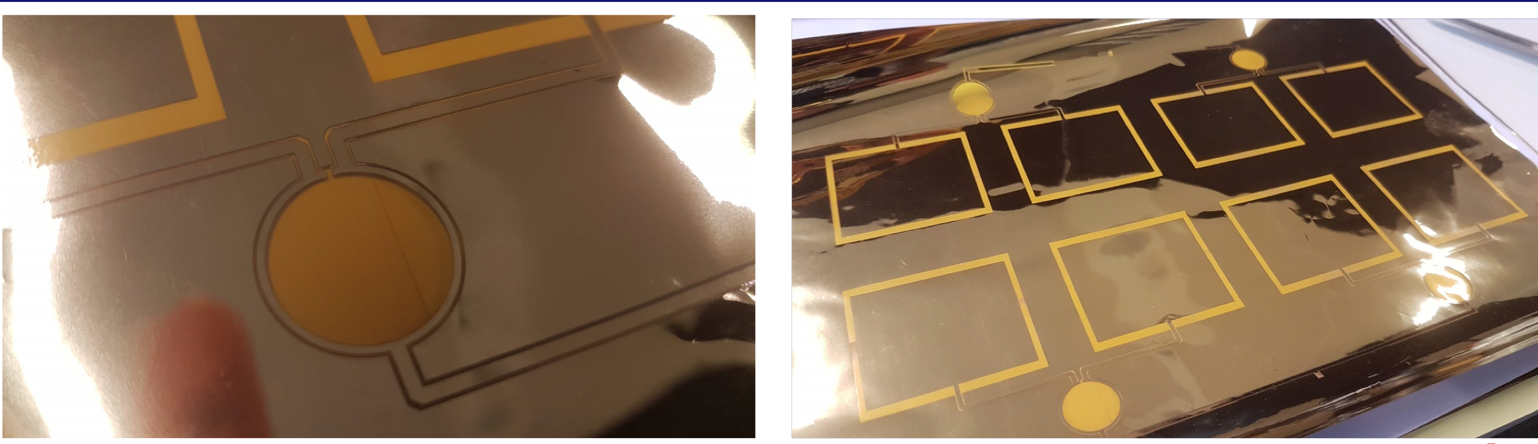
Necessary tech development
Low-mass antennas: unrollable/inflatable structures
Harnessing: local power generation, wireless data transmission
LNA survivability: large temperature range electronics, protection using regolith or shade structures
Performance monitoring and calibration: internal and external
M. Bentum, N. Vertegaal, TU/E

Slide 15
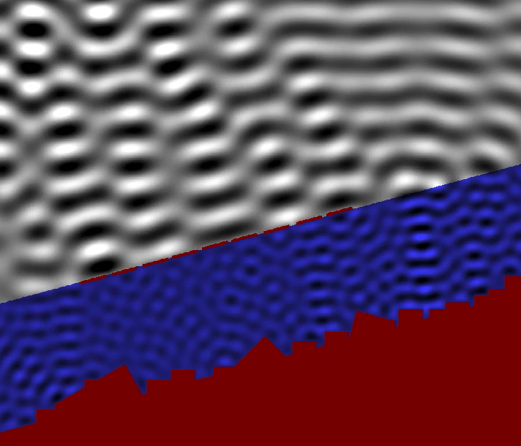
Effects to worry about I
Influence of Lunar regolith:
No ground plane means a risk of ‘multi-path’ array illumination
Severity depends on Lunar regolith dielectric profile (absorption vs reflection, roughness scales)
Can we recognise this effect adequately in our observations?
Snapshot of simplified subsurface
reflection scenario

Slide 16
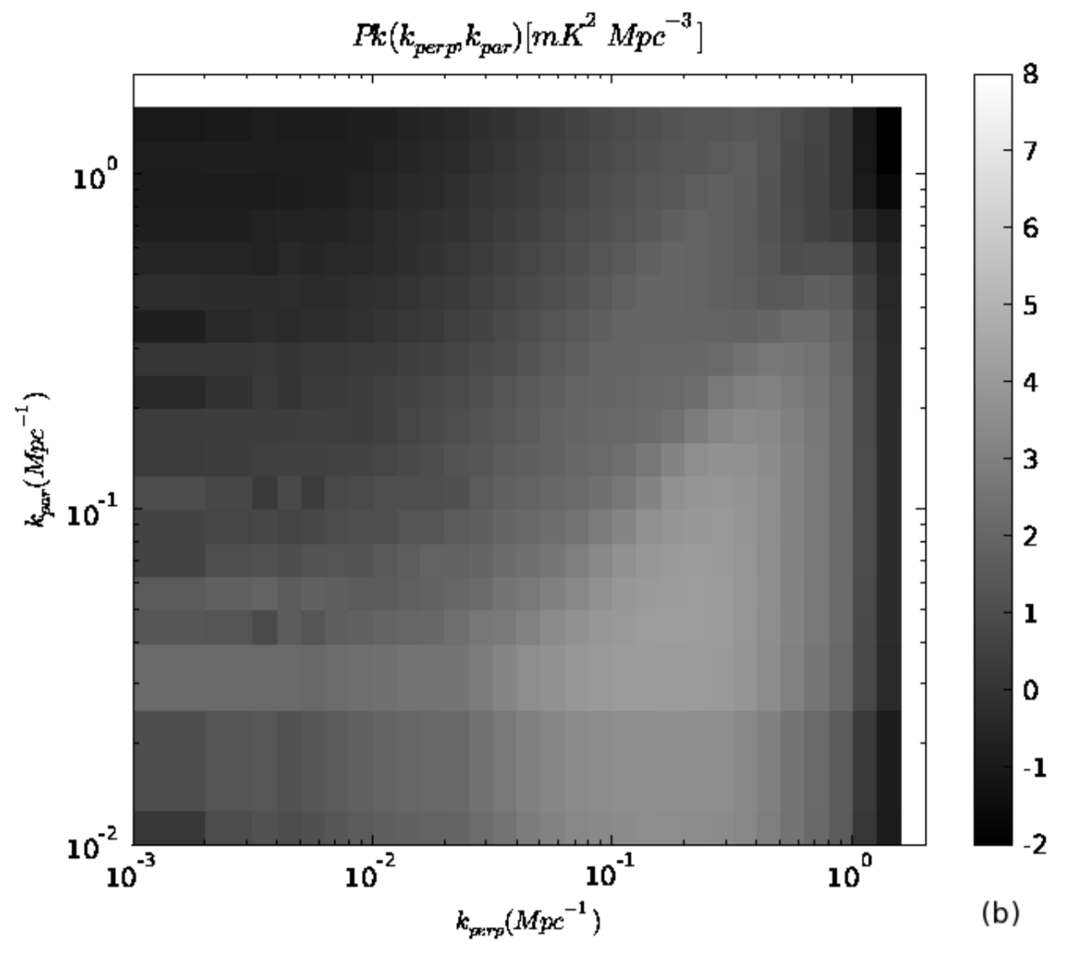
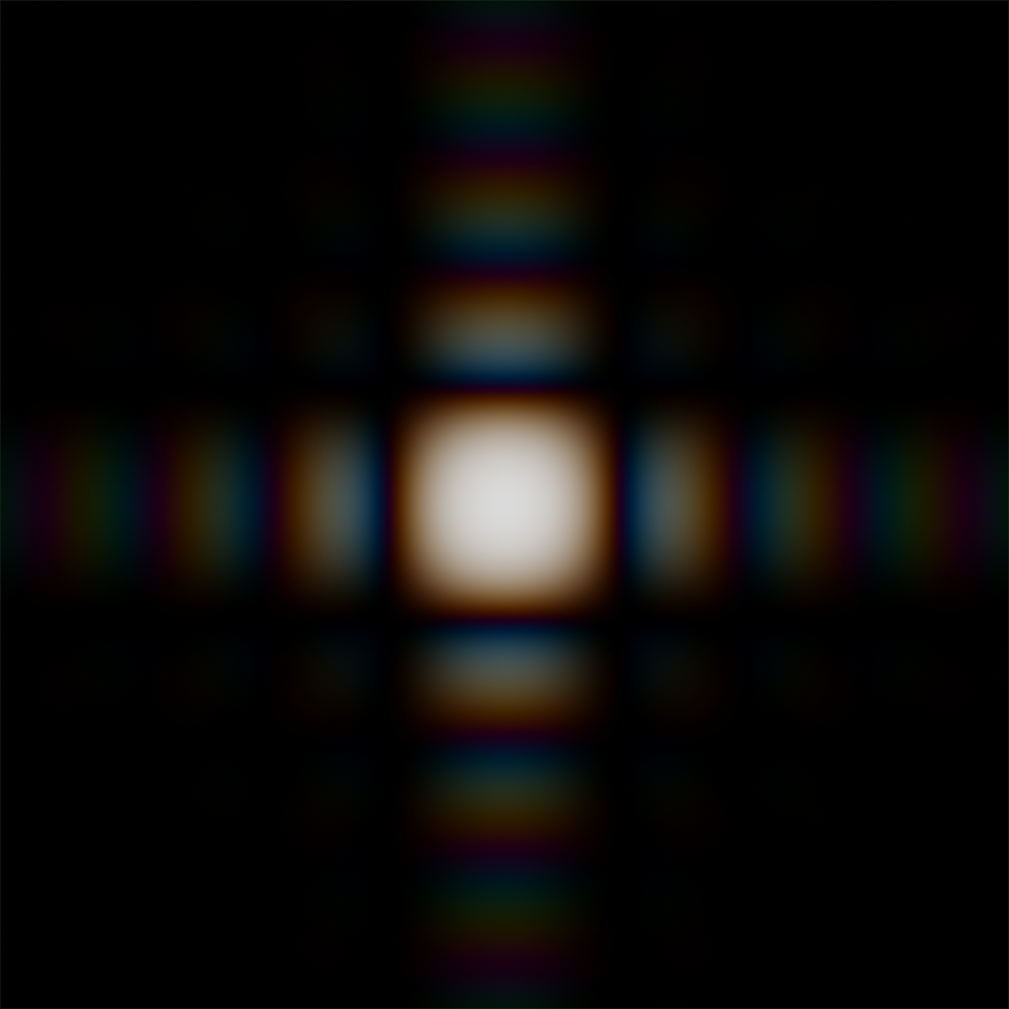
Effects to worry about II
Chromaticity of antennas and array: frequency-dependent beam shapes and angular resolution
Small errors in sky model mimic the signal we are trying to measure by adding frequency structure
Datta et al. 2010

Slide 17
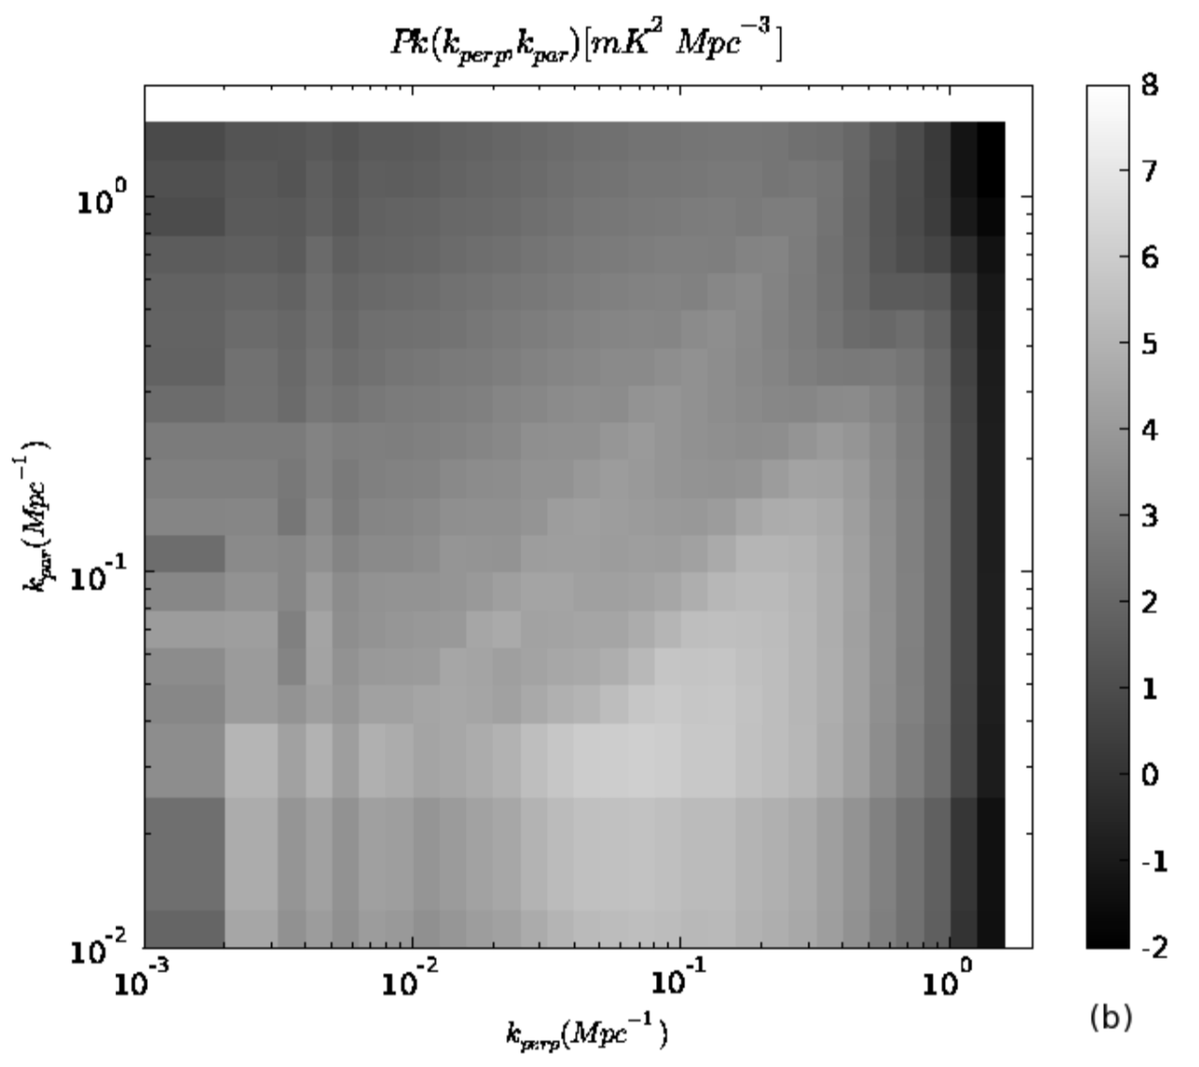
Effects to worry about III
Antenna gains need to be exquisitely calibrated: ~0.05% antenna gain error allowed!
Antenna heterogeneity makes this problem worse
Datta et al. 2010

Slide 18
Current activities of the ALO TT
Identification of necessary technology development for ALO currently underway:
Antennas: low-mass, printed?
Power distribution: local hub power?
Clock synchronisation: central to hubs?
Deployment: inflatable or unrollable structures?
Data transmission: RF or optical? Fiber or free-space?
Calibration: external and/or internal?
Data processing: how to tackle foreground removal?
Interested? Please get in touch!

Slide 19
Online Notebook
Multi-user online Python notebook was used during CDF study
Check different ALO system configurations, impact on array performance
Accessible, transparent and quick way to understand the system
Easily updatable and extendable

Slide 20
5 influences to worry about
Multi-baseline mode mixing (uniform, Hazelton 2013)
Sky model amplitude errors (wedge, Morales 2012)
Sky model position errors (wedge)
Gain amplitude errors (uniform & wedge)

Slide 21
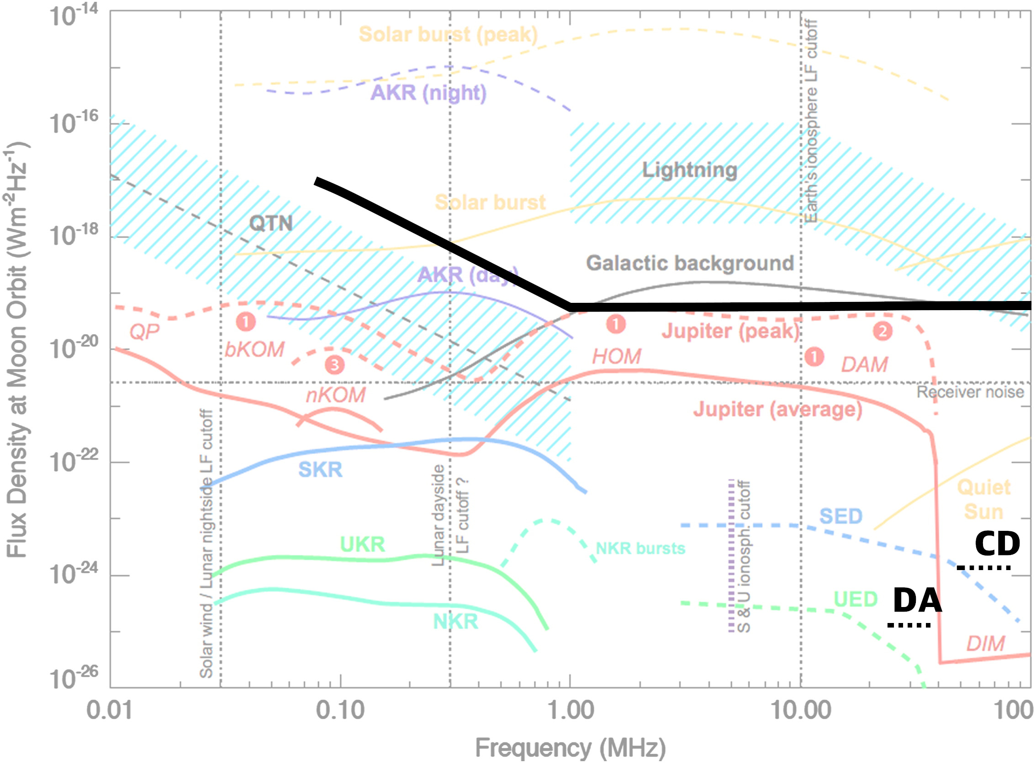

Slide 22
