Slide 1

Radio Interferometry for Rocket Position Reconstruction
The basics, the challenges and the (possible) solutions
PR4 knowledge transfer workshop, 17-02-2022 Christiaan Brinkerink (RRL)

Slide 2
What we will talk about today
Basics of radio interferometry in PR4 context
Setup of PR4 experiment and measurements
Positioning algorithms
Complicating factors
NOTE: This is not a lecture - I don’t have ready-made solutions for the positioning algorithms. Today is about having everyone understand the fundamentals, and about exchanging information and ideas on the challenges faced.

Slide 3
Basics of radio interferometry in PR4
3 transmitters on REXUS rocket
Each sends a ‘pure tone’ at a different frequency close to 433 MHz
Ground stations pick up these tones (with 3 antennas each)
Using phase (and phase difference) measurements, we aim to reconstruct the rocket’s position in near real time
GS1
GS2
GS3

Slide 4
Basics of radio interferometry in PR4
Ground stations at different distances from the transmitter will typically measure a different phase.
But: ambiguity is possible. We know where in the cycle, but not which cycle.
Consequence: a phase difference measurement is consistent with multiple arrival directions (specifics depend on baseline length).
GS1
GS2
GS3

Slide 5
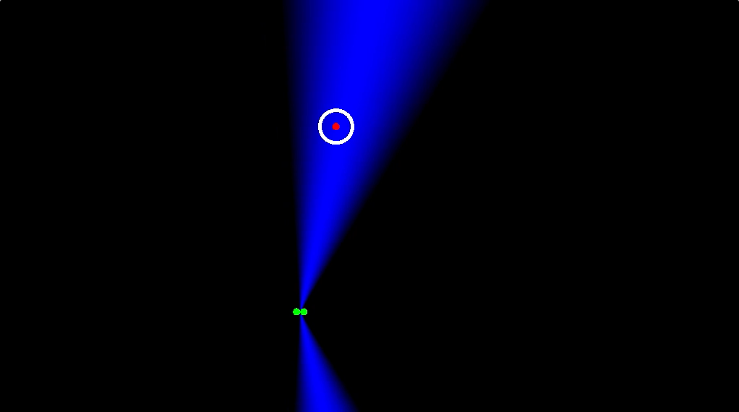
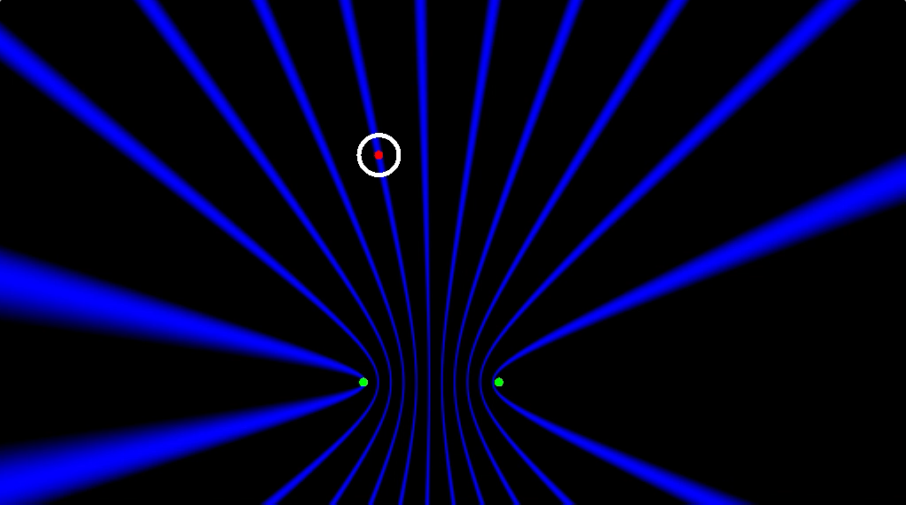
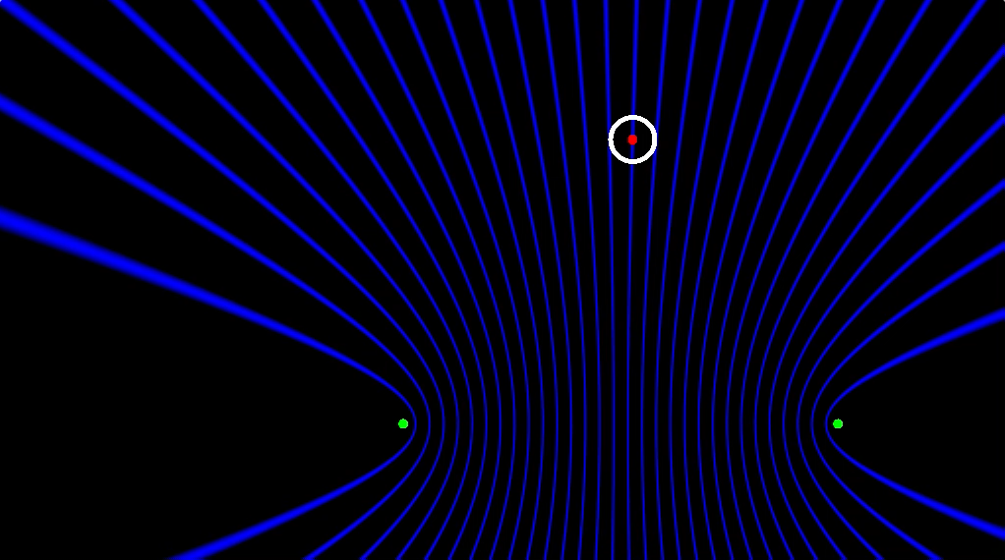
Basics of radio interferometry in PR4
Blue zones: simulated possible locations of the transmitter from a phase difference measurement on single baseline
See: https://www.shadertoy.com/view/3ddfWM
Short baseline: ~1 wavelength
Longer baseline
Even longer baseline
The spacing of the blue zones is a function of the wavelength. But what affects the width of the blue zones?

Slide 6
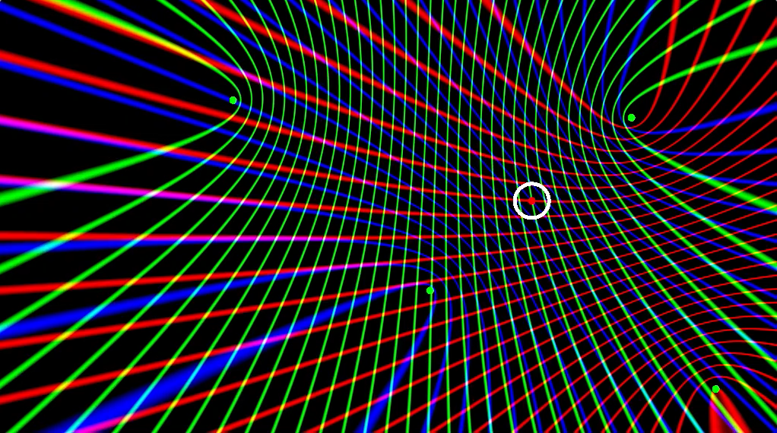
Basics of radio interferometry in PR4
See: https://www.shadertoy.com/view/3ddfWM
Multiple baselines

Slide 7
Our REXUS PR4 setup
Some numbers:
The 3 transmitters use patch antennas and are placed around the rocket fuselage, 120 degrees apart from each other.
Ground stations have 3 (horizontal dipole) antennas each, separated by ~1m and placed in a triangle (we have them in the lab downstairs).
Ground stations will be placed 100s of meters to a few kilometers apart at the Esrange launch site (specific placement is TBD).
The rocket will reach an apogee of ~80 km, total flight time of ~15 minutes (including a long parachute descent), max speed going up is ~1 km/s (Mach 3)

Slide 8
Our REXUS PR4 setup
The ground stations measure voltages from each of their 3 antennas, in the following time pattern:
Antenna 1
Antenna 2
{
Antenna 3
2048 samples,
@ 40 Ms/s
Samples are taken quickly, but in short bursts and only a fraction of the time. Otherwise the data rate gets too large!
1 millisecond
Time

Slide 9
Positioning algorithms
‘Tracking the phase’: monitoring the changing range of the rocket from each antenna on each ground station separately
Arrival direction determination for each individual ground station using phases from different antennas on the same ground station
Full interferometry using baselines between different ground stations for phase difference measurements

Slide 10
Positioning algorithms
1
‘Tracking the phase’: monitoring the changing range of the rocket from each antenna on each ground station separately
GS1
Stationary rocket,
transmitting at 434 MHz
“I measure a frequency of 434 MHz:
the rocket’s range is stationary”

Slide 11
Positioning algorithms
1
‘Tracking the phase’: monitoring the changing range of the rocket from each antenna on each ground station separately
GS1
Moving rocket,
transmitting at 434 MHz
“I measure a frequency of 433.9998 MHz:
the rocket is moving away at 138 m/s”
What happens if the transmitter or receiver clock frequency is not what you think it is, or if it changes over time?

Slide 12
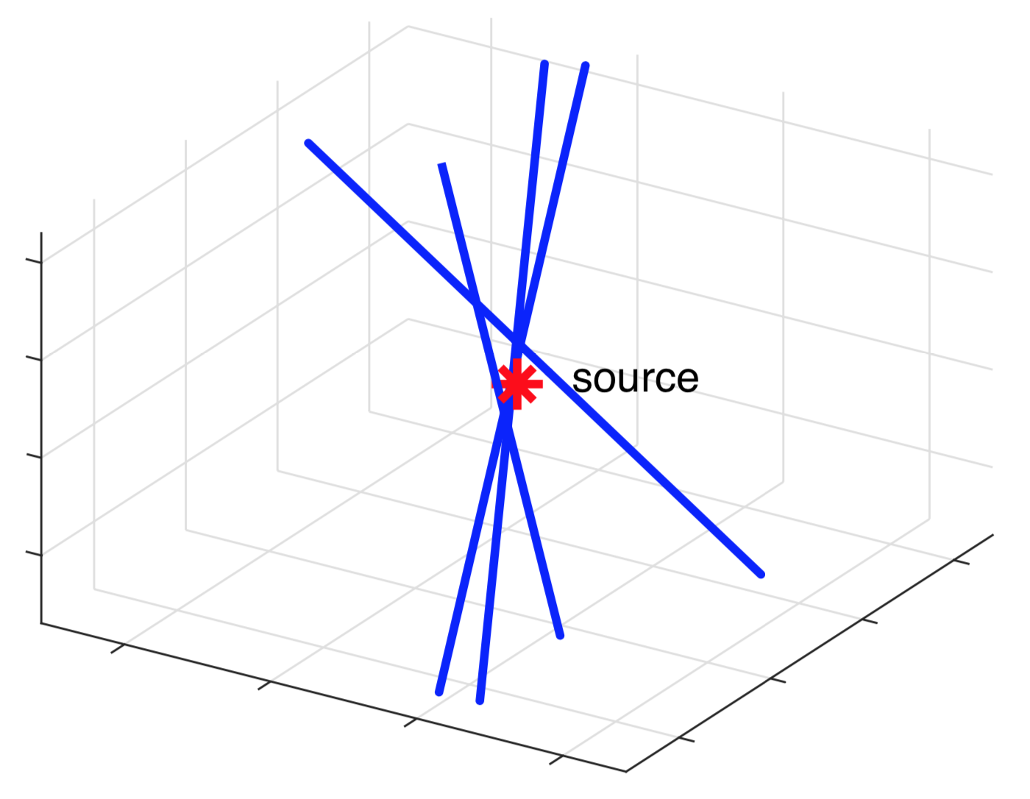
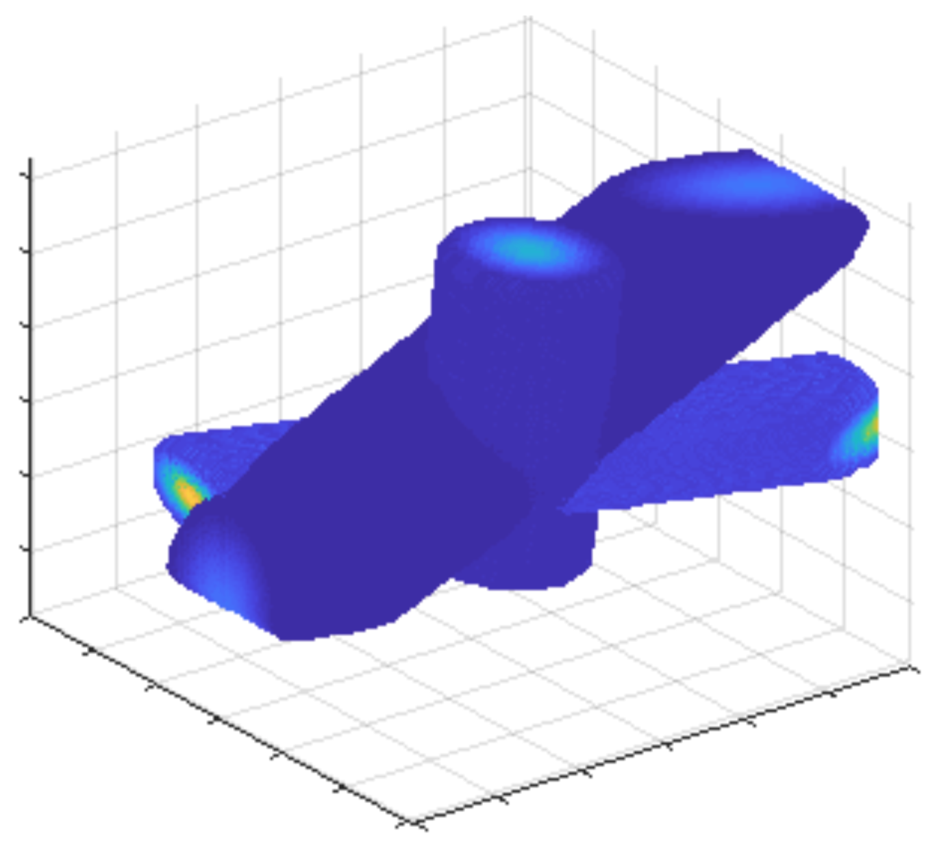
Positioning algorithms
2
Arrival direction determination for each individual ground station using phases from different antennas on the same ground station
For every ground station, determine the (coarse) direction
of arrival using the short baselines between its own antennas
L. van Harten
L. van Harten
Look for best position solution in 3D, closest to all lines of sight
Use weighting by SNR to assign confidence to each line of sight

Slide 13
Positioning algorithms
3
Full interferometry using baselines between different ground stations for phase difference measurements
How do we select the correct blue zone?
Use all combinations of antennas (on all ground stations) to get phase difference measurements for position reconstruction

Slide 14
Positioning algorithms
3
Full interferometry using baselines between different ground stations for phase difference measurements
Biggest issues:
Synchronising receiver clocks
Synchronising the measurement cadence
Antenna 1
Antenna 2
Use all combinations of antennas (on all ground stations) to get phase difference measurements for position reconstruction
What happens to the measured phase difference if antenna 2 measures every sample train at a starting time with an uncertainty of 1 microsecond relative to antenna 1?

Slide 15
Open questions
Multipath effects: what is the influence of nearby objects (ground, trees, metal structures) on the measured phase differences? - Field measurements - Predictions from basic calculations - Related: antenna pattern characterisation
What does the ground station clock stability mean for the quality of our phase measurements? - Predictions from calculations (Roos’ bachelor thesis) - Verification with field tests
How much is performance improved by employing a stationary beacon? - Conceptual rationale: which aspects of system performance are addressed? - Verification with field tests

