Slide 1


Slide 2


Slide 3


Slide 4
The RRL is involved in several projects on performing radio astronomy from space:
The Netherlands-China low frequency explorer (NCLE), the Chinese Chang’e 4 space mission orbiting behind the Moon
The Radio and Plasma Waves instrument on the Solar Orbiter (SO) space mission moving around the Sun
The Astrophysical Lunar Observatory (ALO)

Slide 5
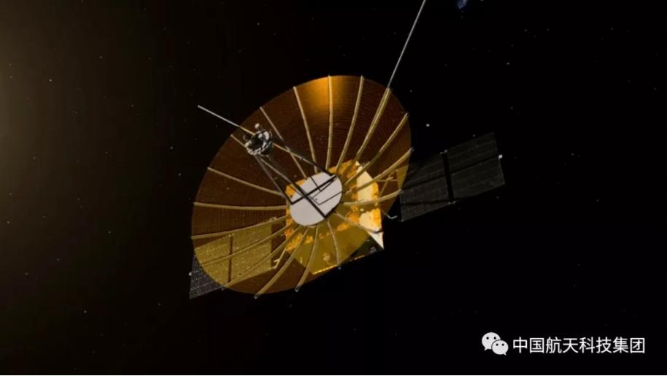
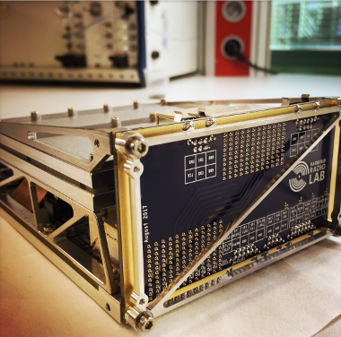
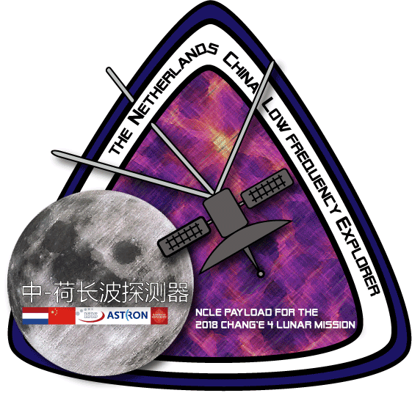
The NCLE instrument now orbiting around the Moon
The main scientific objectives of NCLE are:
exploring the radio signals from the early universe
study the radio- and plasma physics of the Earth-Moon system
quantify the man-made interferences and investigate the natural emission of the Earth’s ionosphere.
NCLE has been designed and manufactured by a consortium led by the Radboud Radio Lab and including ASTRON and ISIS-Space.

Slide 6
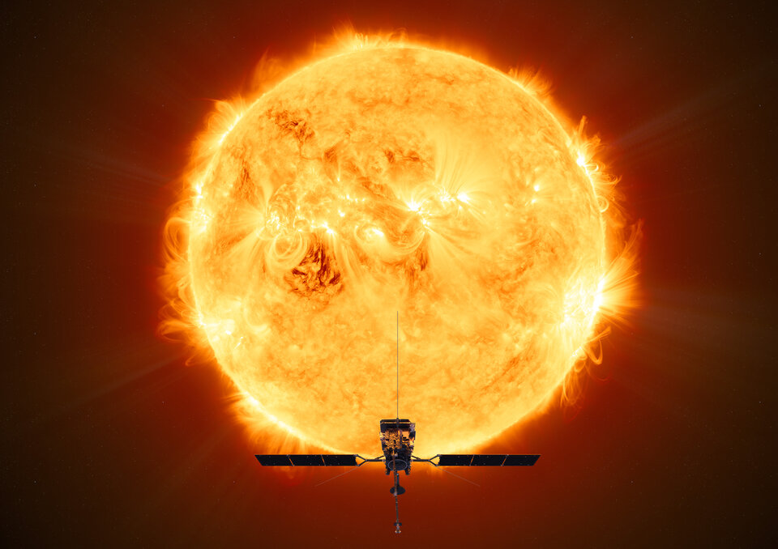
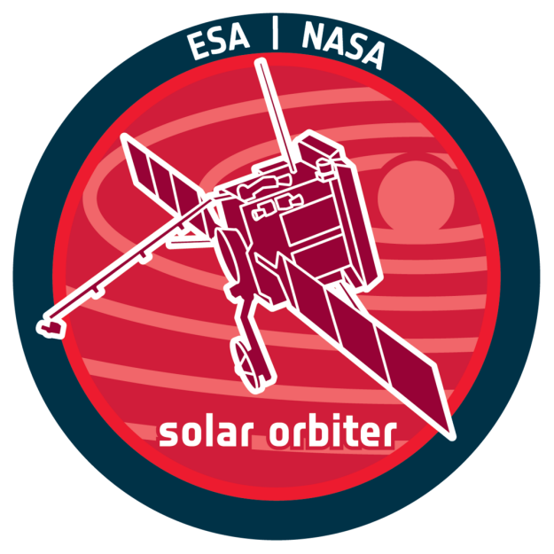

The RPW instrument on the Solar Orbiter space mission
Solar Orbiter is a ESA-NASA mission dedicated to solar and heliospheric physics.
The Radio and Plasma Waves (RPW) experiment measures magnetic and electric fields to characterize the properties of electromagnetic and electrostatic waves in the interplanetary space.
The Radboud Radio Lab is involved in the Solar Orbiter mission participating in the development and exploitation of the RPW instrument.

Slide 7
The ALO on the far side of the Moon
The Astrophysical Lunar Observatory (ALO) will deploy a large radio interferometer on the far side of the Moon to do very sensitive measurements on the signals from the early Universe.
To prepare the way for ALO, the RRL is currently developing a precursor instrument (PRE-DEX) which will characterise the local radio environment on the Moon, giving us valuable insight into the optimal choices for ALO.

Slide 8
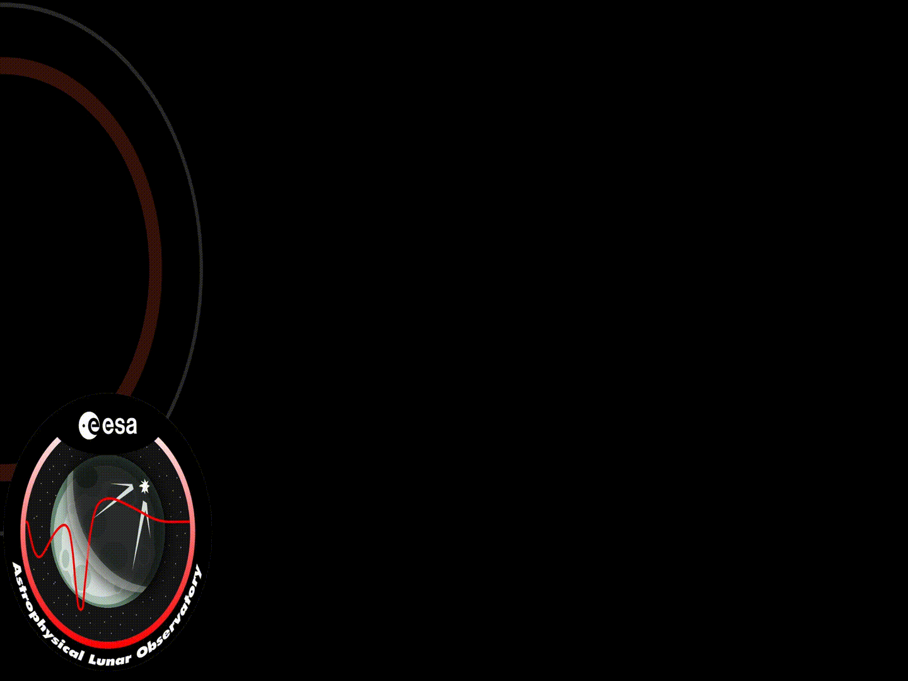
The ALO on the far side of the Moon
The Astrophysical Lunar Observatory (ALO) will deploy a large radio interferometer on the far side of the Moon to do very sensitive measurements on the signals from the early Universe.
To prepare the way for ALO, the RRL is currently developing a precursor instrument (PRE-DEX) which will characterise the local radio environment on the Moon, giving us valuable insight into the optimal choices for ALO.

Slide 9
The RRL is involved in several projects covering radio astronomy using ground-based facilities:
The Africa Millimeter Telescope (AMT) in Namibia
The Event Horizon Telescope, a network of existing (and planned) radio telescopes across several continents to form a virtual telescope the size of the Earth
The Pierre Auger Observatory in Argentina

Slide 10
Africa Millimeter Telescope

Slide 11
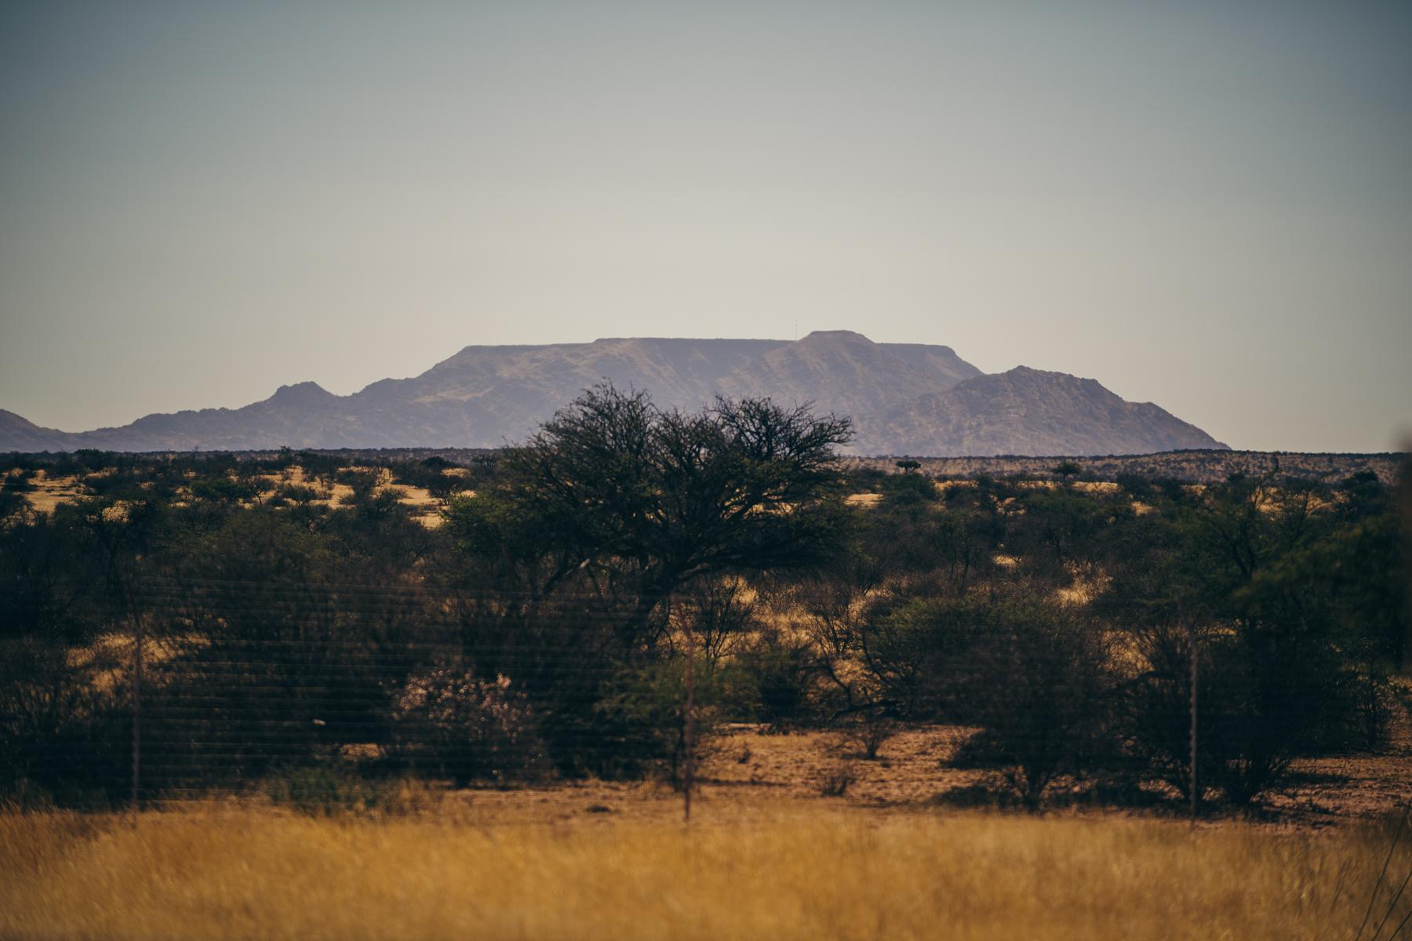
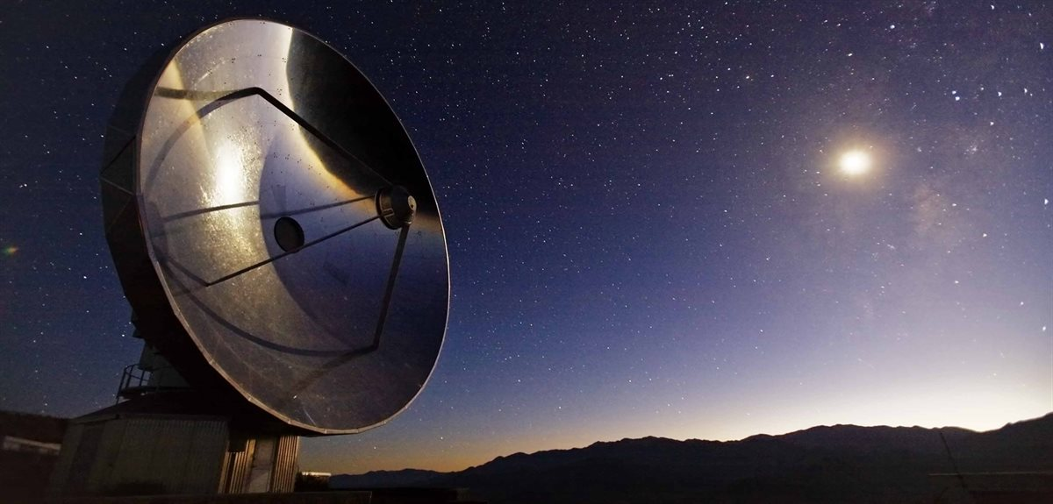
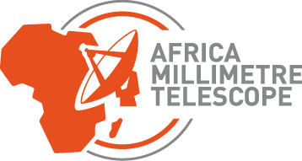
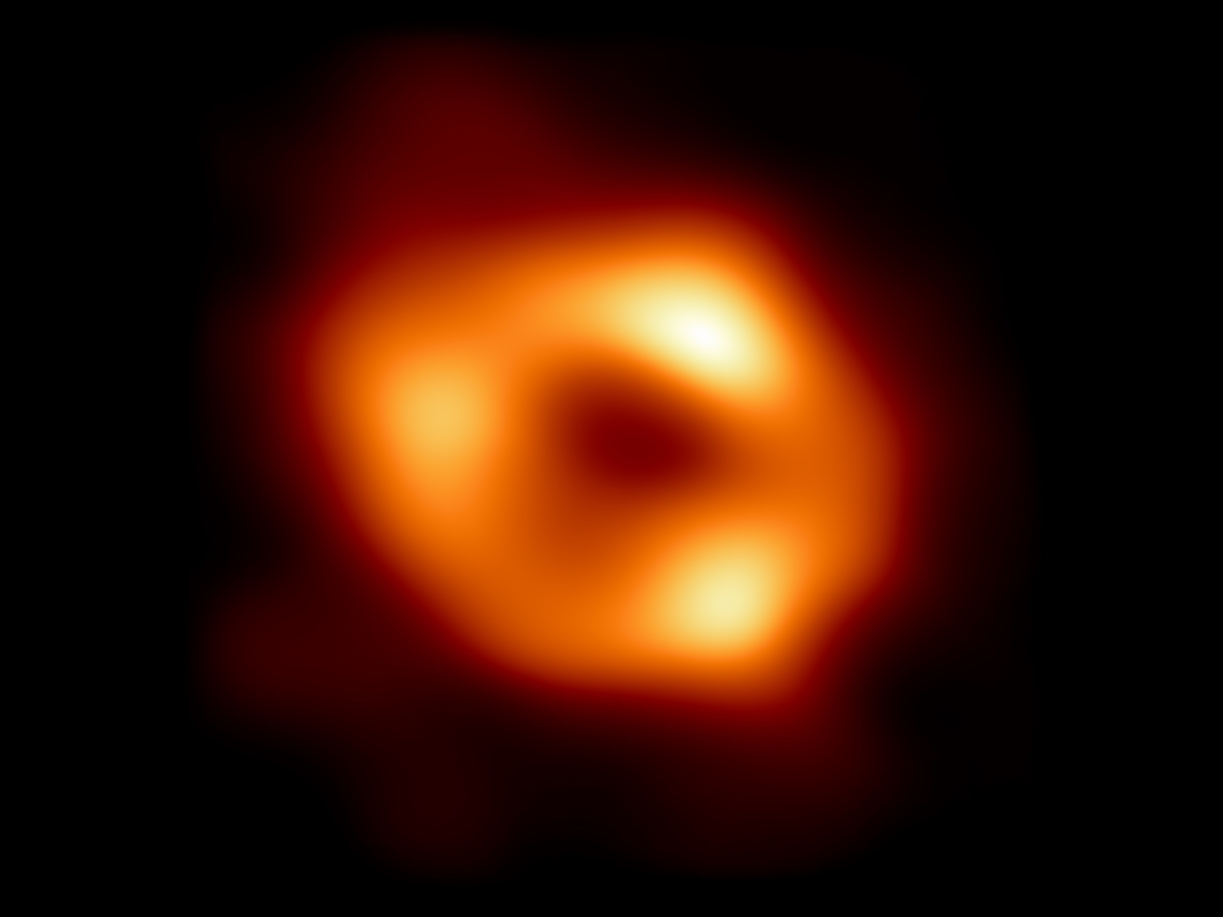

Africa Millimeter Telescope
15-meter radio telescope in Namibia
Part of the global Event Horizon Telescope network
In collaboration with University of Namibia
Location: on or near the Gamsberg
Gamsberg mountain, image by: Barbara Kerkhof

Slide 12
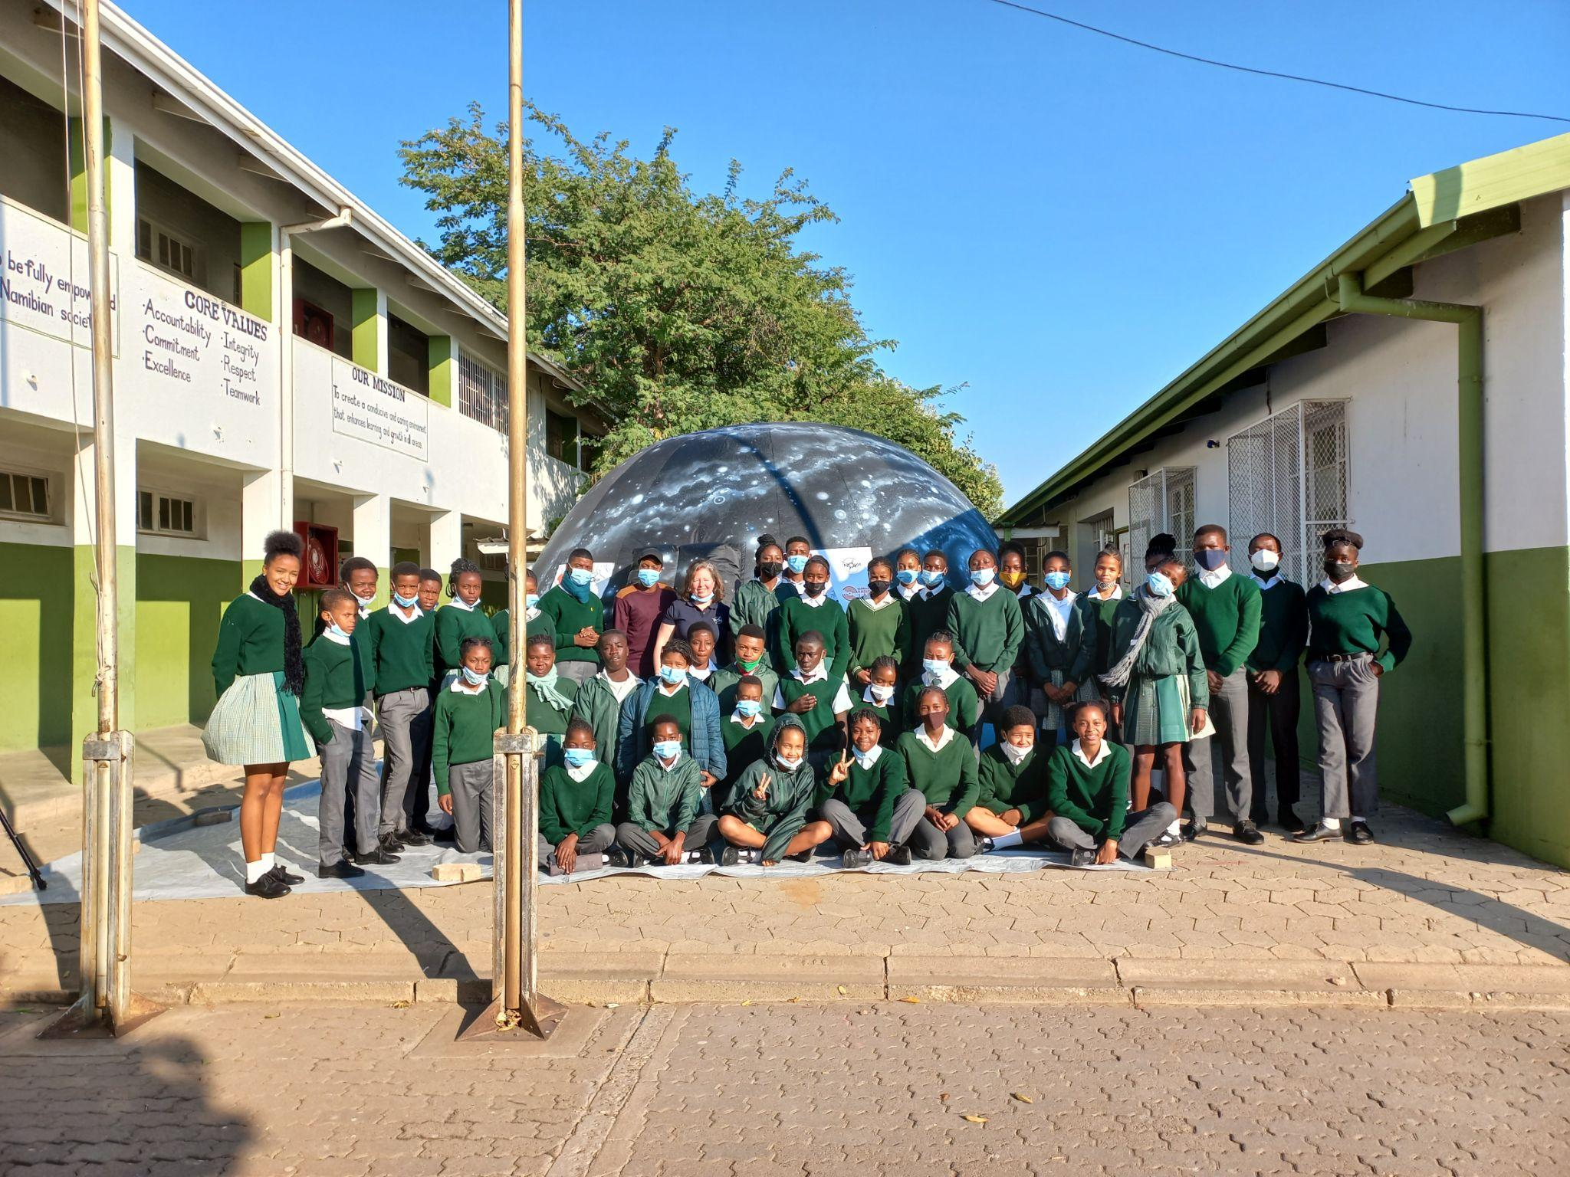
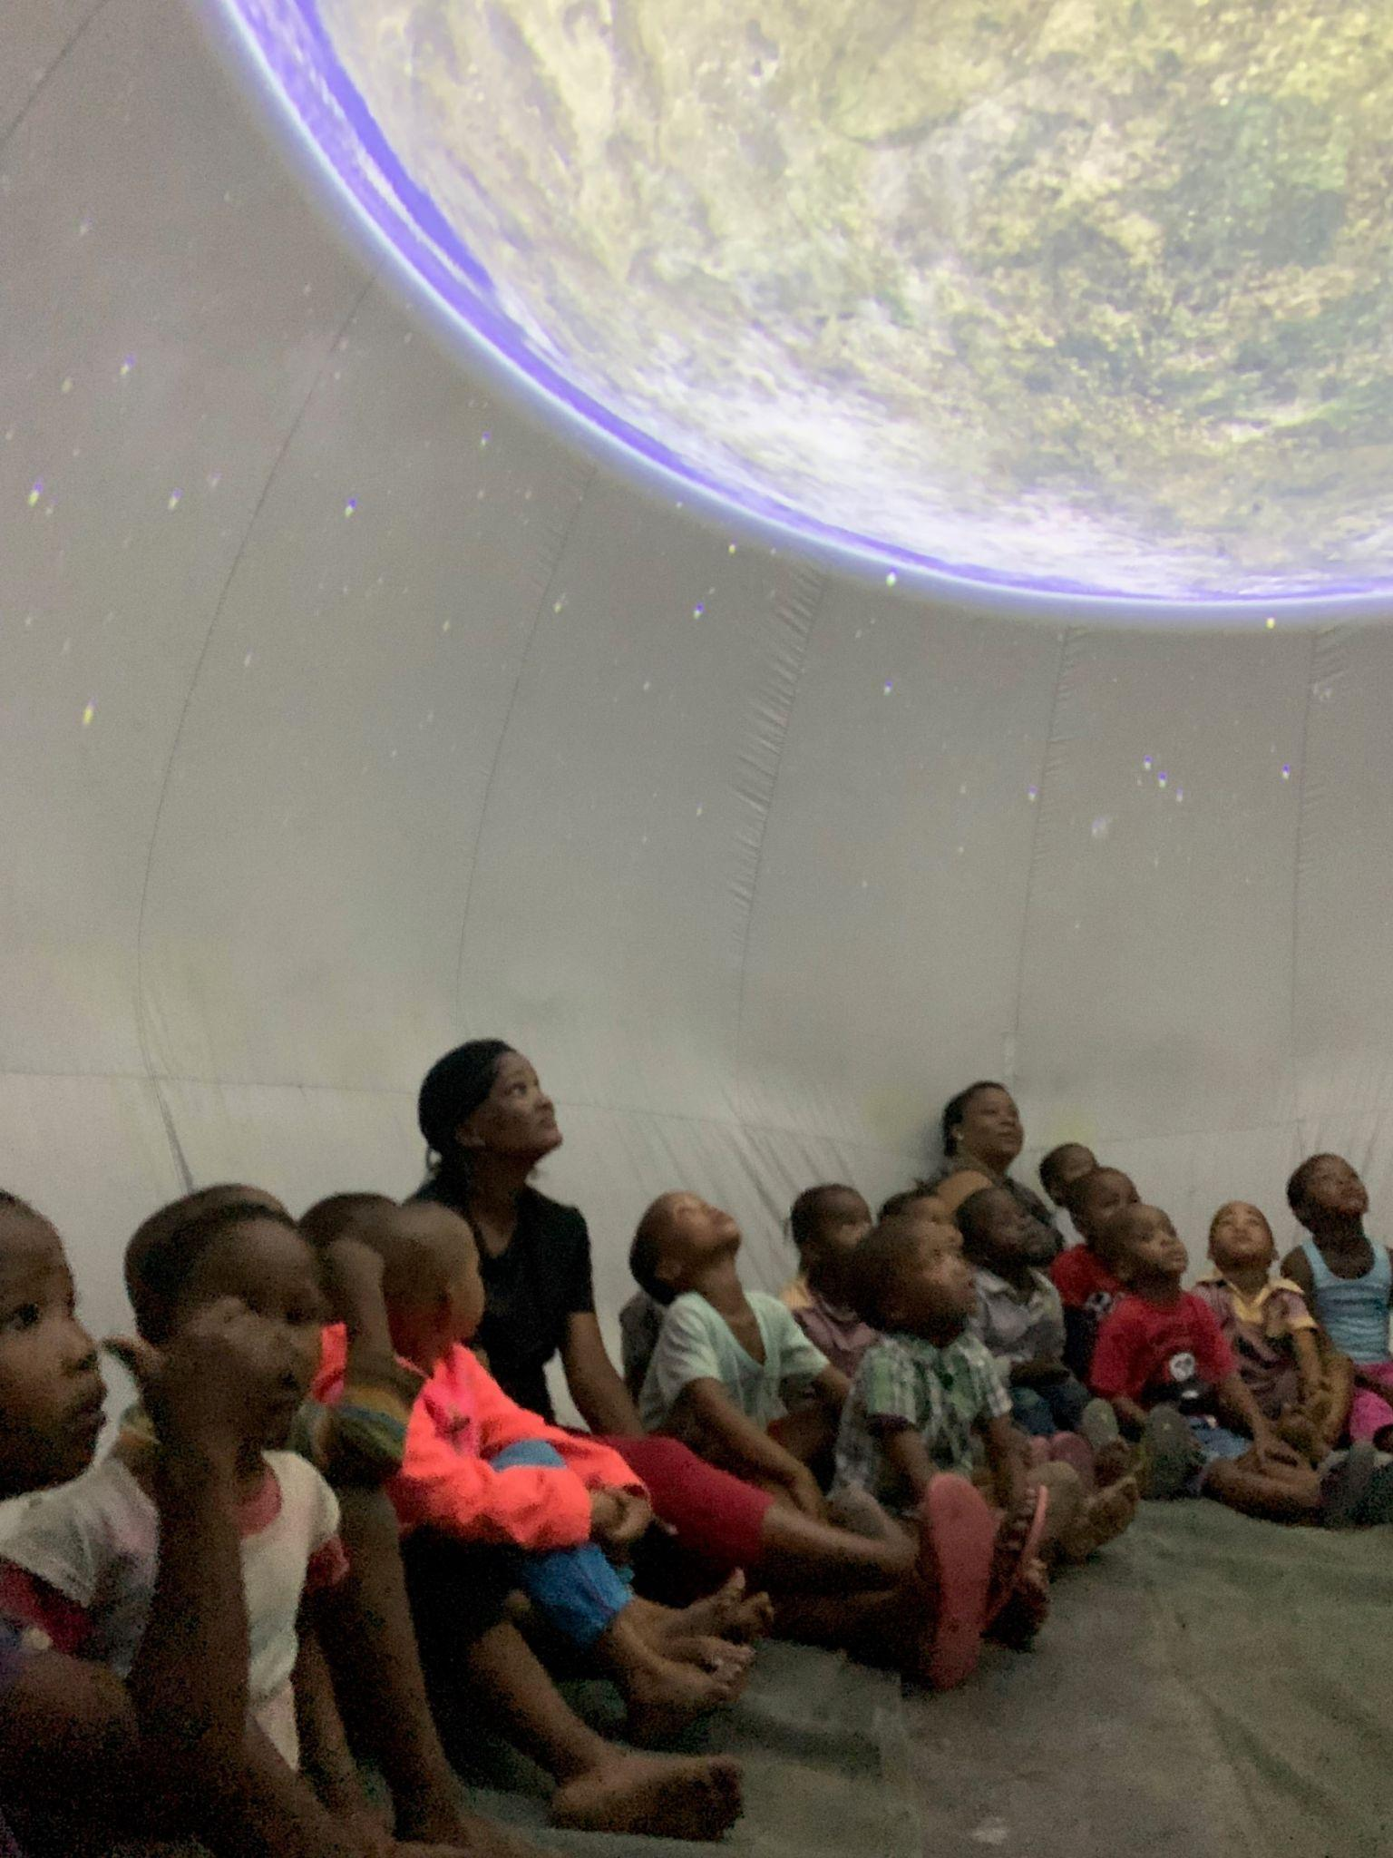
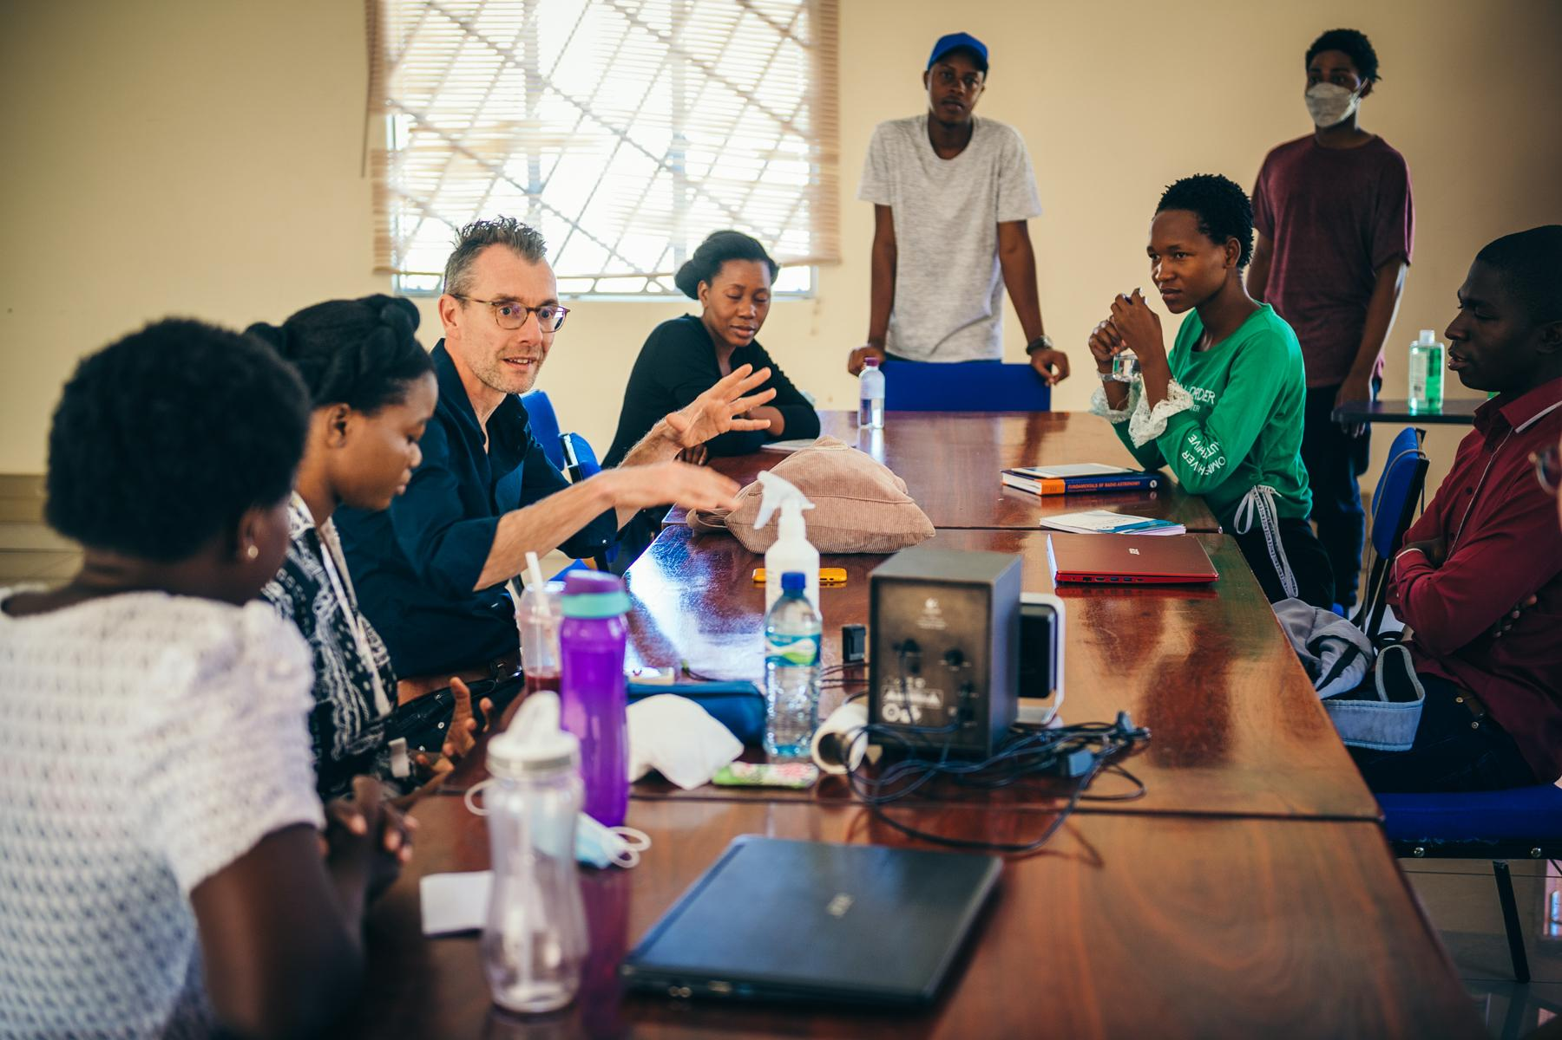
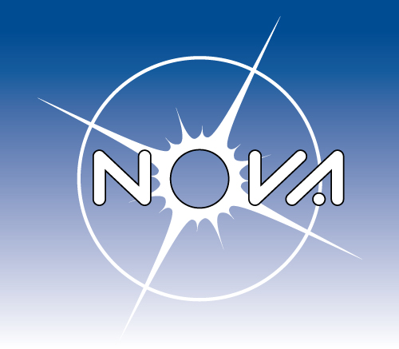
Astronomy Education in Namibia
The RRL helps develop astronomy education for children and students in Namibia, for example:
NOVA mobile planetarium program
Opportunities for student projects at Namibian Universities
AMT PhD positions

Slide 13
EHT & VLBI Monitor

Slide 14
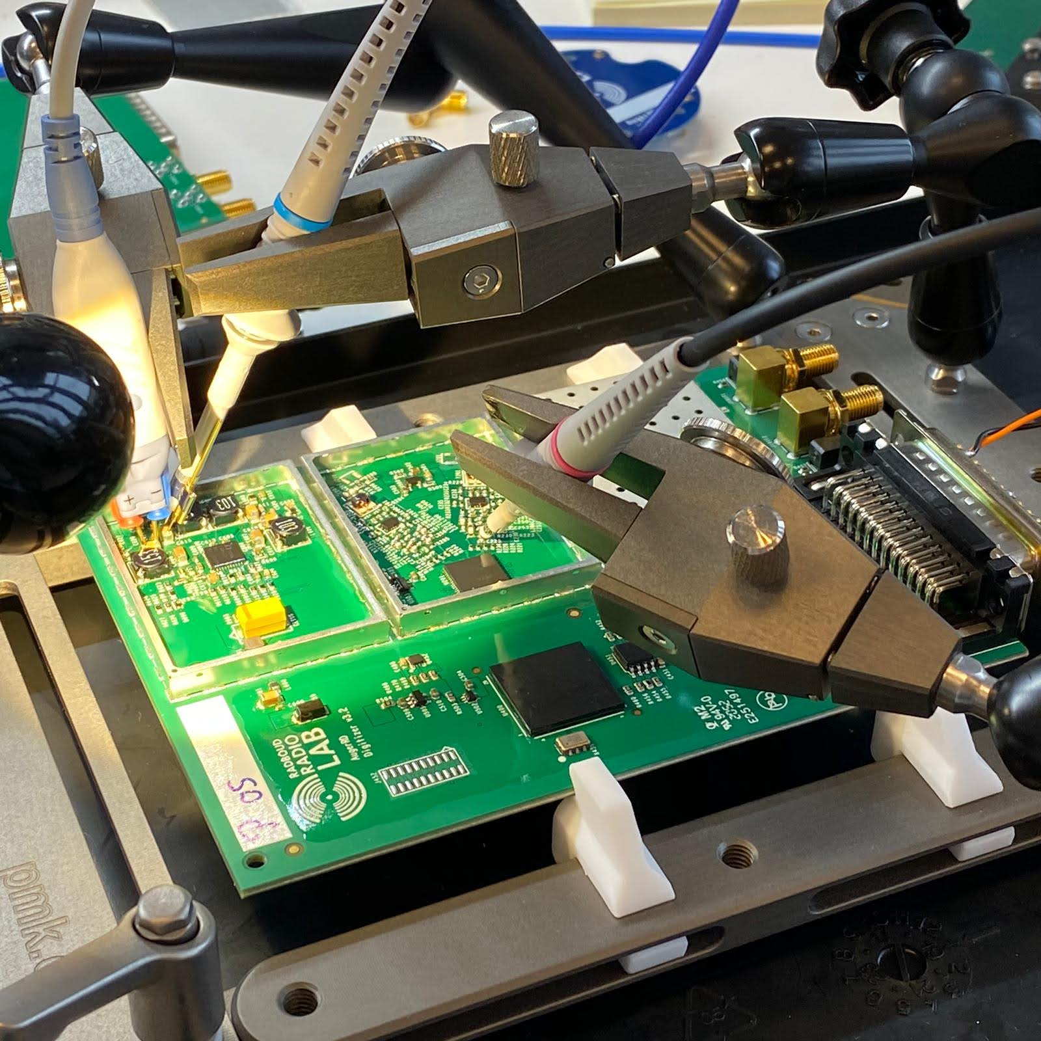
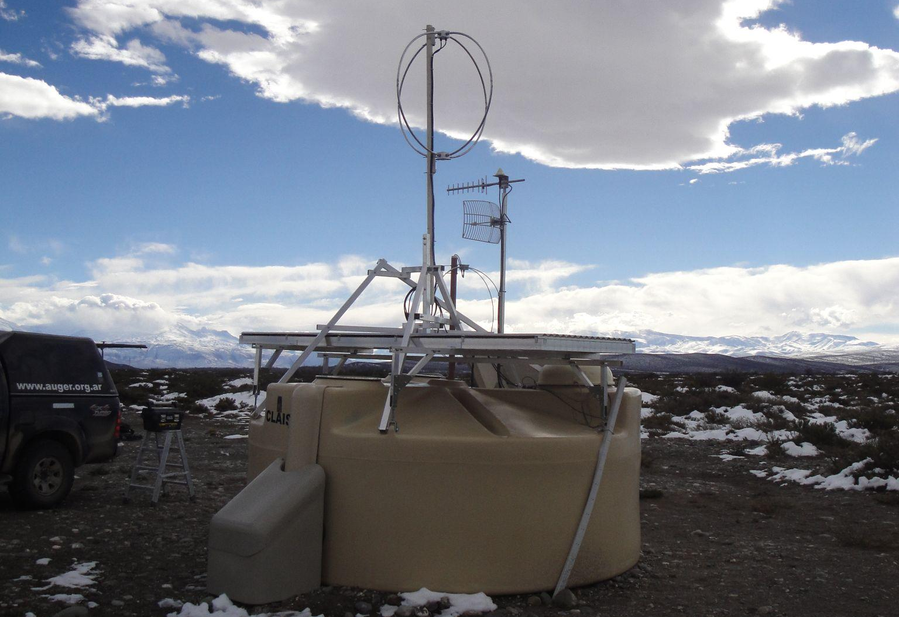
Auger Radio Upgrade
RRL has designed, developed, calibrated and coordinated the deployment of ~1700 radio receiver stations that are being deployed at the particle detectors of the Pierre Auger Observatory, which spans an area ~3000 square kilometers in Argentina.

Slide 15
The RRL is involved in several projects concerning optical astronomy:
BlackGEM & MeerLICHT
Dream

Slide 16
Gravitational Wave Toolbox
Test, hello world

Slide 17


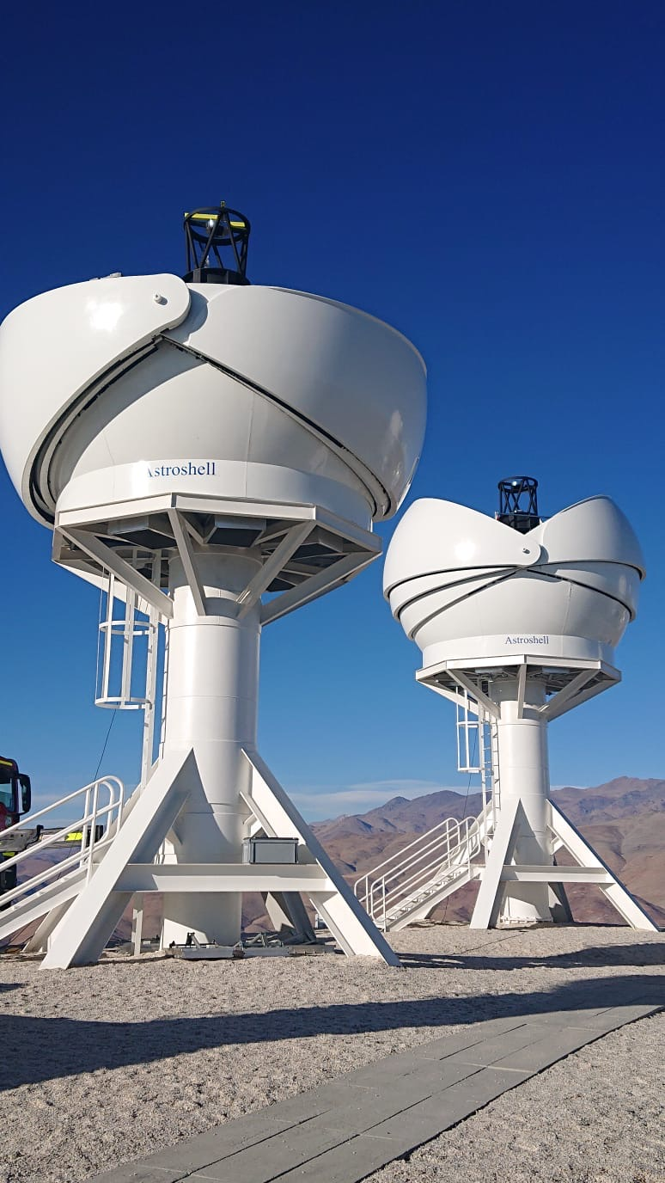
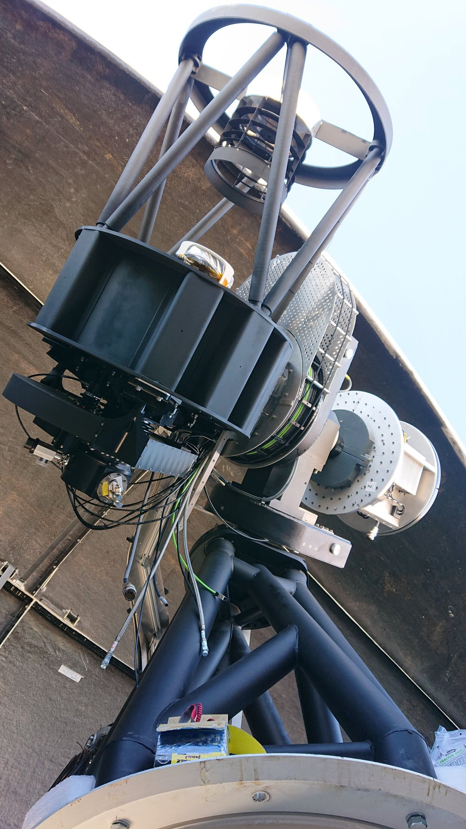
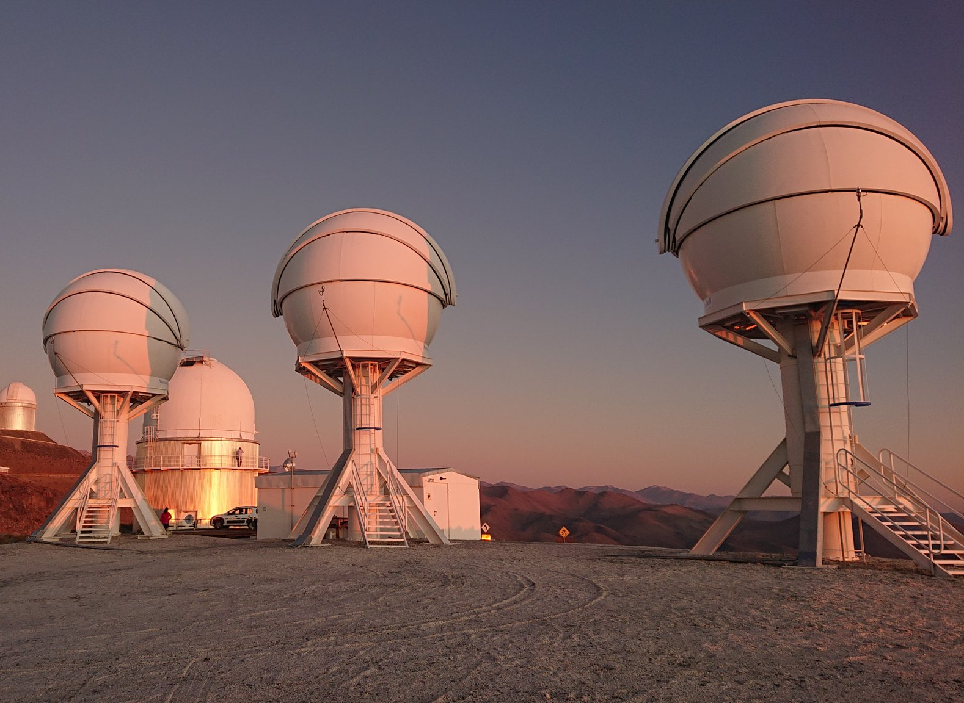
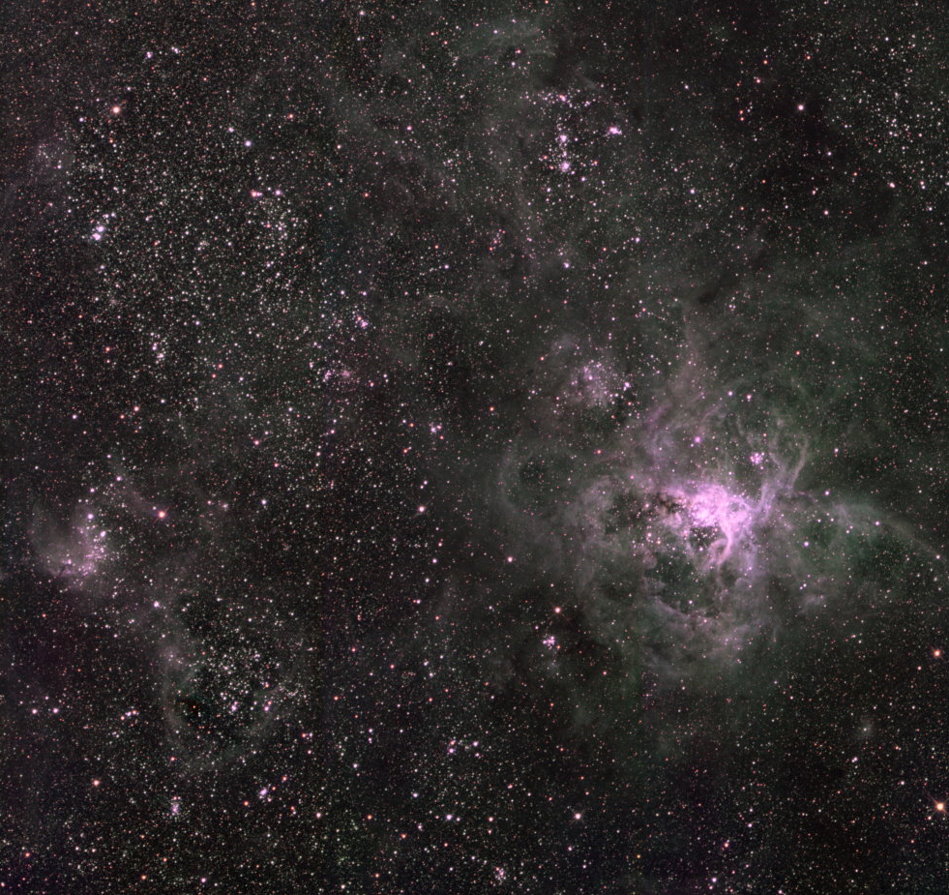
BlackGEM & MeerLICHT
3 optical telescopes in Chile and 1 in South Africa
RRL is involved in design, construction, commissioning and observing
Designed to detect optical light from gravitational wave sources and to perform transient surveys
65 cm primary mirrors, 110 Mpix cameras

Slide 18
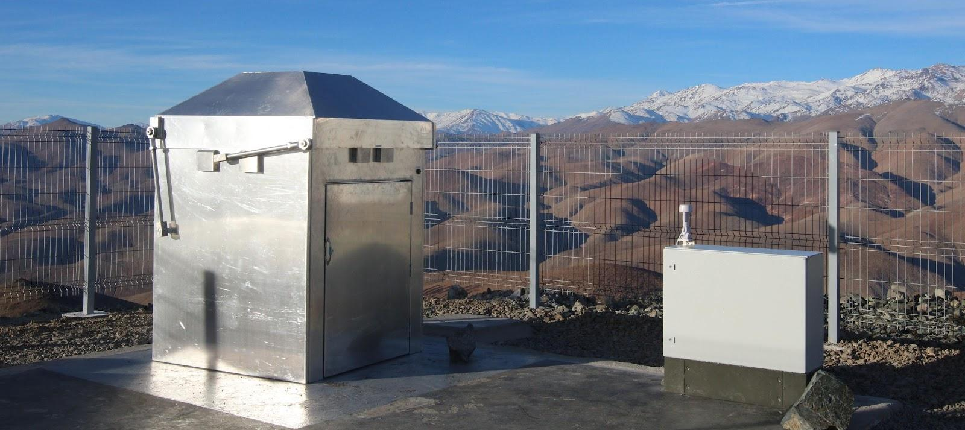
DREAM
RRL is updating the design of an all-sky camera system. The original is used to hunt for exoplanets and transient events. One of the calibration products is a detailed map of the cloud cover which can be used for other telescopes in the vicinity to perform better observation scheduling.

Slide 19
The RRL pursues projects for the development of instrumentation in astrophysics especially suitable for students:
PR4 SPACE
Astrometrix
Universal telescope mount

Slide 20
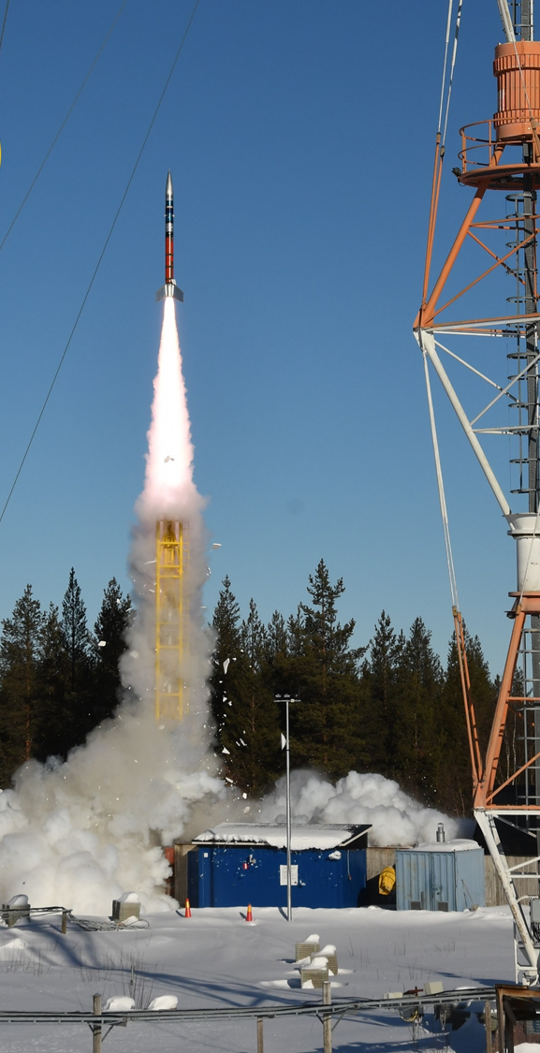

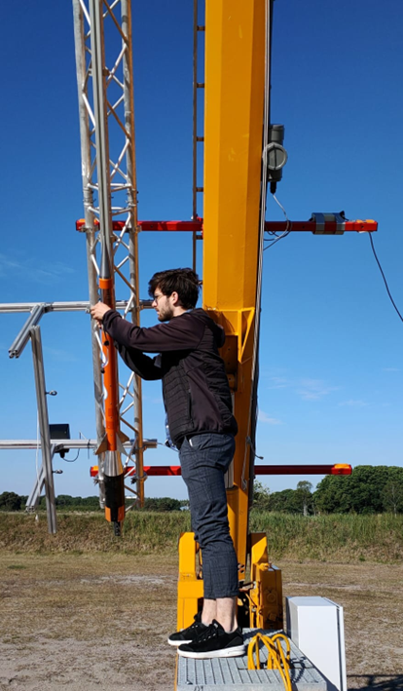
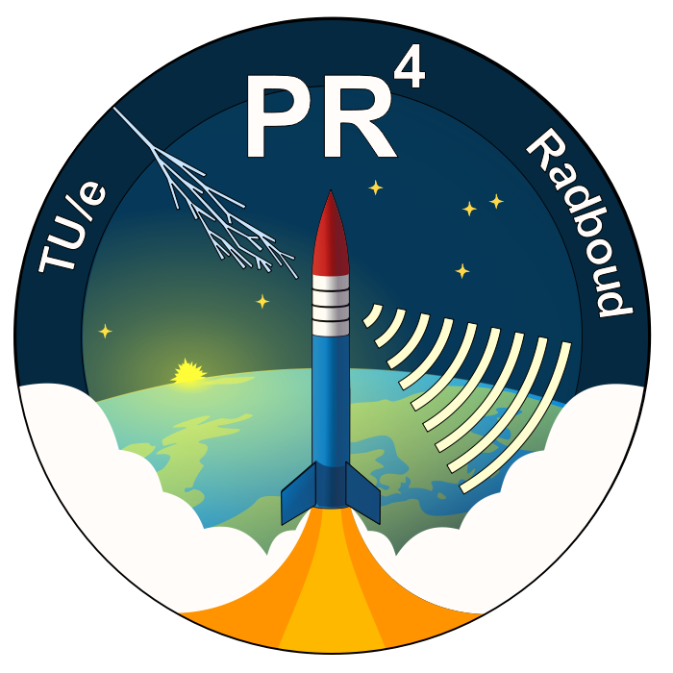
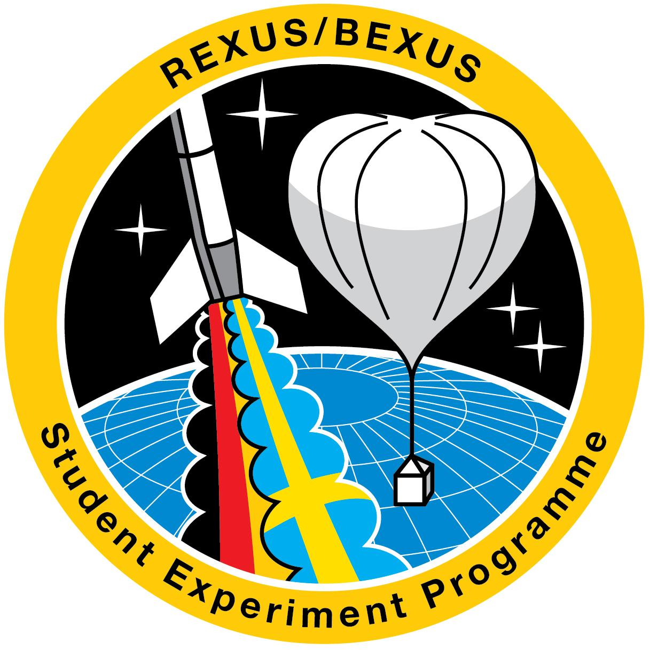




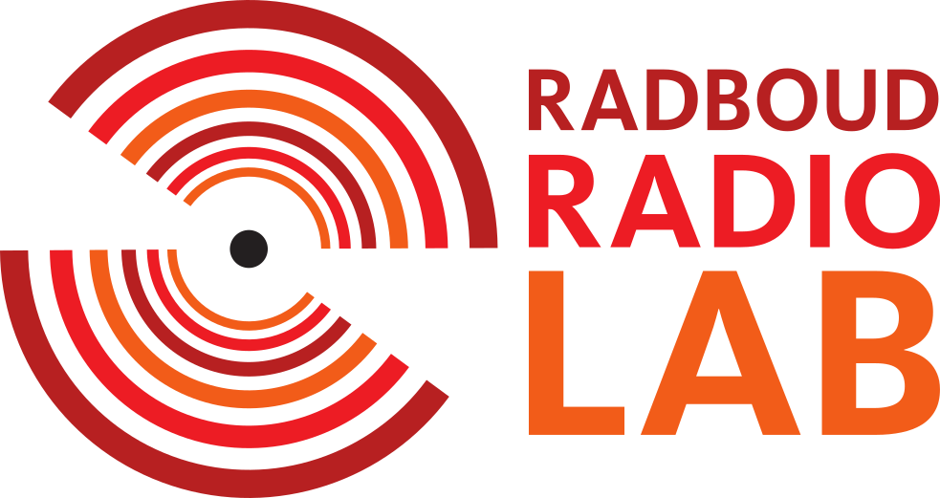
PR4space is a joint student team from Radboud University and Eindhoven University of Technology. We design and develop experimental payloads for sounding rockets. Currently we are working on a system to track the rocket with radio interferometry and an experiment on cosmic ray detection. We are flying with the REXUS program from SNSA, DLR and ESA, but also with rockets built by Dutch organizations like T-Minus Engineering and the student team DARE.

Slide 21
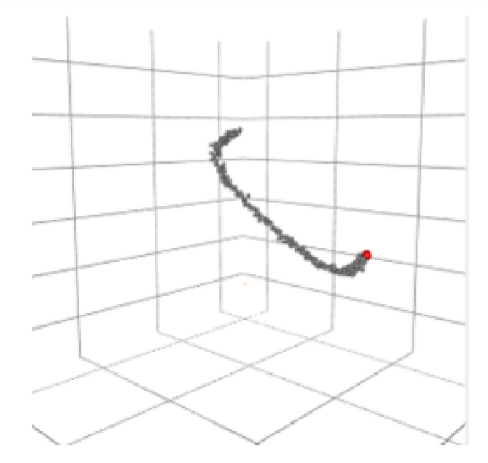
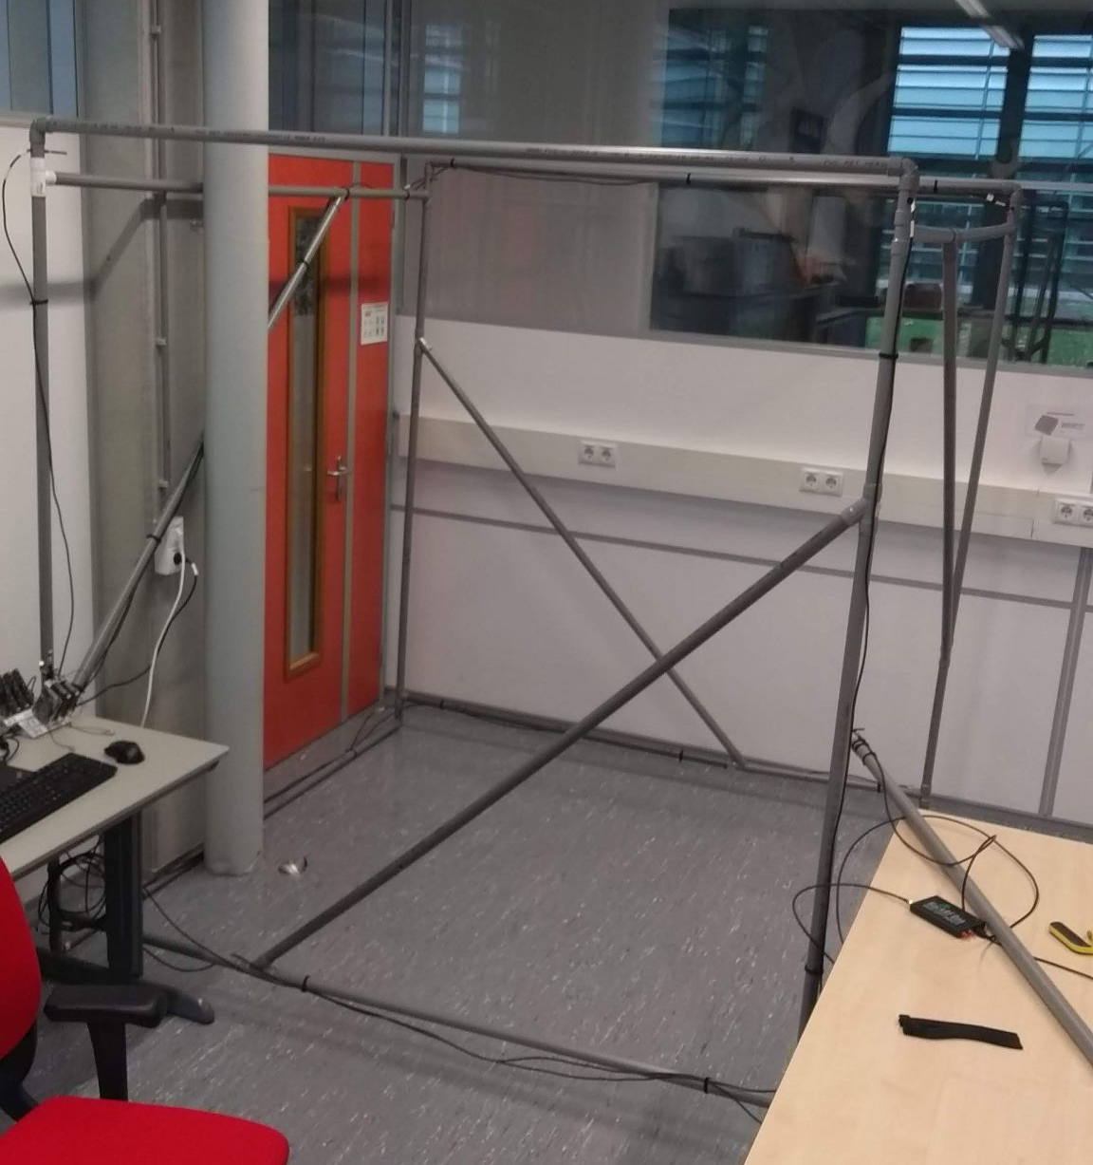
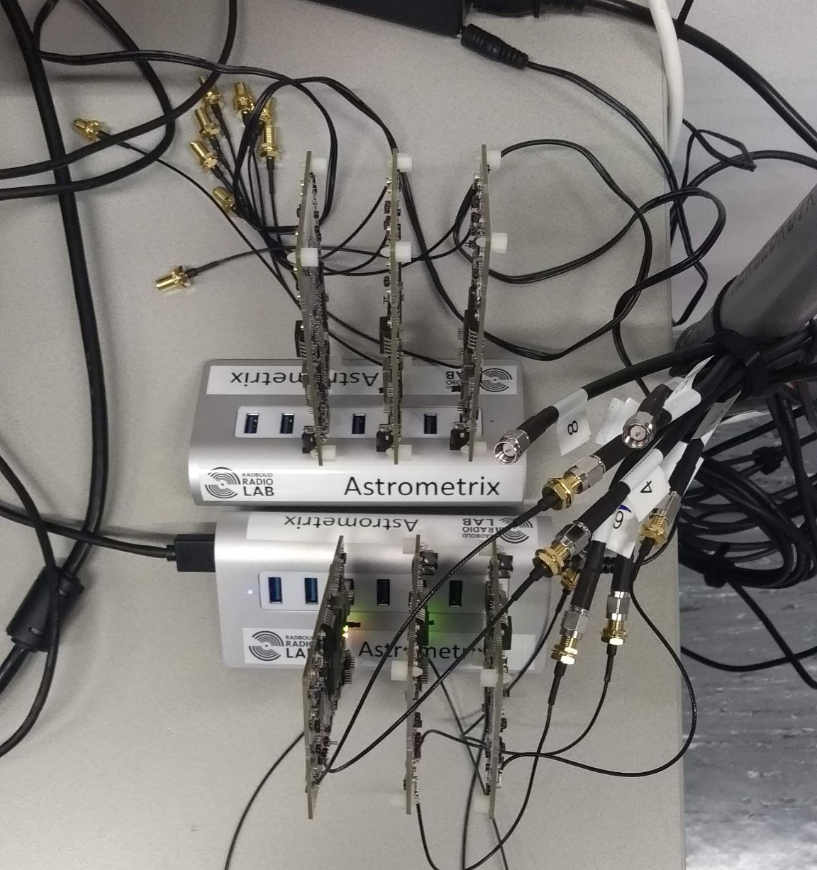
Astrometrix
Student project, in which the principles from radio interferometry (as used in astronomical observations) are turned on their head to develop a hyper-accurate location tracking system for indoor positioning.

Slide 22
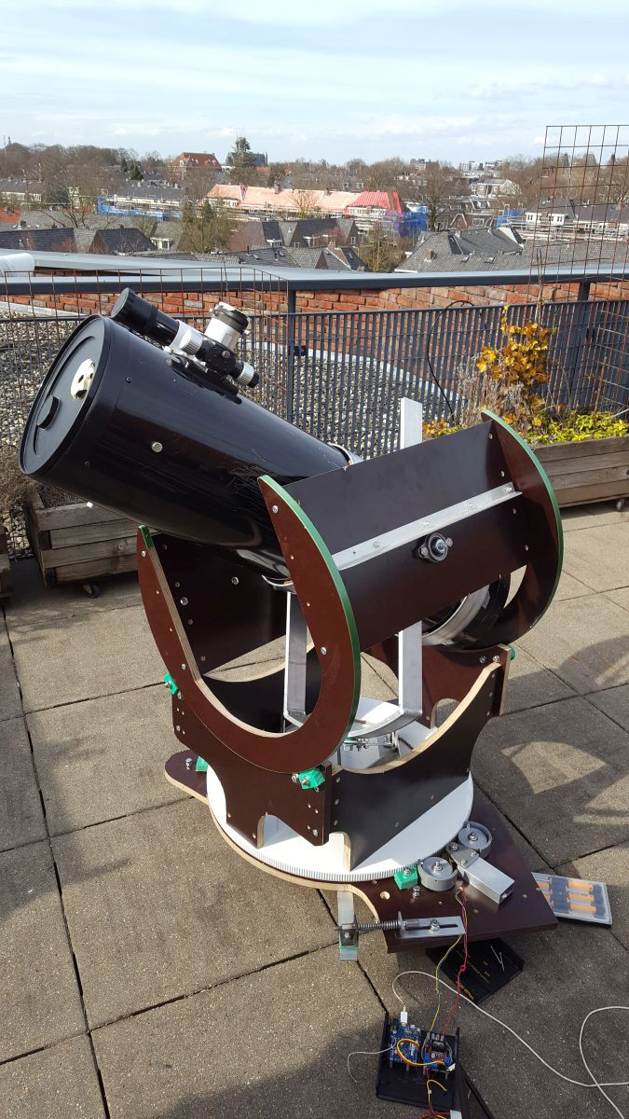
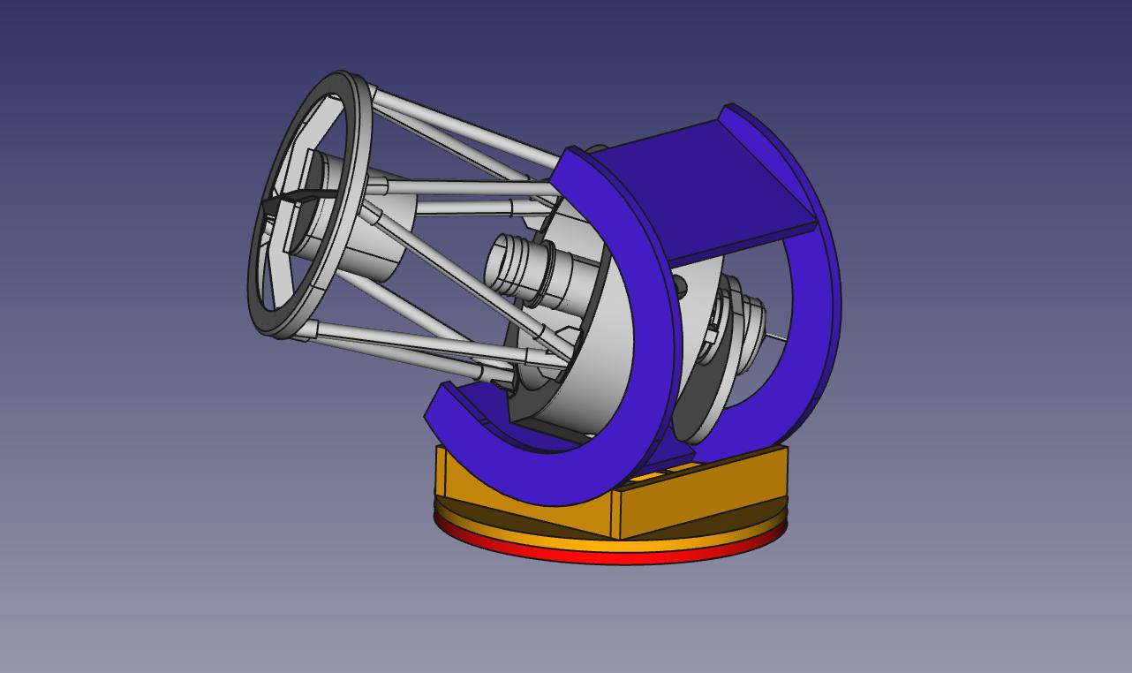

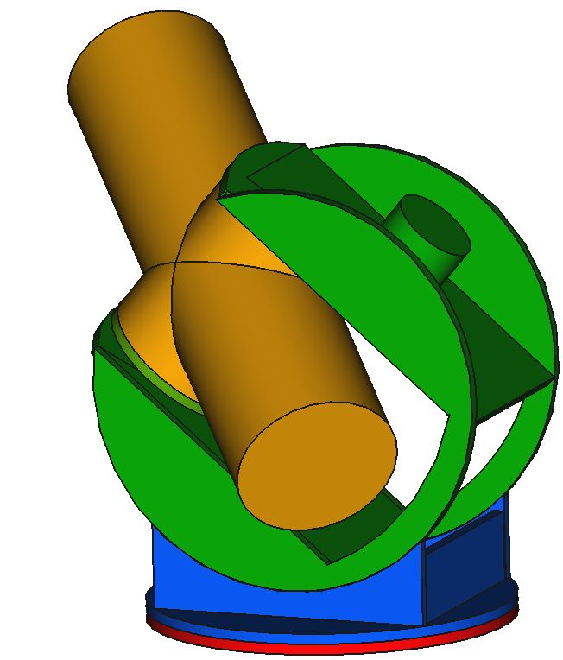
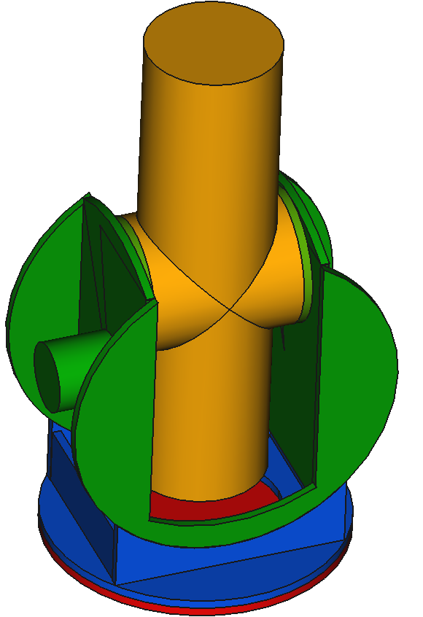
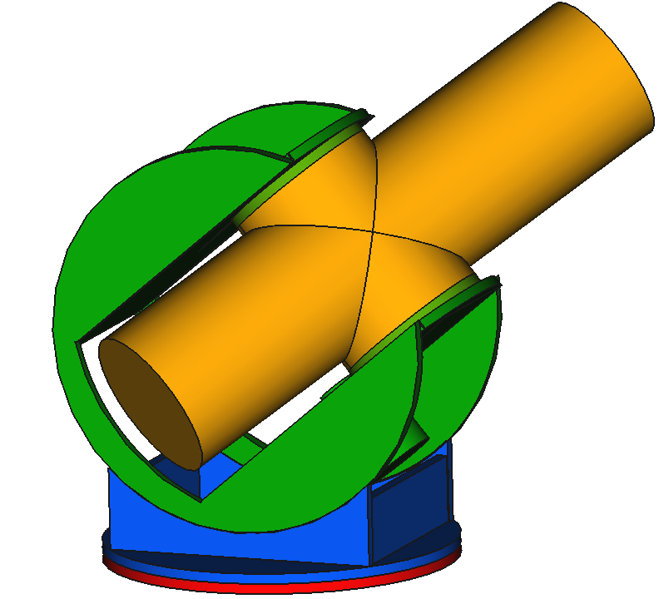
Universal Telescope Mount
The UTM is an open source project with the aim to develop the most flexible telescope mount to point and track any celestial body. It solves all design shortcomings of the currently used telescope mounts.
An affordable version developed for Newtonian telescopes will expand the possibilities for citizens to contribute to true scientific observations.
Key feature of this mount is control of three axes to track and point instead of two.

