Slide 1
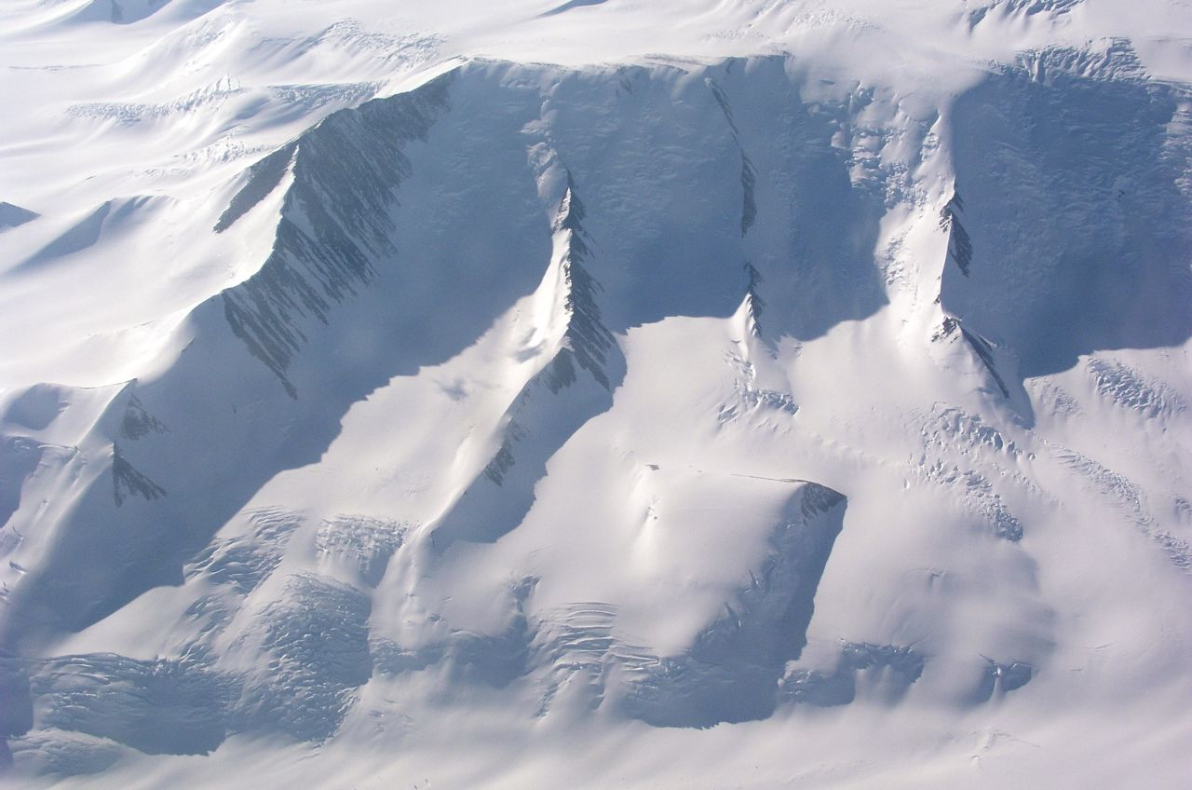
Searching for Quantum Gravity with High-energy Neutrinos
John Kelley
Radboud University Nijmegen
ESQG Workshop
Nordita, Stockholm, Sweden
July 12, 2010

Slide 2
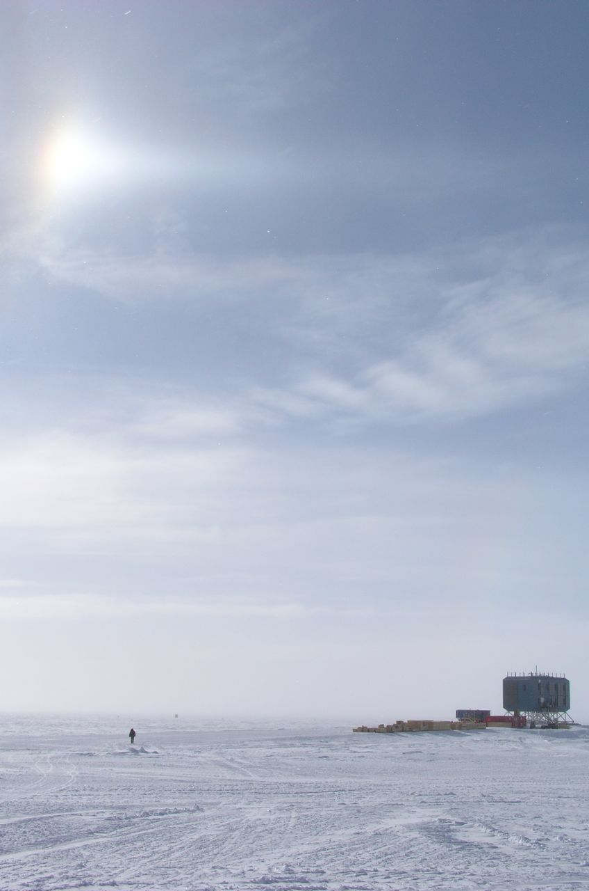
Outline
Motivation and available neutrino sources
Atmospheric neutrinos
AMANDA / IceCube constraints
Cosmogenic / GZK neutrinos
Experimental status and plans

Slide 3
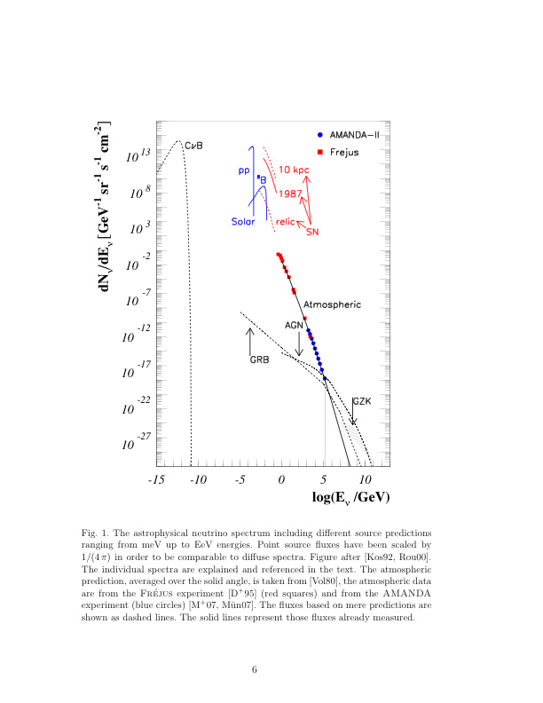
Neutrino Sources
Becker, Phys. Rep. 458, 173 (2008)
Neutrinos as new physics probes?
  high energy
  long baselines
  high Lorentz boost (> 10¹¹)
Interesting quantum gravity phenomenology depends upon neutrino source
All high-energy fluxes connected with cosmic rays
Challenges:
  low cross section and/or low fluxes
  absolute fluxes often uncertain

Slide 4
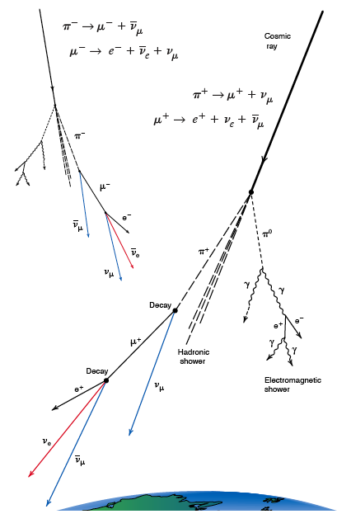

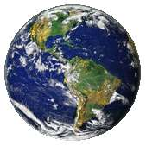
Atmospheric Neutrinos
Produced in cosmic ray interactions, charged pion/kaon decay
Below ~50 GeV: mass-induced oscillations!
(SuperK 1998)
Figure from Los Alamos Science 25 (1997)

Slide 5
Violation of Lorentz Invariance (VLI)
Lorentz symmetry violation possible in various QG formulations
Appealing as a (relatively) low-energy probe of quantum gravity
  oscillations are a sensitive quantum-mechanical interferometer
Effective field-theoretic approach by Glashow & Coleman, Colladay & Kostelecký*, et al.
  Standard Model Extension (SME): all renormalizable VLI terms to SM
  Recently: higher dimension non-renormalizable terms (permitted in SUSY)
  Large parameter space and rich phenomenology
*see e.g. hep-ph/9809521

Slide 6

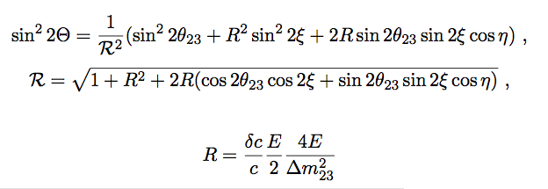

Neutrino VLI (one example)
Turn on one rotationally-invariant term in SME (c_{AB}⁰⁰ ≠ 0 )
Equivalent to modified dispersion relation:
Different maximum attainable velocities c_{a} (MAVs) for different particles: ΔE ~ (δc/c)E
For neutrinos: MAV eigenstates not necessarily flavor or mass eigenstates ⇒ mixing ⇒ VLI oscillations
González-García, Halzen, and Maltoni, hep-ph/0502223

Slide 7
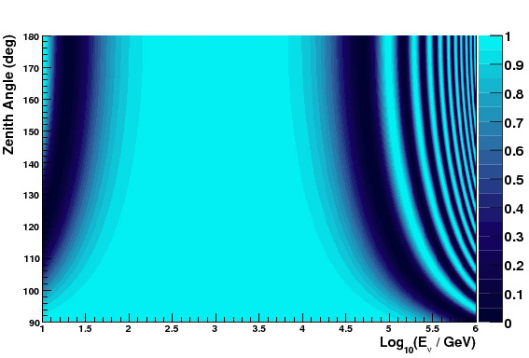
VLI Atmospheric ν_{μ} Survival Probability
maximal mixing, δc/c = 10⁻²⁷

Slide 8
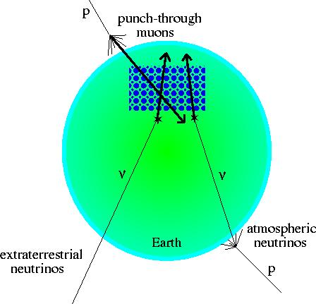
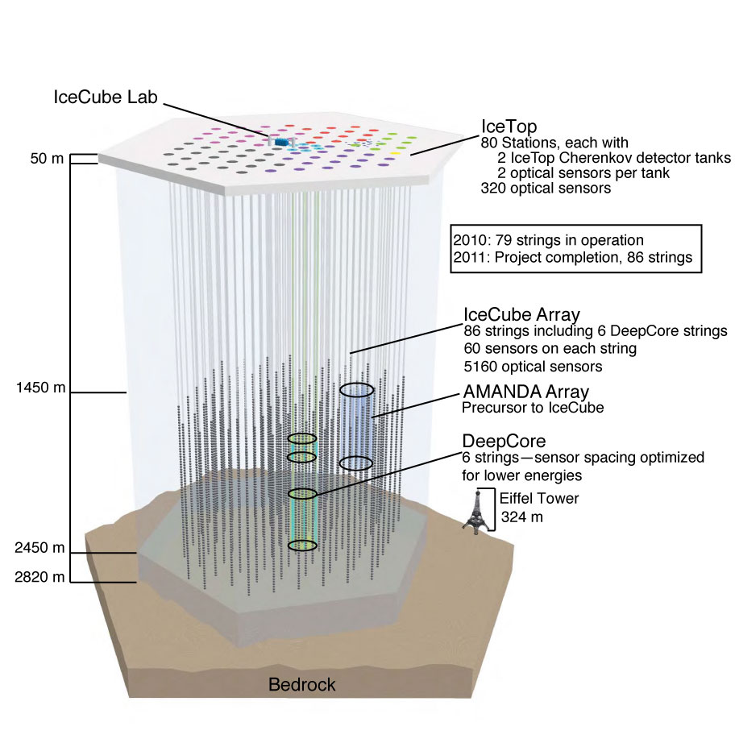
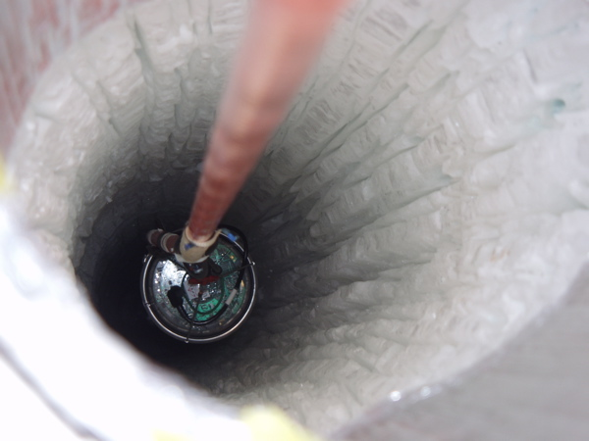
AMANDA and IceCube

Slide 9
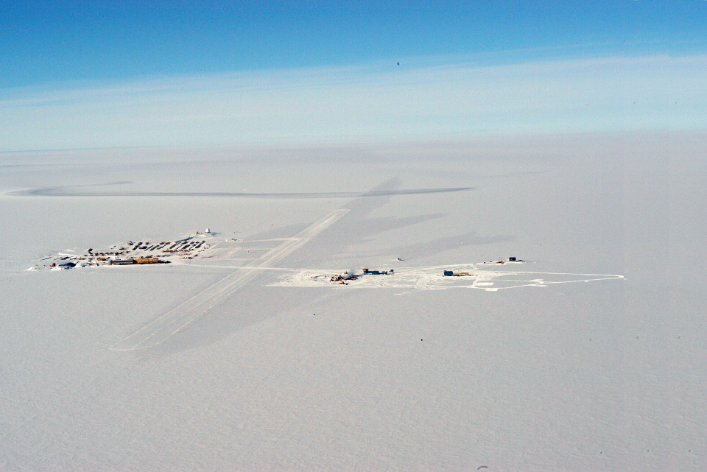
Amundsen-Scott
South Pole Research Station
IceCube
South Pole Station
AMANDA-II
skiway
Geographic
South Pole

Slide 10
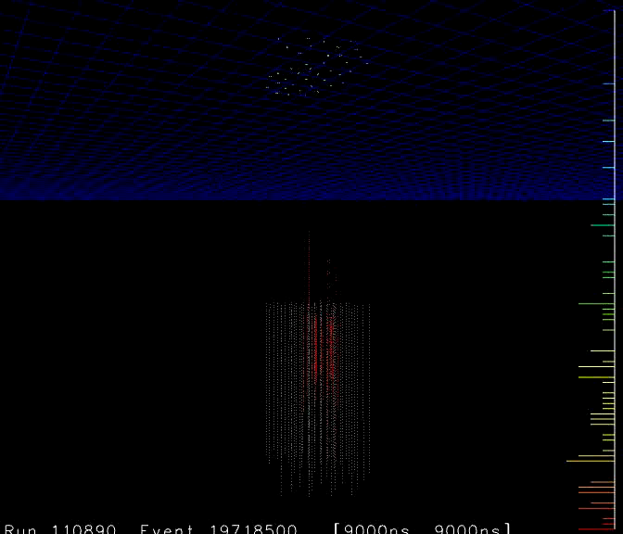
E_{primary} ~ 1 EeV

Slide 11
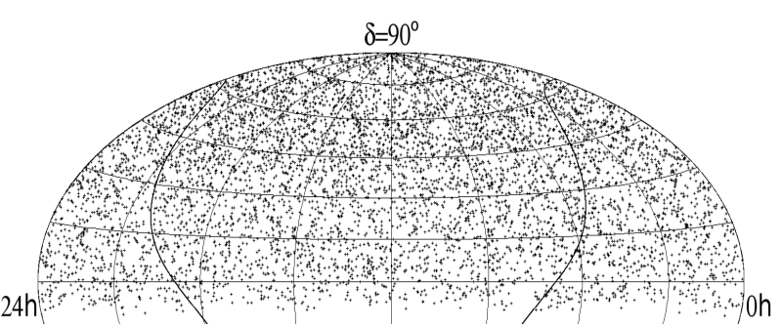
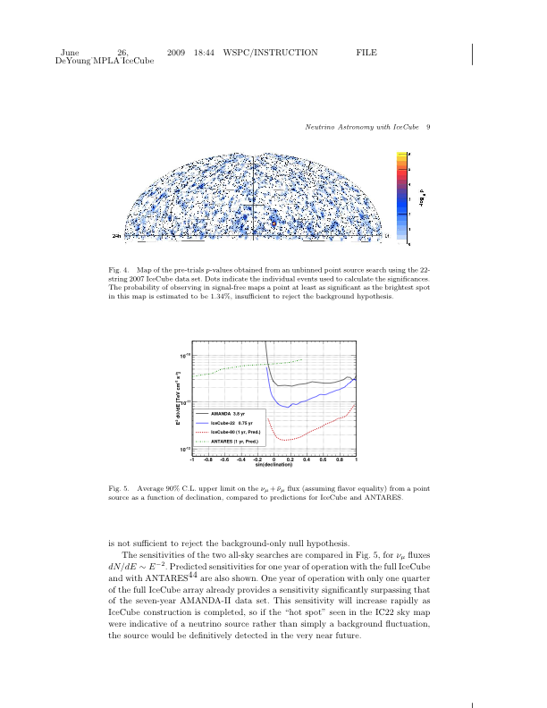
Current Experimental Status
PRD 79 062001 (2009)
Large sample of atmospheric muon neutrinos
  AMANDA-II: 6500 events in 7 years,
  energy range: 0.1-10 TeV
  One year of IceCube 22-string data: ~5700 neutrino candidates
  One year of IceCube 40-string data: ~14000 neutrino candidates
2000-2006 AMANDA neutrino skymap
arXiv:0905.2253
22-string IceCube neutrino skymap (2007)

Slide 12
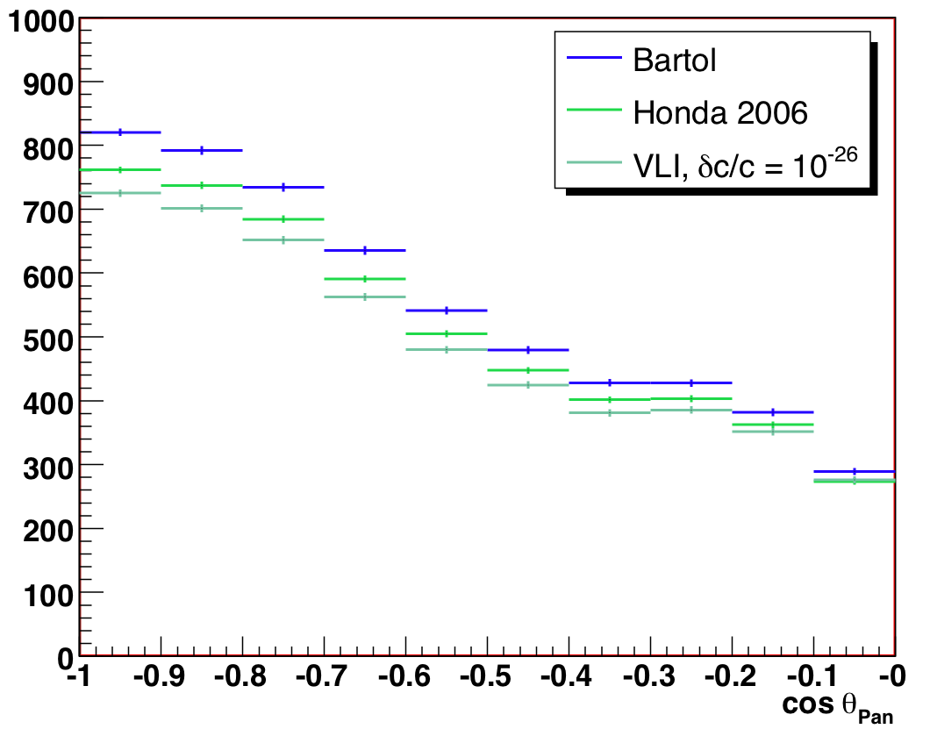
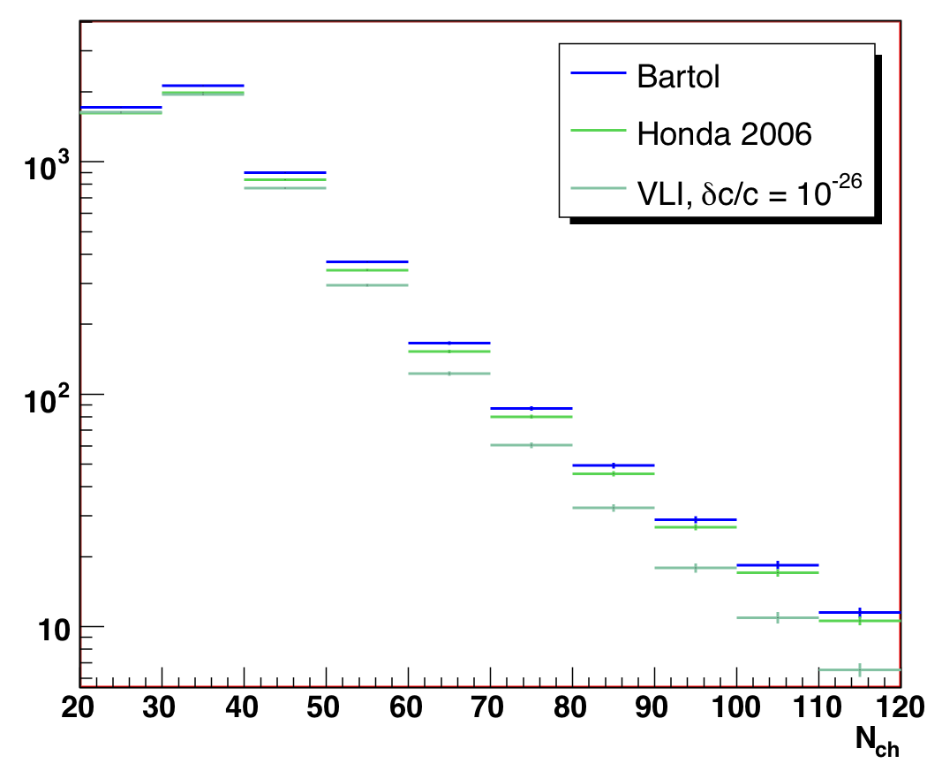
Simulated Observables
(AMANDA 2000-2006)
VLI signature: deficit of muon neutrinos at high energy, near vertical
reconstructed zenith angle
N_{channel} (energy proxy)

Slide 13
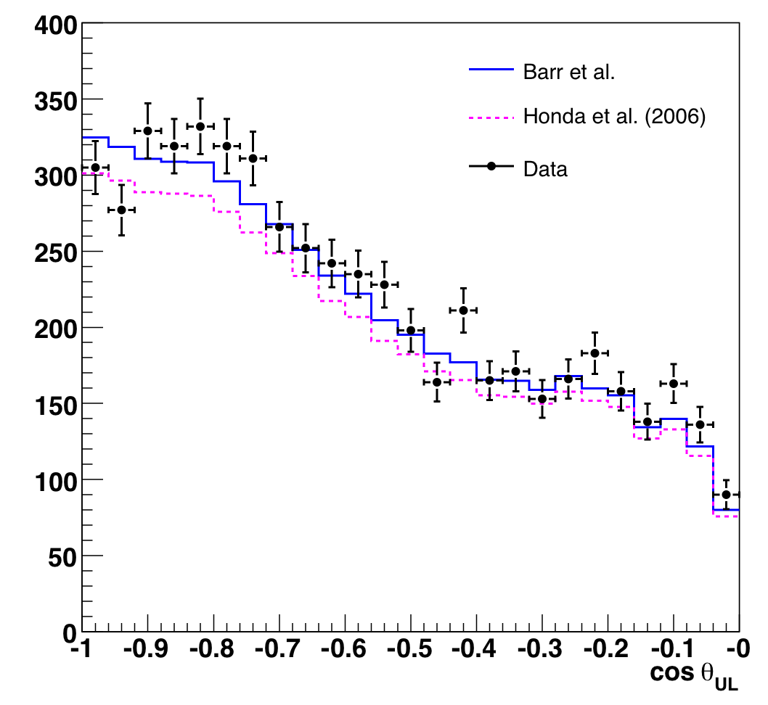
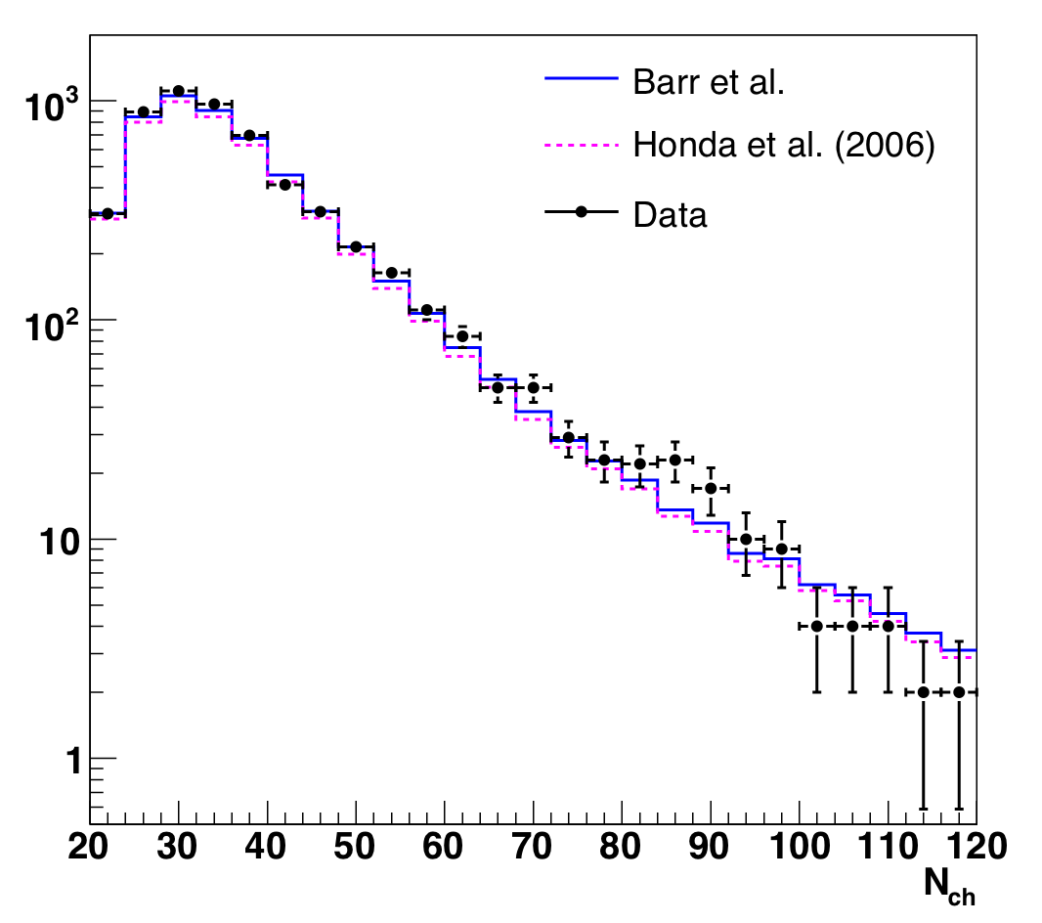
Results: Observables
(AMANDA 2000-2006)
zenith angle
number of OMs hit
Data consistent with SM atmospheric neutrinos + O(1%) background

Slide 14
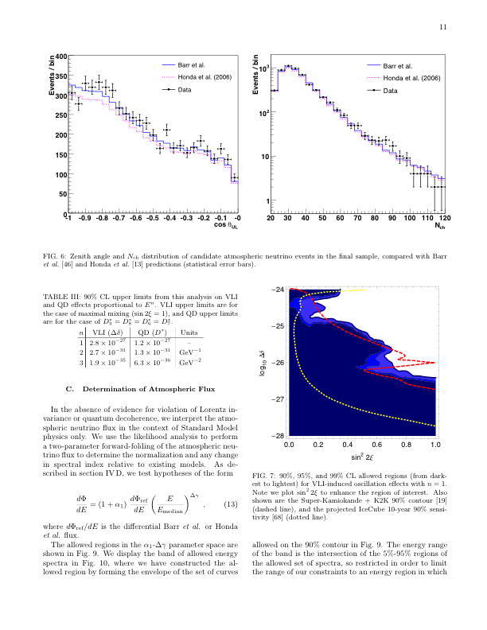
Results: VLI upper limit
Abbasi et al., PRD 79, 102005 (2009)
maximal mixing
SuperK+K2K limit* (red dotted):
δc/c < 1.9 × 10⁻²⁷ (90%CL)
AMANDA 2000-2006 data:
δc/c < 2.8 × 10⁻²⁷ (90%CL)
IceCube 40-string analysis underway
  10-year 80-string sensitivity ~ 10⁻²⁸
  (yellow dotted)
Cosmic ray limits (on p,π)§: ~10⁻²³
excluded
90%, 95%, 99% allowed CL
*González-García & Maltoni, PRD 70 033010 (2004)
§Scully & Stecker, Astropart. Phys. 31 (2009) 220

Slide 15
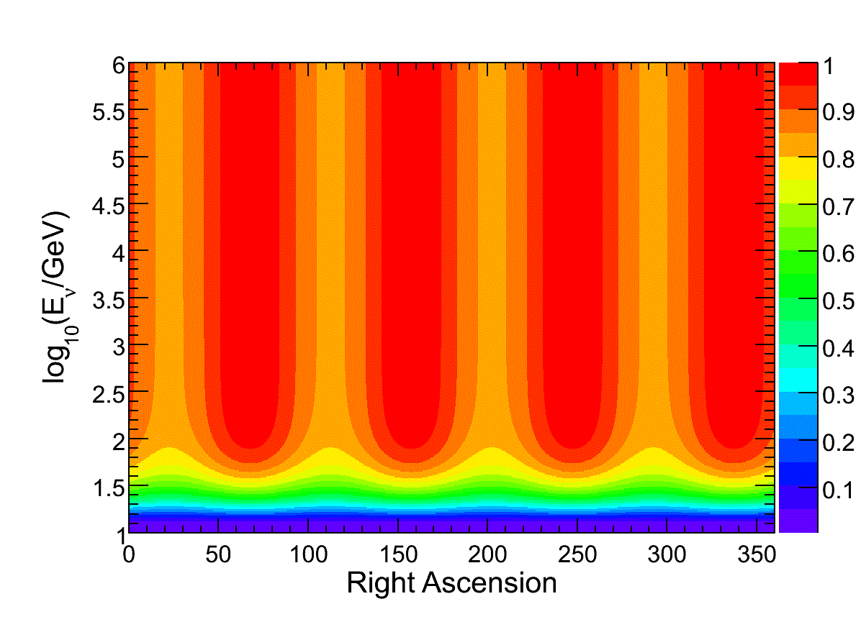
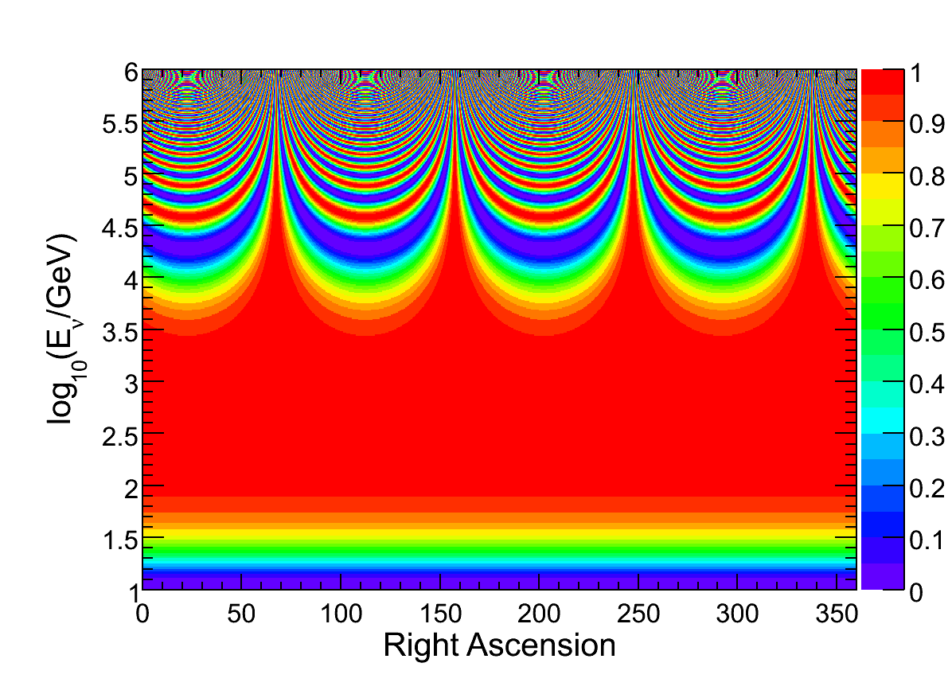
Direction-dependent Oscillations
Survival probability
Standard Model Extension includes interaction
coefficients that violate rotational invariance
“Vector Model”
Kostelecky and Mewes, PRD 70, 076002

Slide 16
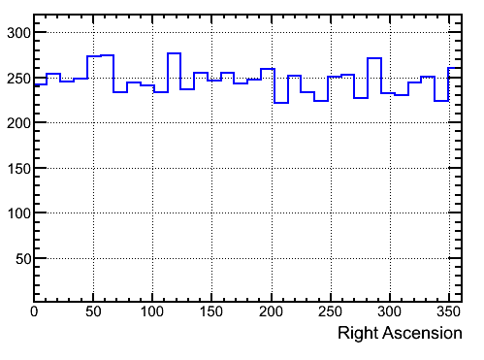
Direction-dependent VLI: IceCube results
Right ascension distribution consistent with atmospheric neutrino expectation
Set upper limits based on power in DFT modes
Results 3-4 orders of magnitude improved over MINOS
IC40 atmospheric neutrino RA
PRELIMINARY
32 bins in RA
(using zenith 97 to 120)
W. Huelsnitz, Ph.D. thesis
manuscript in preparation

Slide 17
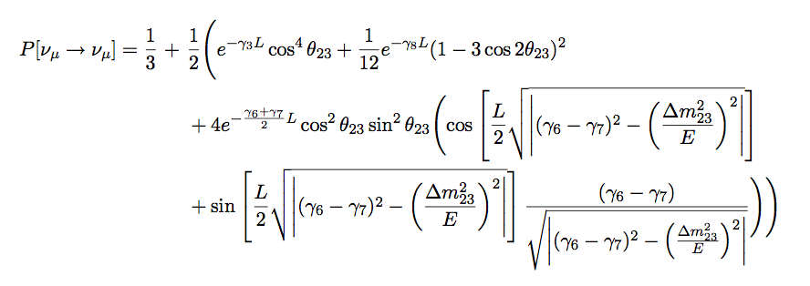

Decoherence + Atmospheric Oscillations
characteristic exponential behavior
1:1:1 ratio after decoherence
derived from Barenboim, Mavromatos et al. (hep-ph/0603028)
Energy dependence depends on phenomenology:
n = -1
preserves
Lorentz invariance
n = 0
simplest
n = 2
recoiling
D-branes*
n = 3
Planck-suppressed
operators‡
*Ellis et al., hep-th/9704169
‡ Anchordoqui et al., hep-ph/0506168

Slide 18
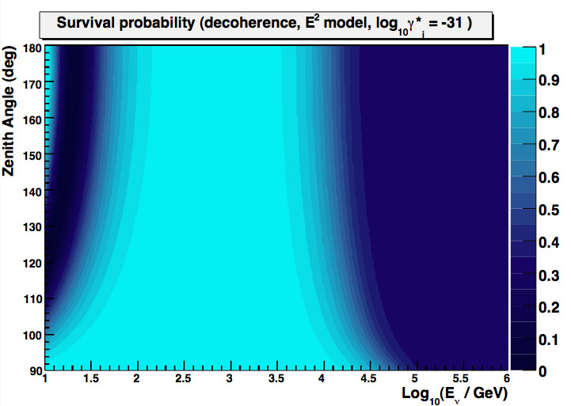
QD Atmospheric ν_{μ} Survival Probability
p=1/3

Slide 19
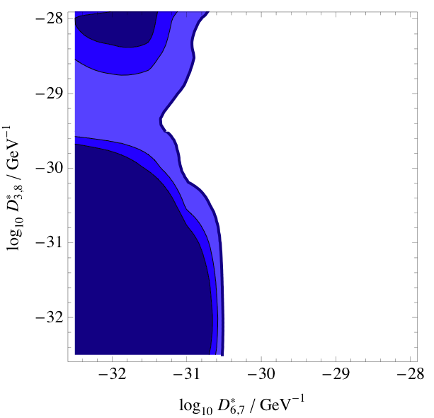
Results: AMANDA 2000-2006
QD upper limit
Abbasi et al., PRD 79, 102005 (2009)
E² model (E, E³ limits also set)
SuperK limit‡ (2-flavor):
γ_{i} < 0.9 × 10⁻²⁷ GeV⁻¹ (90% CL)
ANTARES sensitivity* (2-flavor):
γ_{i} ~ 10⁻³⁰ GeV⁻¹ (3 years, 90% CL)
This analysis:
γ_{i} < 1.3 × 10⁻³¹ GeV⁻¹ (90% CL)
excluded
log₁₀ γ*_{3,8} / GeV⁻¹
best fit
log₁₀ γ*_{6,7} / GeV⁻¹
* Morgan et al., astro-ph/0412618
‡ Lisi, Marrone, and Montanino, PRL 85 6 (2000)

Slide 20

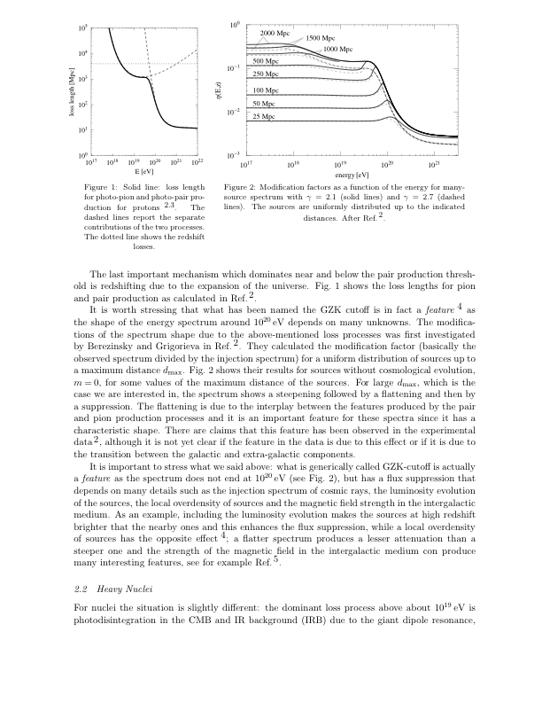
GZK Effect
proton loss length
Suppression (“cutoff”) of high-energy cosmic rays due to interaction with CMB photons (Greisen-Zatsepin-Kuzmin)
Threshold ~ 6 × 10¹⁹ eV
Pion decay results in neutrinos
Experimental status unclear 4-5 years ago: cutoff or not?
e⁺e⁻
photopion
Berezinsky et al. 2007

Slide 21
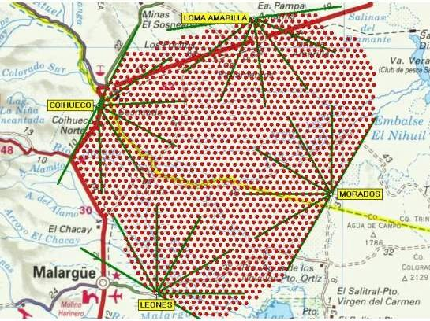
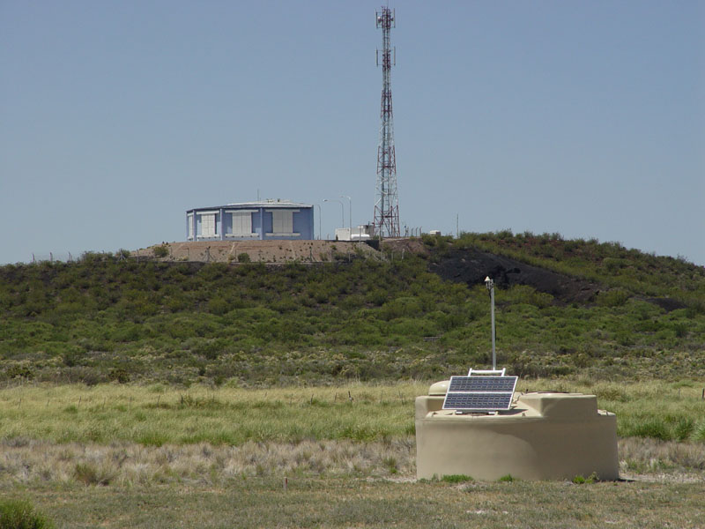
Pierre Auger Observatory
Hybrid air shower detector
Southern site (3000 km²) in Argentina completed 2008
Northern site (21000 km²) planned for Colorado, U.S.A.
Auger South

Slide 22
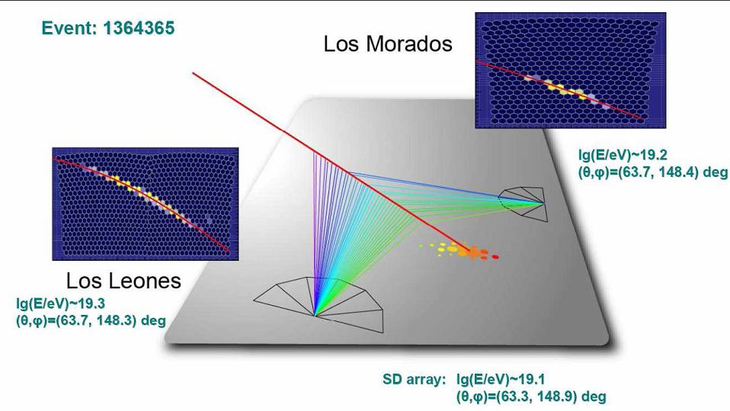
Hybrid Detection
fluorescence
track
fluorescence
track
Cherenkov tank
signals
Hybrid observation: energy cross-calibration, better angular resolution

Slide 23
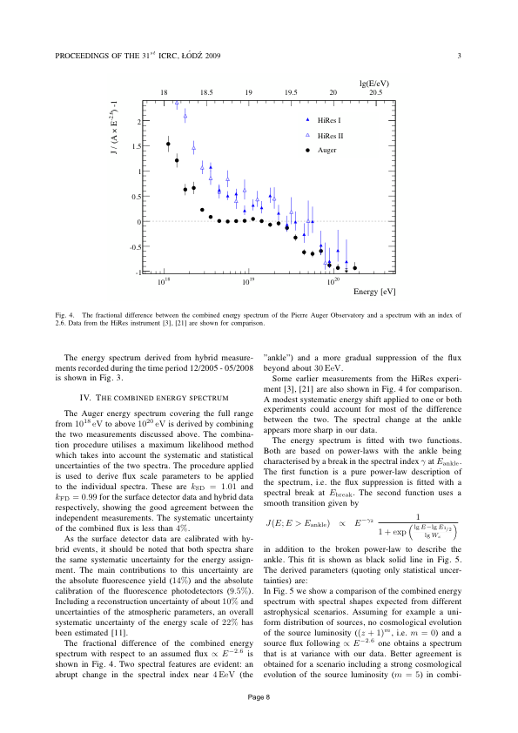
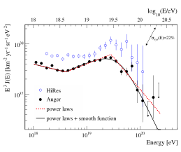
Latest UHECR Energy Spectrum
2008: Continuation of spectrum rejected at 6σ. 2009: combined FD + SD spectrum
Suppression energy consistent with GZK onset
BUT: could be source cutoff (see e.g. Aloisio et al., arXiv:0907519)
VLI constraints possible using spectrum
Abraham et al. Phys. Lett. B 685 (2010)

Slide 24
Composition
Slant depth X_{max} (integrated density) of shower maximum in atmosphere
  energy and composition-dependent
  higher in atmosphere for heavier nuclei
  (interact, lose energy sooner)
Shower-to-shower fluctuations of X_{max}
  iron showers (~superposition of 56 single-nucleon showers of 1/56 energy) have fewer fluctuations
X_{max}

Slide 25
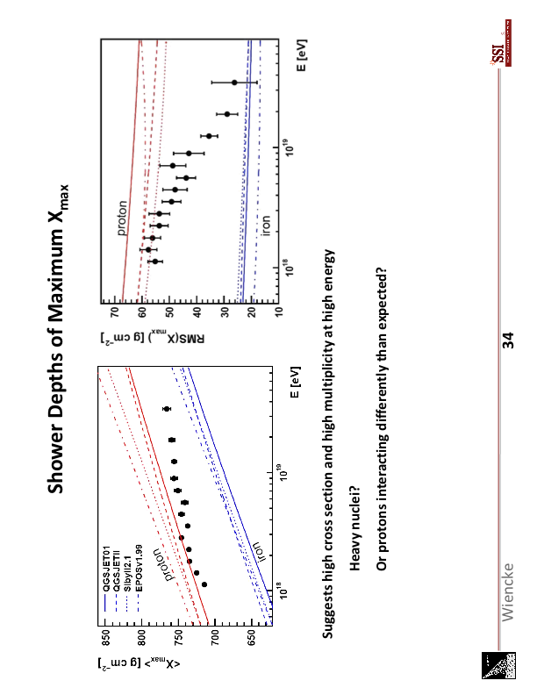
Latest Auger Results: Composition
Abraham et al., PRL 104 (2010) 091101
Both indicate composition getting heavier…
or protons behaving very differently than expected?
But data run out just at GZK-like feature…
comp. data

Slide 26

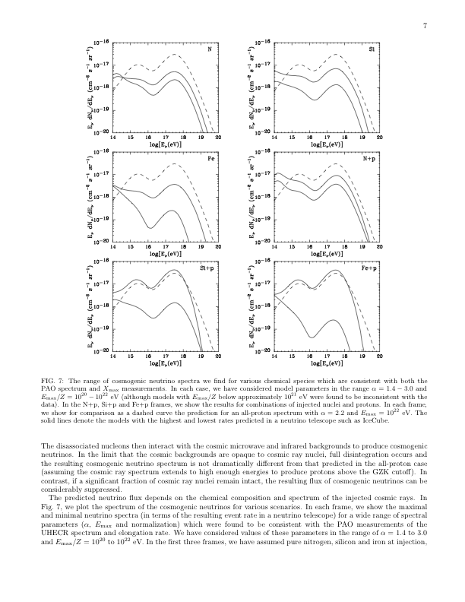
The Neutrino Connection
GZK process also produces UHE neutrinos!
Nuclei will tend to photodisintegrate first (reduced flux)
New source for QG tests
  cosmological baselines probed
  energies ~ 10¹⁸-10¹⁹ eV
GZK neutrino flux models
best-fit proton
range of iron
Anchordoqui et al., PRD 76 123008 (2007)

Slide 27

Possible Tests of QG with GZK neutrinos
VLI-induced neutrino splitting
  modification of spectral shape
  see e.g. Mattingly, Liberati et al., arXiv: 0911.0521
Neutrino / dark energy coupling leading to VLI / CPTV
  flavor ratio via angular dependence
  see e.g. Ando et al., arXiv:0910.4391
Talk this afternoon by J. Christian…

Slide 28
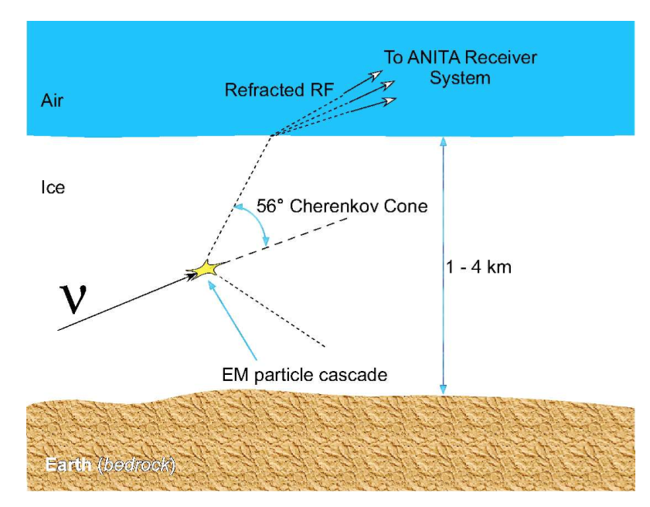
Askaryan Emission
Coherent radio pulse from charge excess (60-1000 MHz) in neutrino-induced showers
Radiation characteristics confirmed in sand, salt, and ice
Cold ice is exceptionally RF-transparent
Radio is scalable to very large arrays
Kowalski et al. 2007

Slide 29
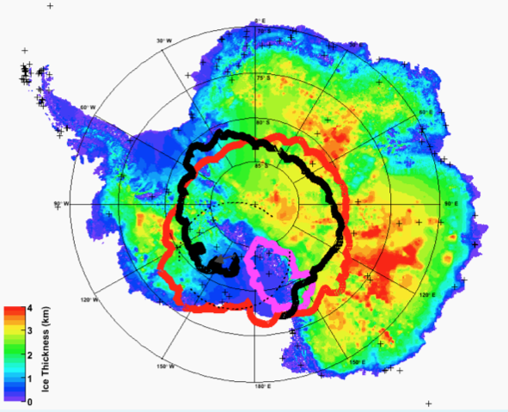
ANITA
ANITA payload
Mt. Erebus
ANITA-II flight (2008-09; 31 days)

Slide 30
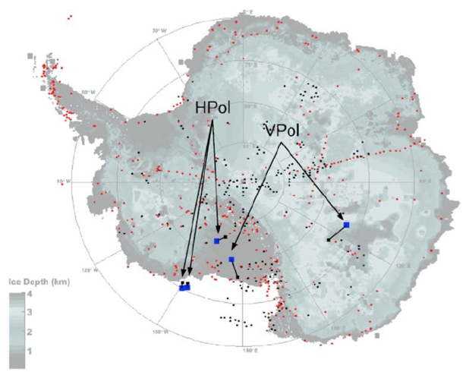
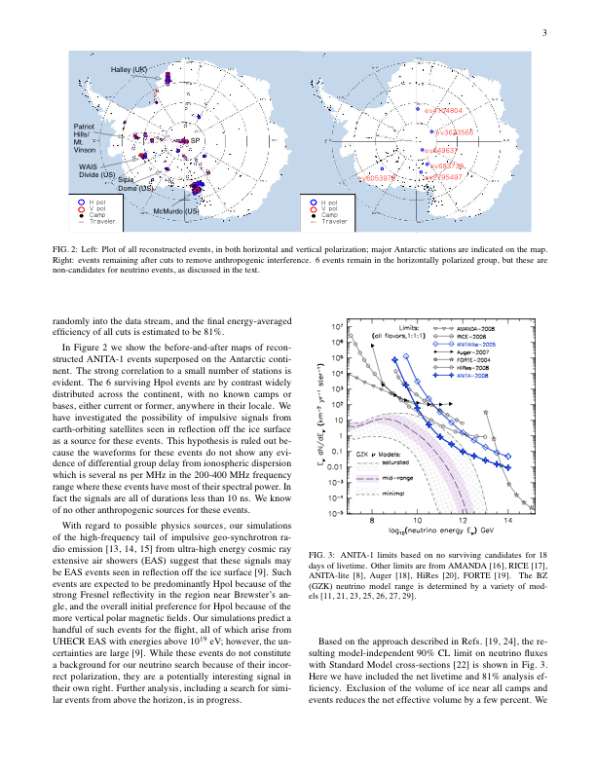
ANITA-II Limits
M. Mottram, ARENA 2010
2 events (0.65 ± 0.39 expected)
3rd flight proposed for 2012
Gorham et al. , PRL 103, 51103 (2009)

Slide 31
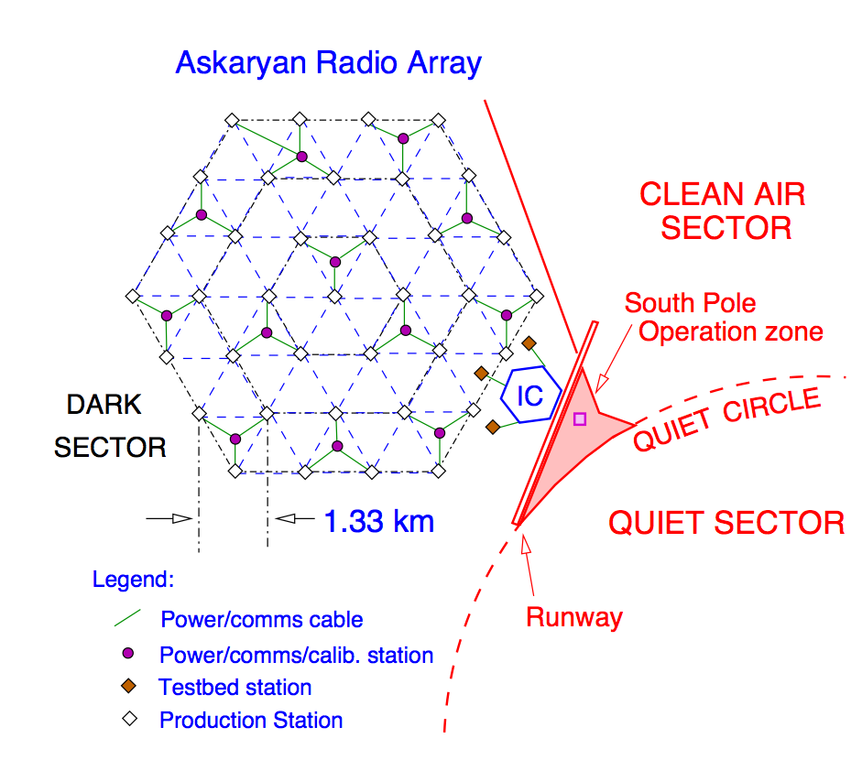
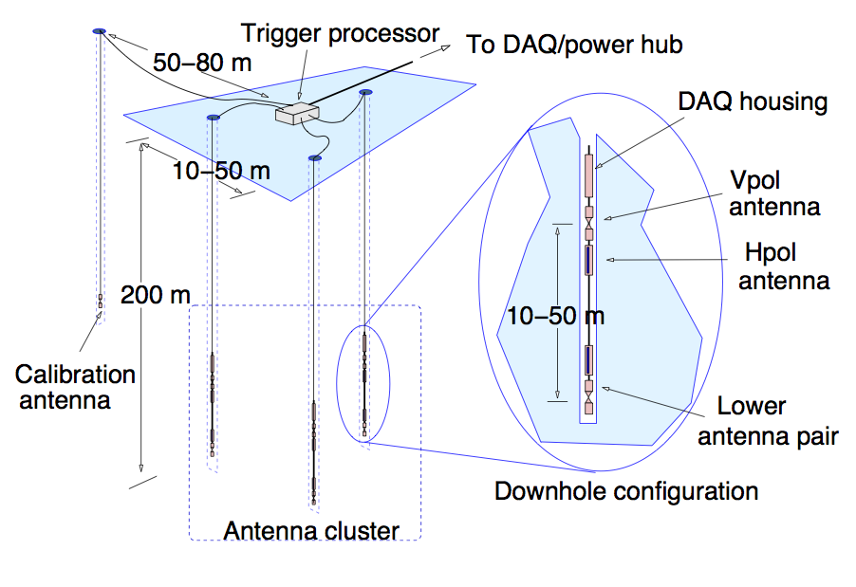
ARA: Askaryan Radio Array
80 km² radio-frequency extension of IceCube
New collaboration + name: previous work as AURA / NARC / IceRay
GZK neutrino rates up to 25 events / year
Iron UHECR: 0.7 ev/yr

Slide 32
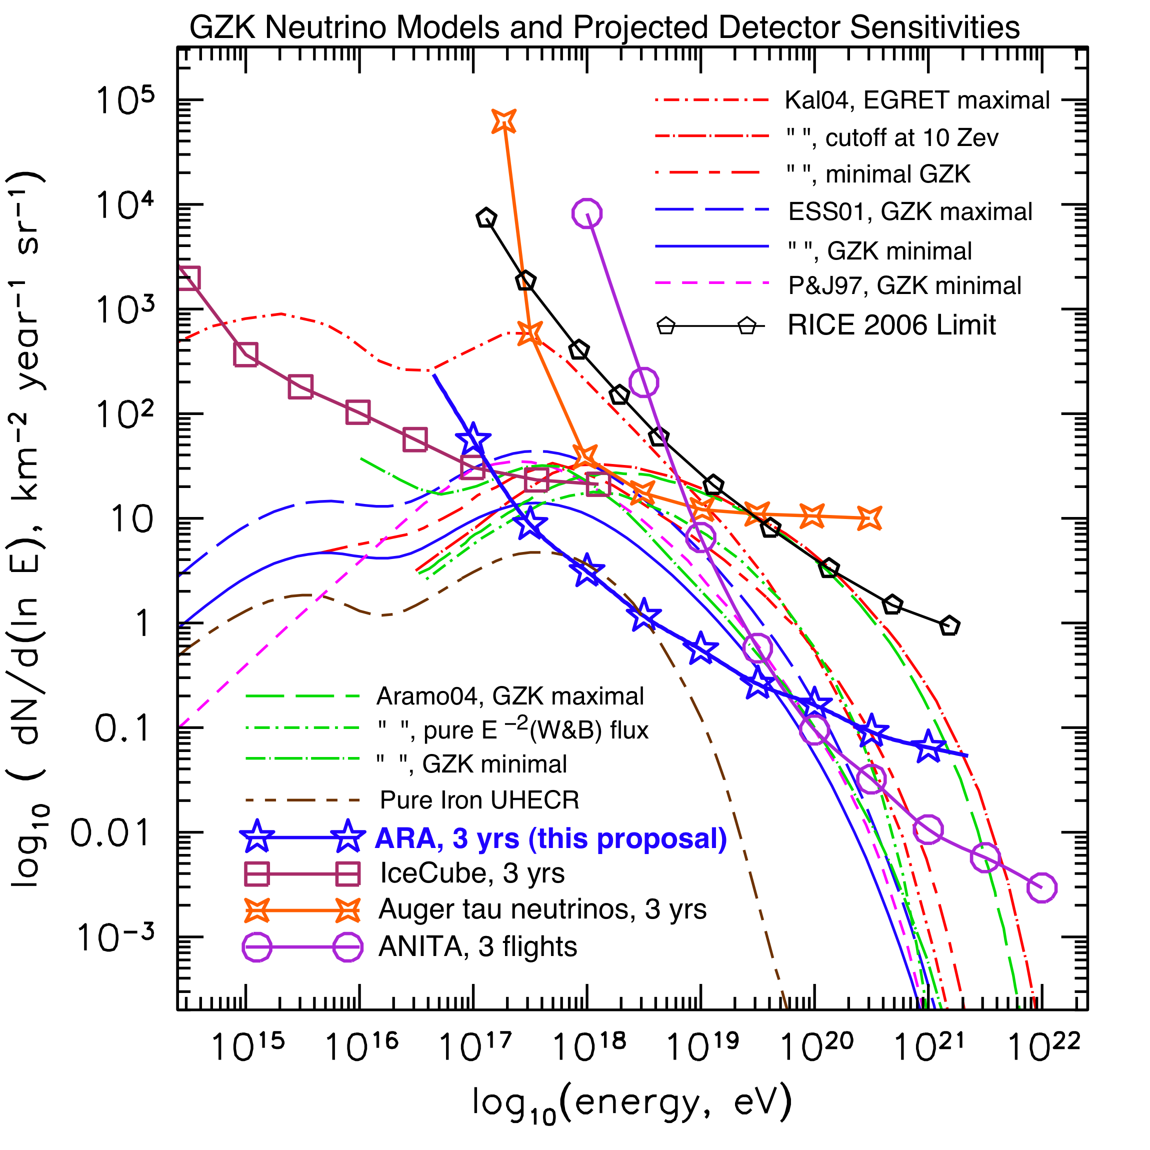
ARA Sensitivity
ARA primary scientific goal: determine absolute flux level
Phase I is funded ($4 million); completion 2015
A larger-scale experiment necessary to:
  measure spectrum
  flavor identification
K. Hoffman, ARENA 2010

Slide 33
Summary (I)
Neutrinos provide sensitive tests of possible QG effects
Atmospheric neutrinos
  Detected now up to 100 TeV
  AMANDA atmospheric neutrino limits:
    VLI: differences in MAV ~10⁻²⁷
    QD: E² decoherence ~ 10⁻³¹ GeV⁻¹
  New IceCube constraints on directional dependence

Slide 34
Summary (II)
For the next step, need a new HE neutrino source
  Point sources: none yet; may be difficult to disentangle source characteristics
GZK neutrinos promising, but…
  Flux depends highly on cosmic ray composition, which is starting to look heavy
  IceCube or ANITA detection: need optimistic flux (proton-induced)
  Next-generation arrays (ARA, ARIANNA) have started development of first stations

Slide 35
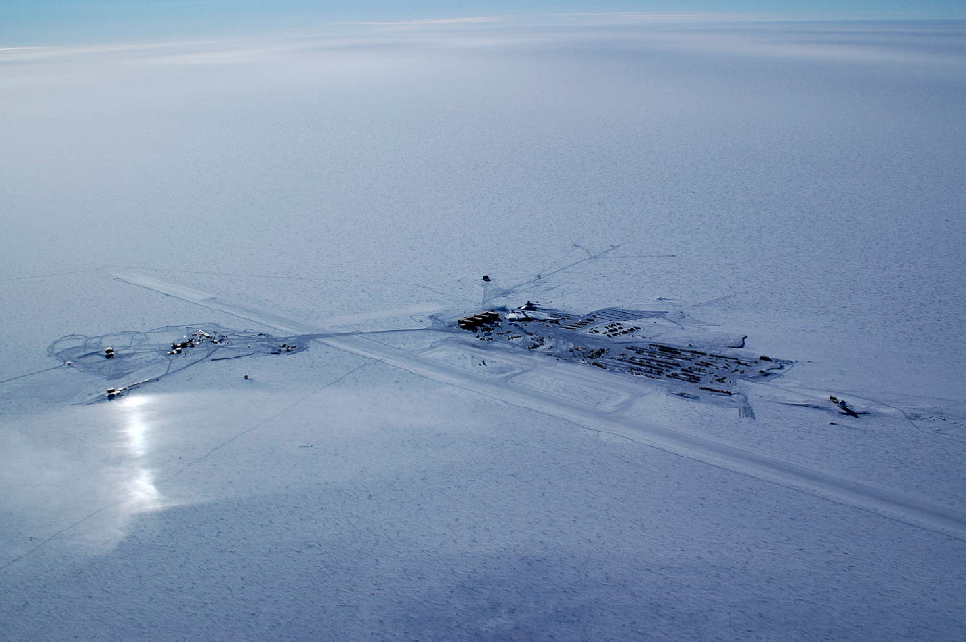
Thank you!

Slide 36
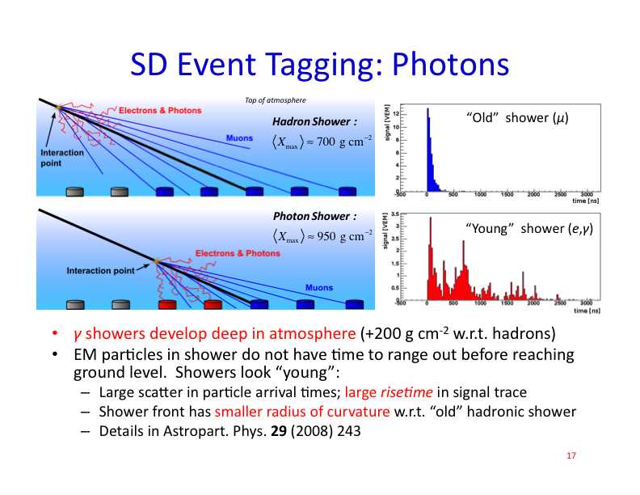
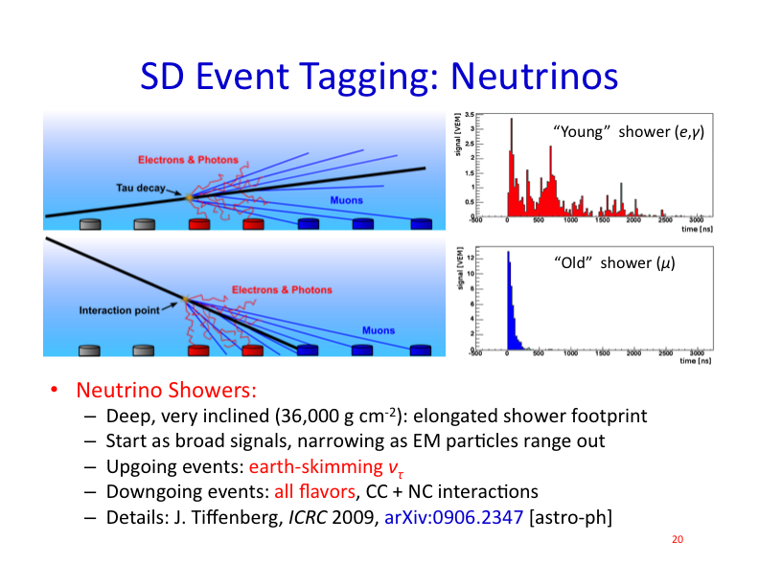
Neutrino Detection via Air Showers
“normal” inclined shower:
only muons left
neutrino-induced shower:
young EM component
(broad signals in tanks)
tau decay from Earth-skimming ν_{τ}:
dense target, but only one flavor

Slide 37
Backup Slides

Slide 38
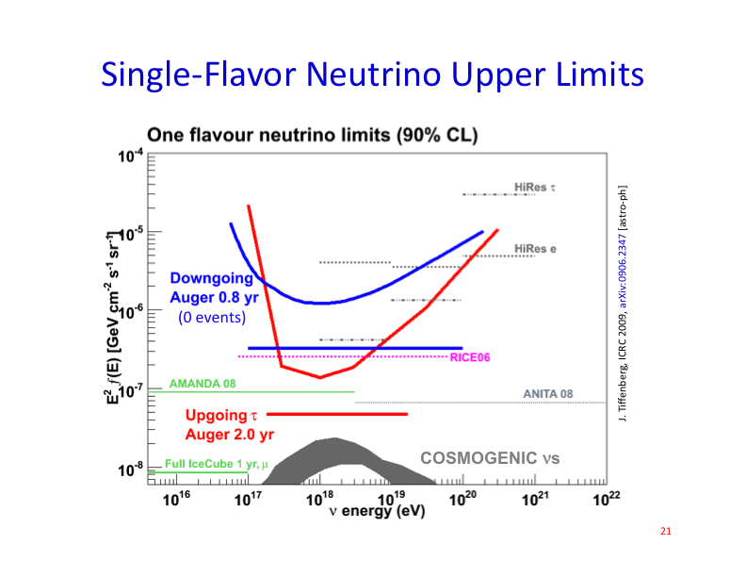
Limits on Diffuse Neutrino Flux

Slide 39
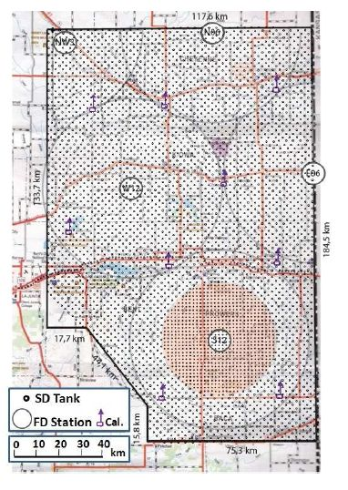
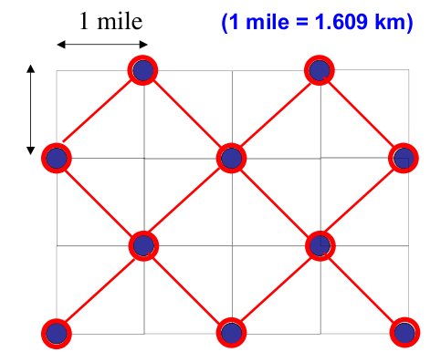
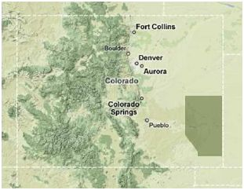
The Future: UHECRs
Auger North: 21000 km²
Precision spectrum
  can test VLI “recovery” scenarios
UHE composition studies

Slide 40
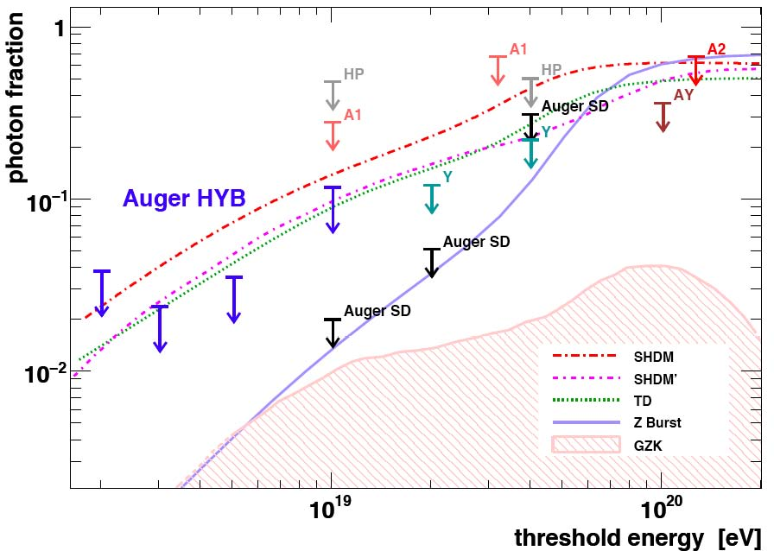
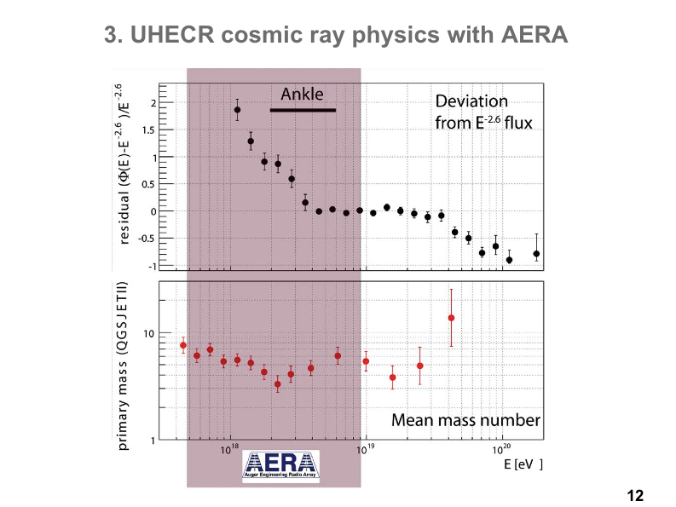
AERA Physics
Radio will open a new window
onto cosmic ray physics!

Slide 41
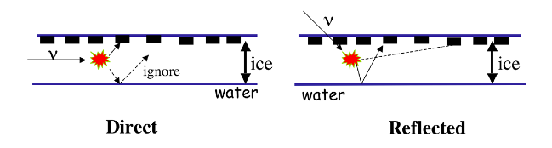

ARIANNA
Askaryan pulses in Ross ice shelf
Antennas at surface: use water/ice reflection to improve angular acceptance
Prototype station tested last season (see Gerhardt et al., arXiv:1005.5193)

